Slide 1
SFA in the World
Dispatches from SFA members in
international world of archives.

Slide 2
Technology: Accessibility & Collaboration
Mike Asencio

Slide 3
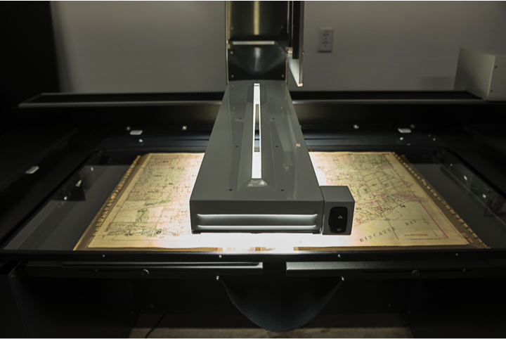
Digitizing Collections

Slide 4
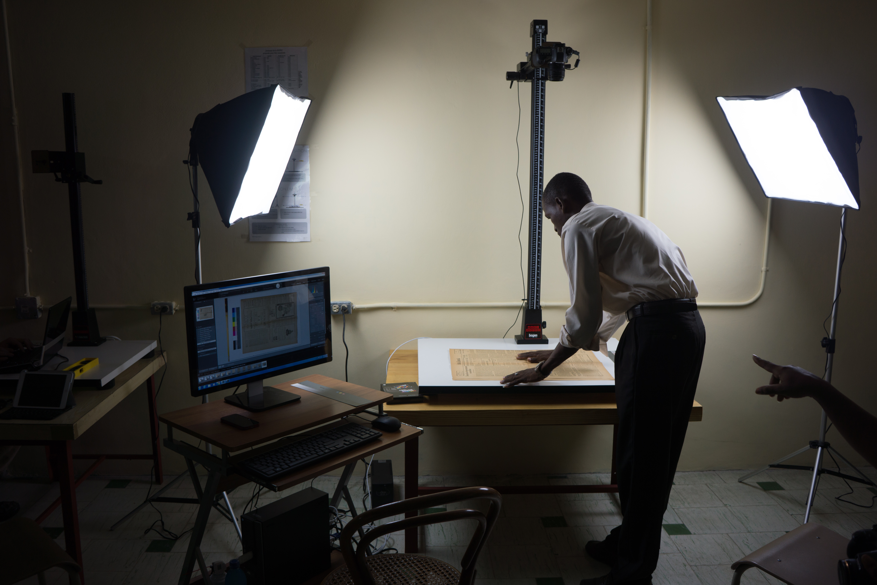
Challenges

Slide 5
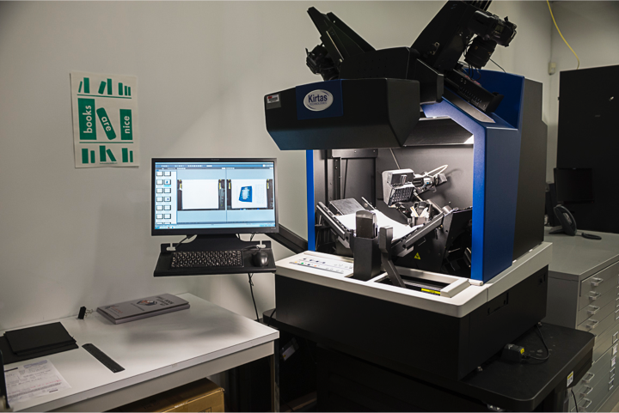
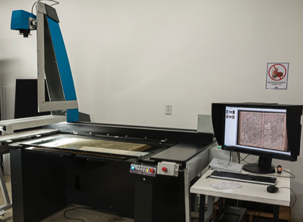

Slide 6
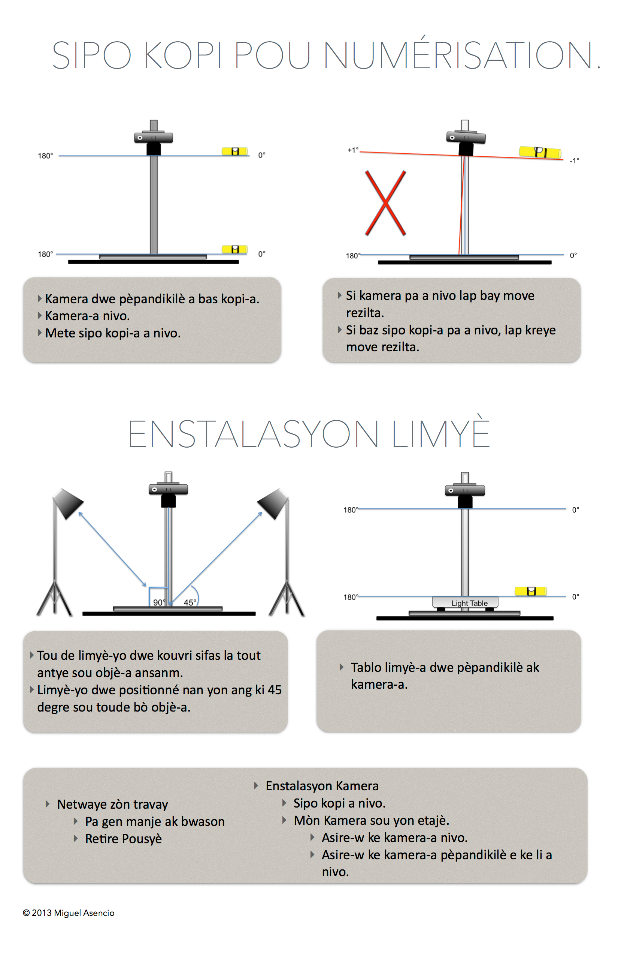
Standards

Slide 7
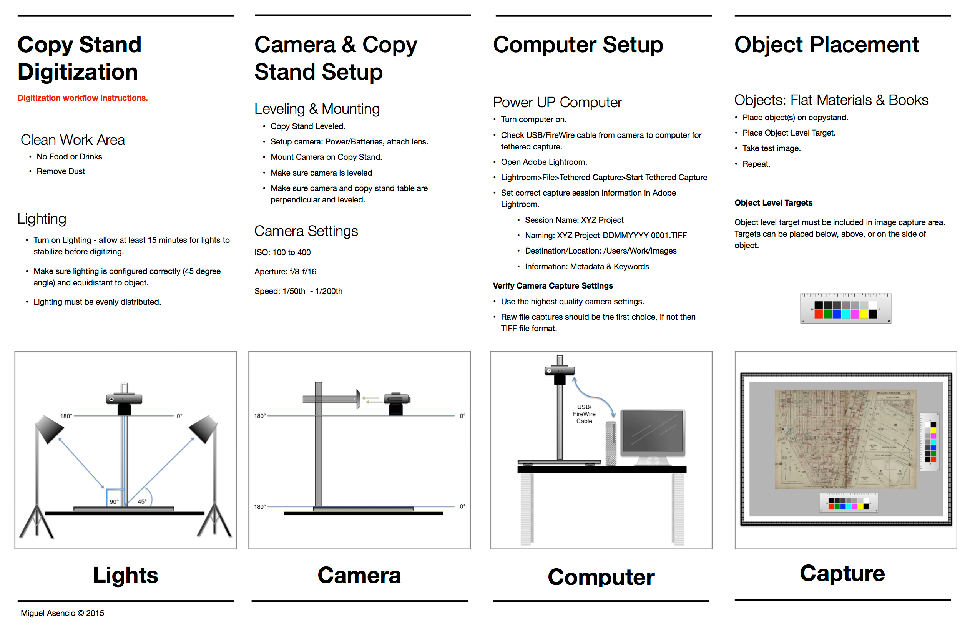
Workflow

Slide 8
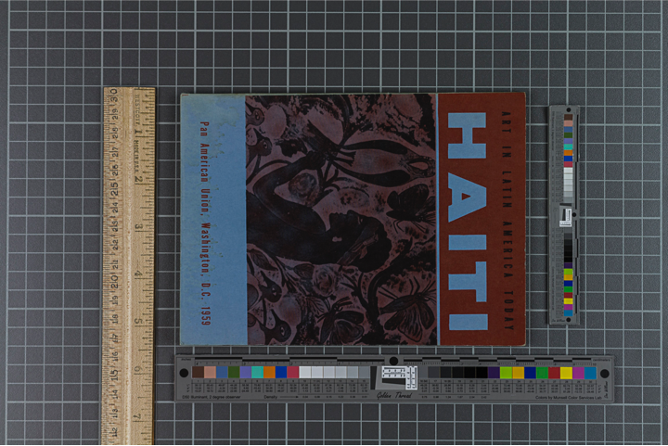
Consistency

Slide 9
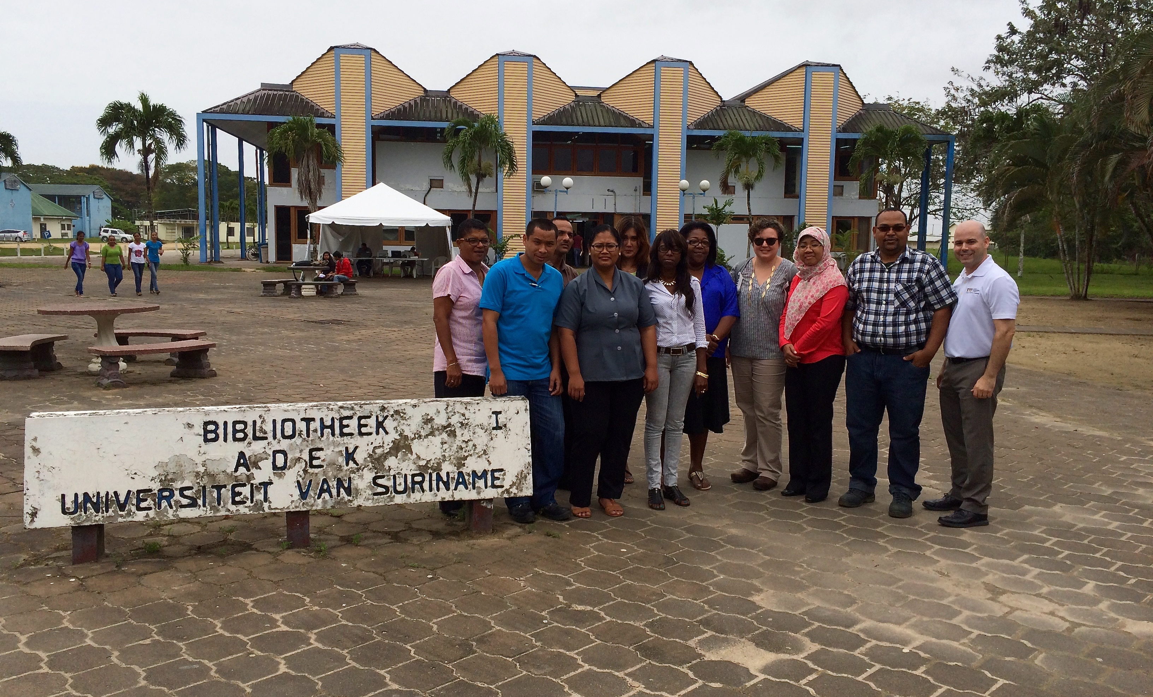
Collaboration

Slide 10
Thank You

