Slide 1
Adventures in Outreach: A Case Study
Katherine Hoarn and Rebecca Bramlett
Florida State University

Slide 2
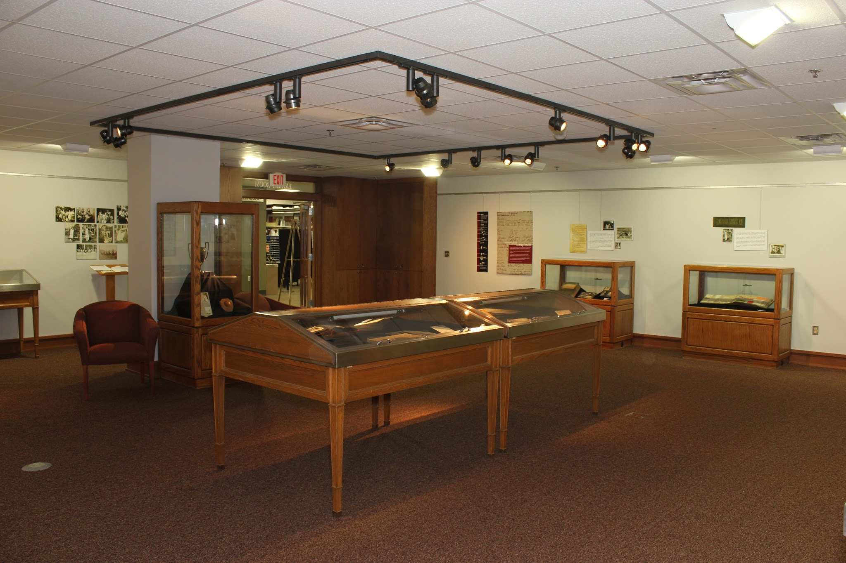
Exhibits as Outreach
That I May Remember: Scrapbooks of the Florida State College for Women 1905-1947
Fall 2014 Exhibit
Strozier Library
Florida State University

Slide 3
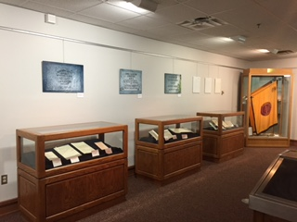
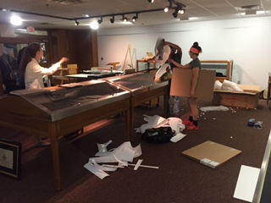
Expectations vs. Reality

Slide 4
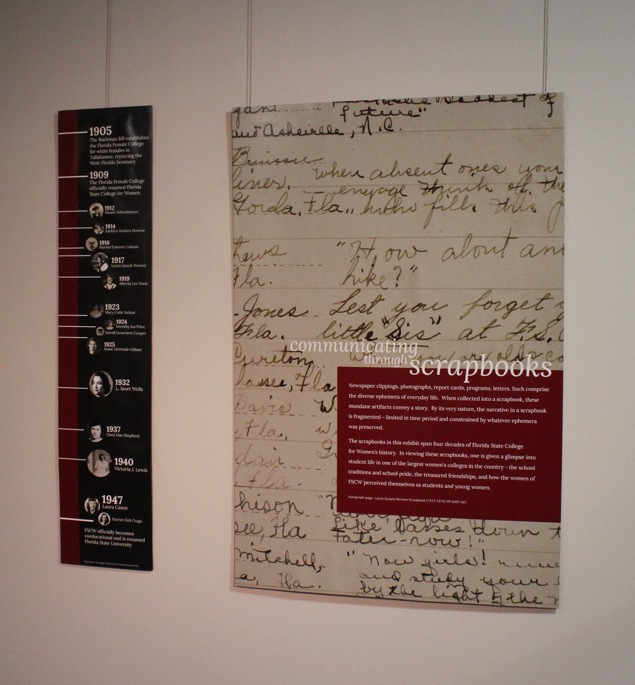
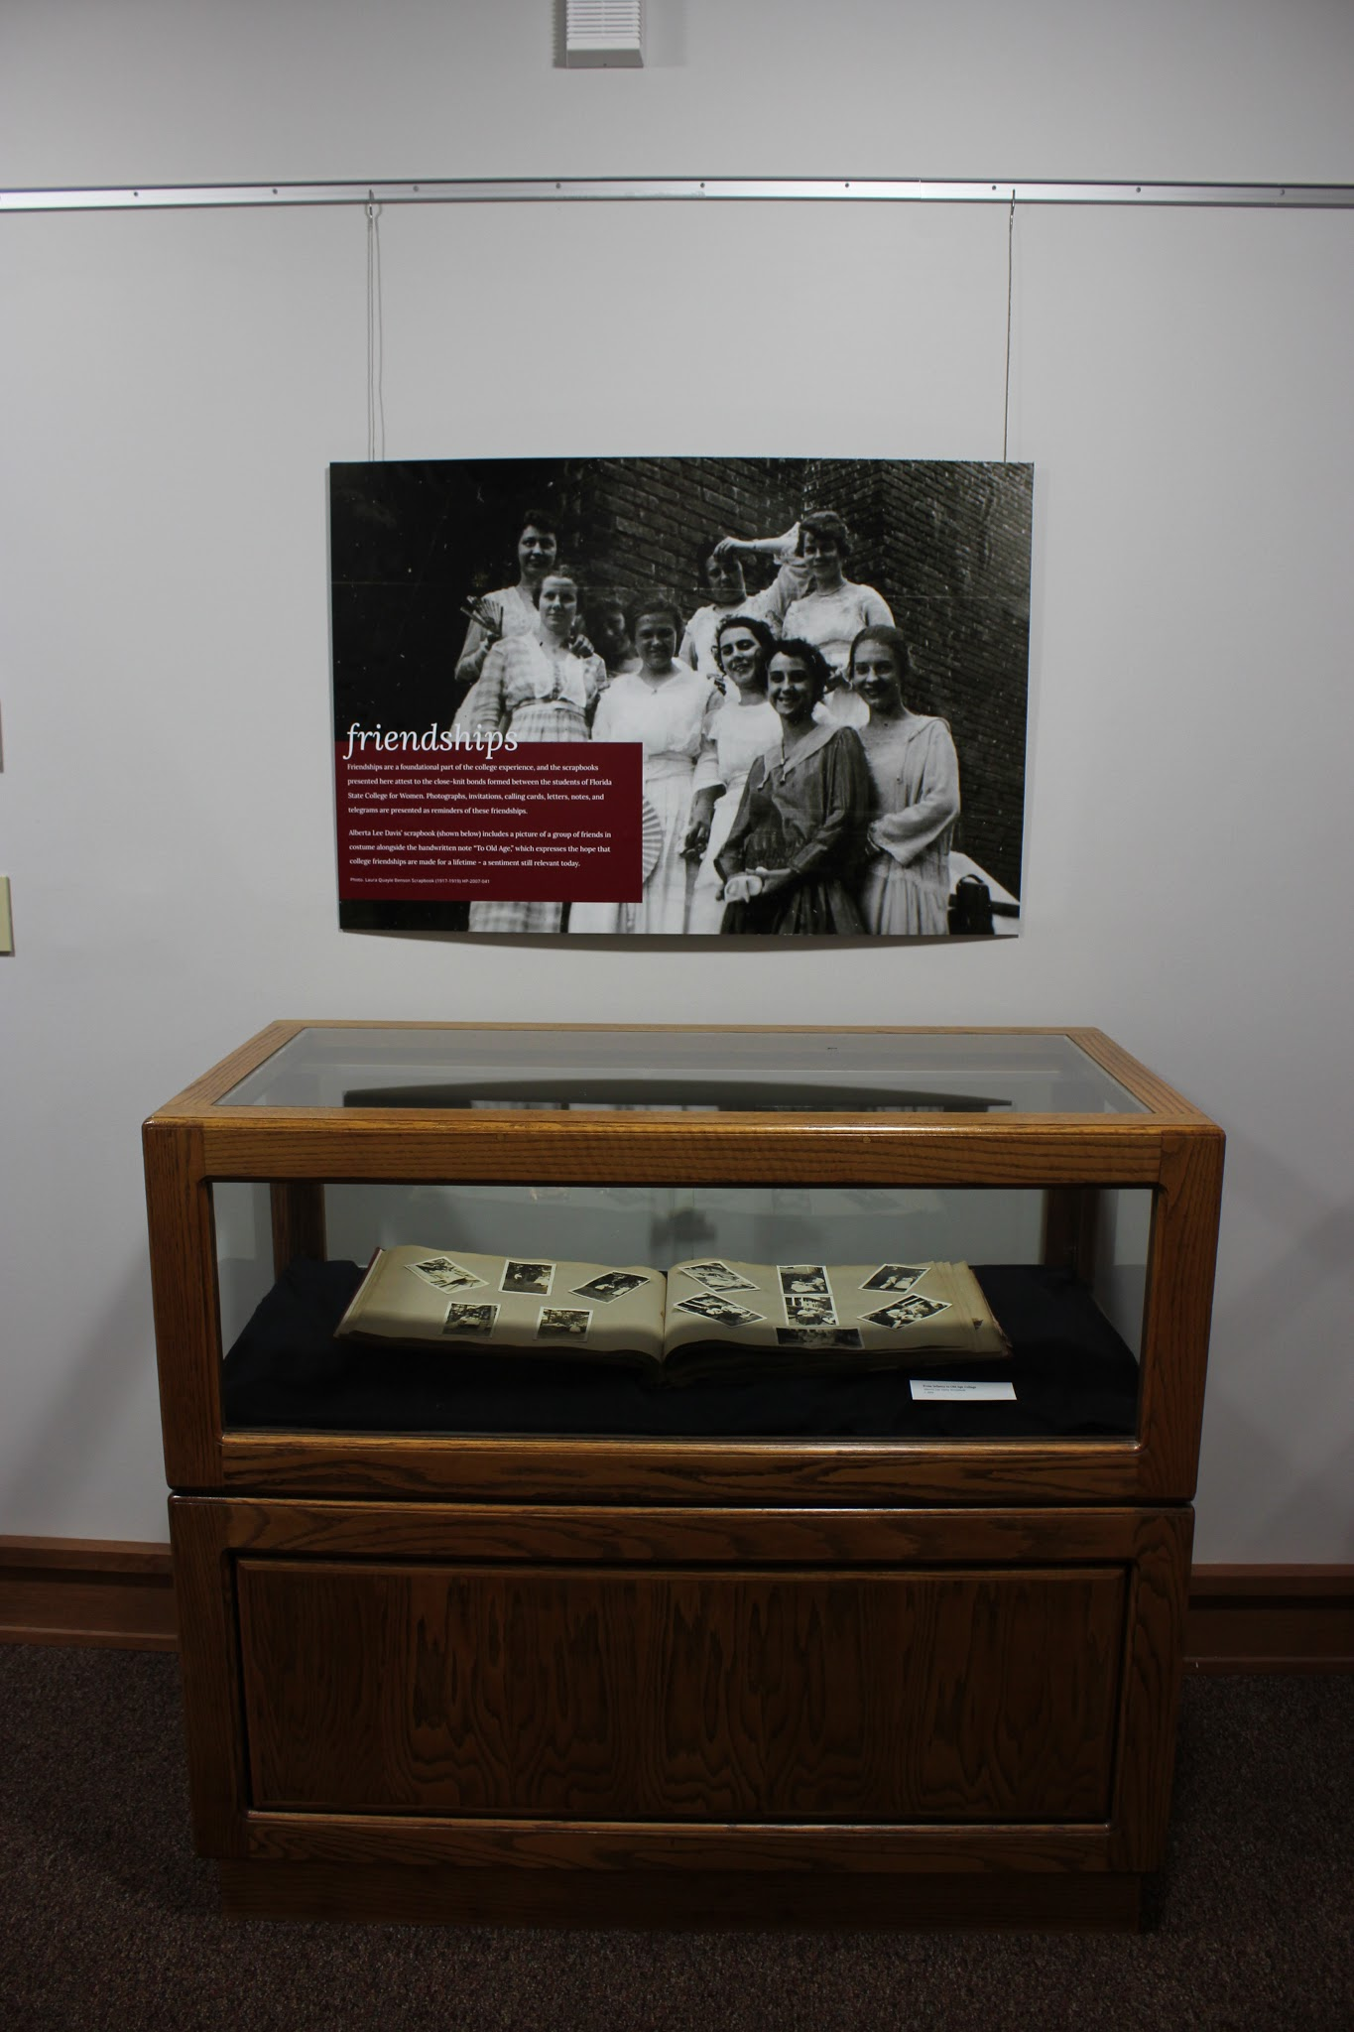
Thinking like a Museum (sort of)
Excerpts from the Exhibit Guest Book:
“Very nice display. Well done.”
“This collection is well presented.”
“An awesome exhibit, well done and thank you!”
“This is awesome!”

Slide 5
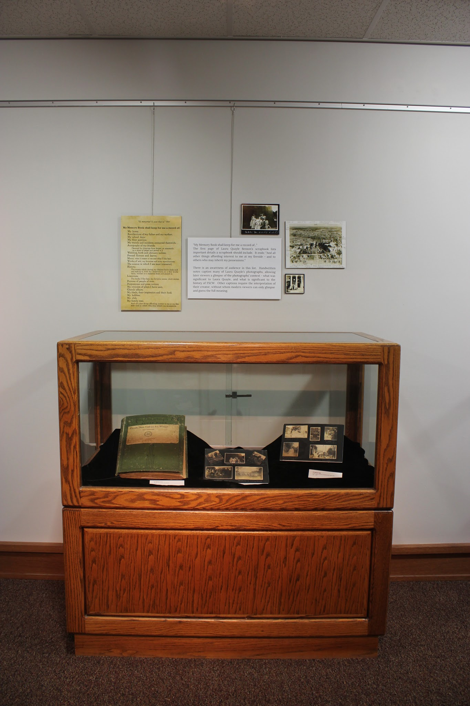
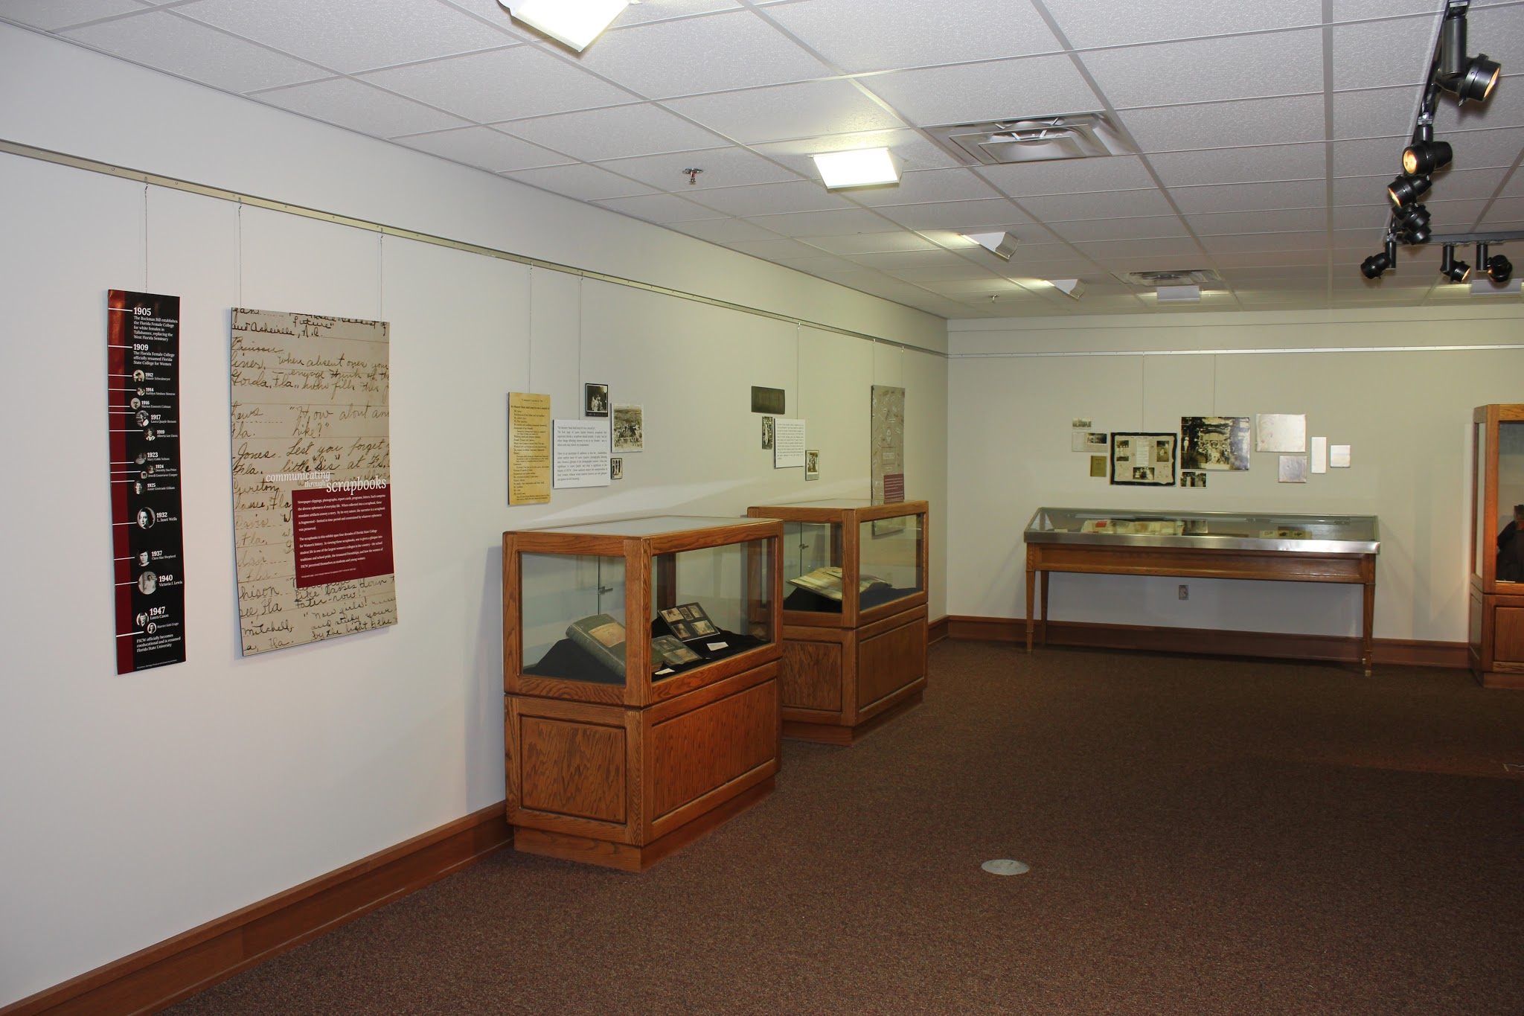
Exposure for Hidden Collections
“I never knew this was here. Such a cool look back in history!”

Slide 6
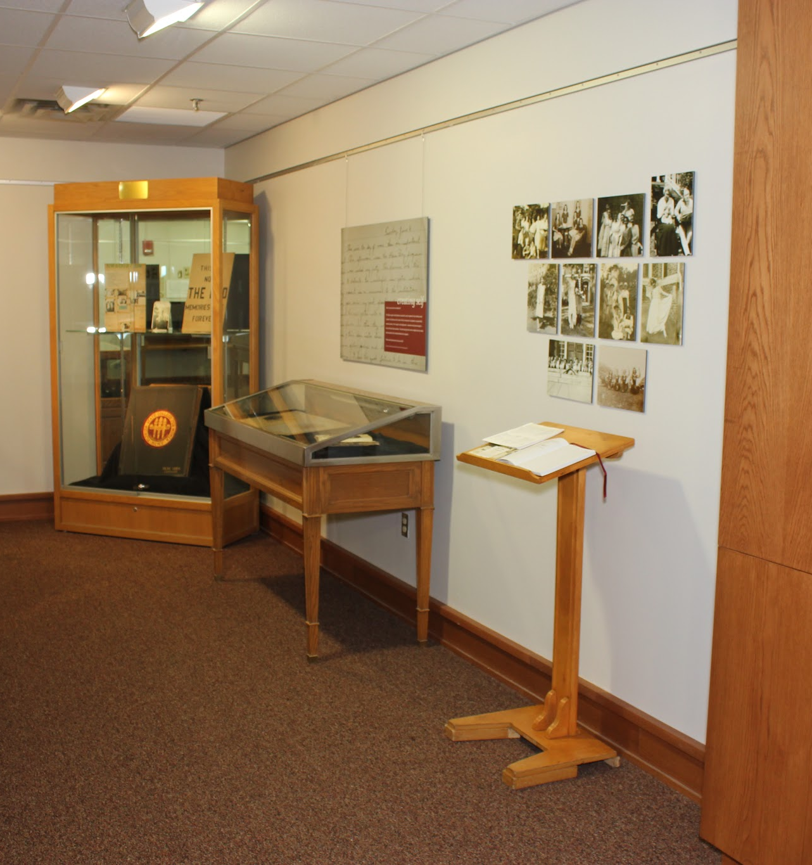
Community Outreach
Excerpts from the Exhibit Guest Book:
“I love history! As a female attending FSU it was great to see such a rich history documented by other women.”
“Growing up, my best friend’s grandmother was the class of ‘46. This reminded me so much of the photos she used to share with us.”
“Thanks for celebrating the FSCW past. A wonderful experience for former students of that time!”

Slide 7
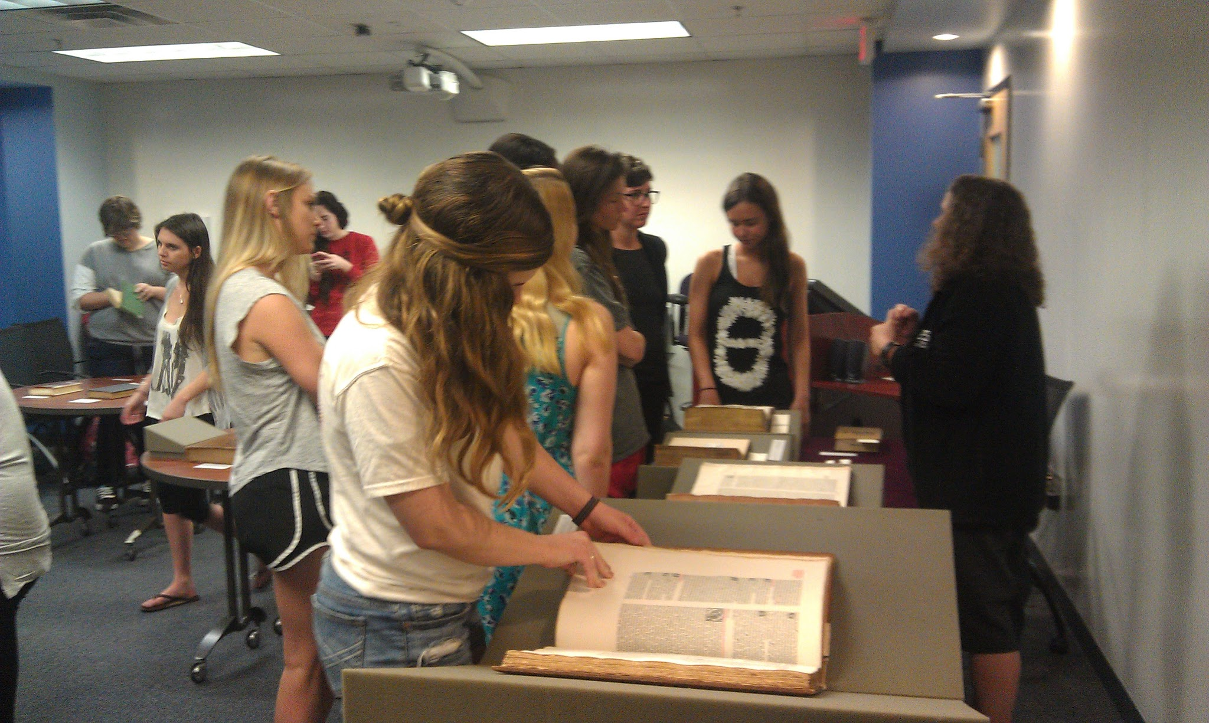
Instruction as Outreach

Slide 8
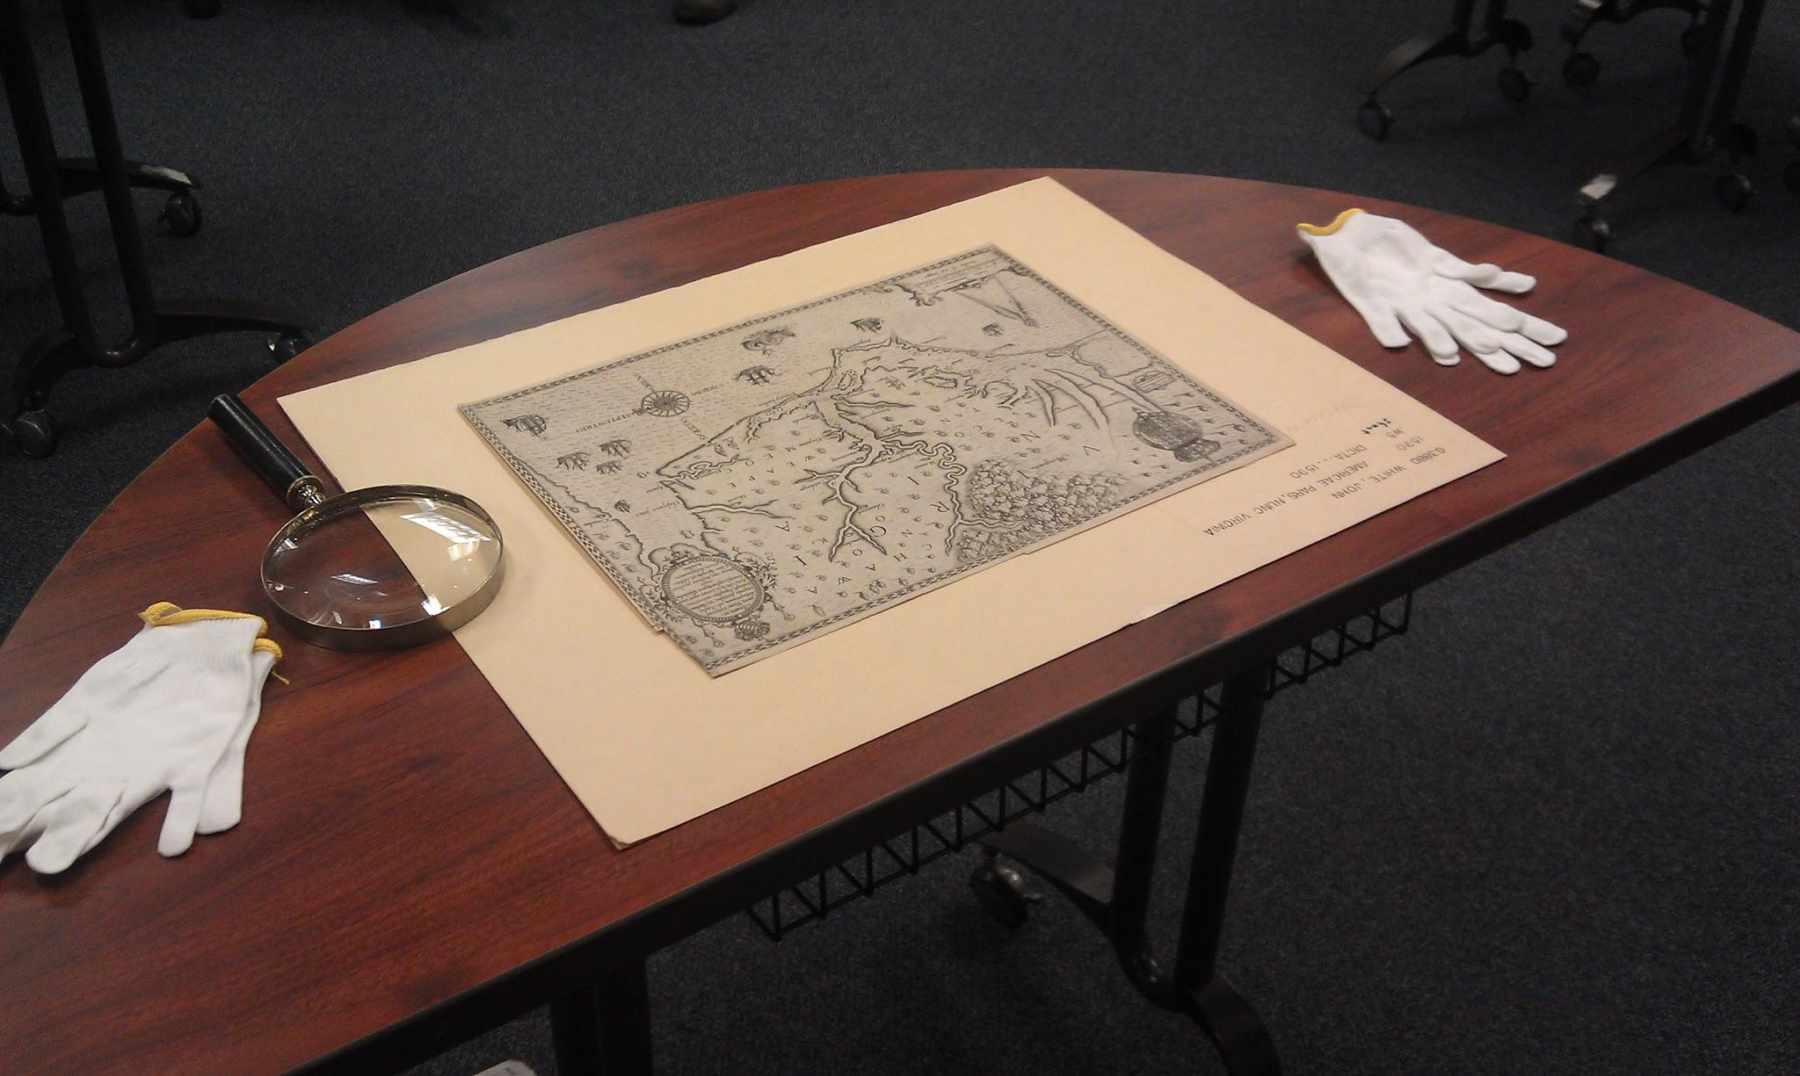
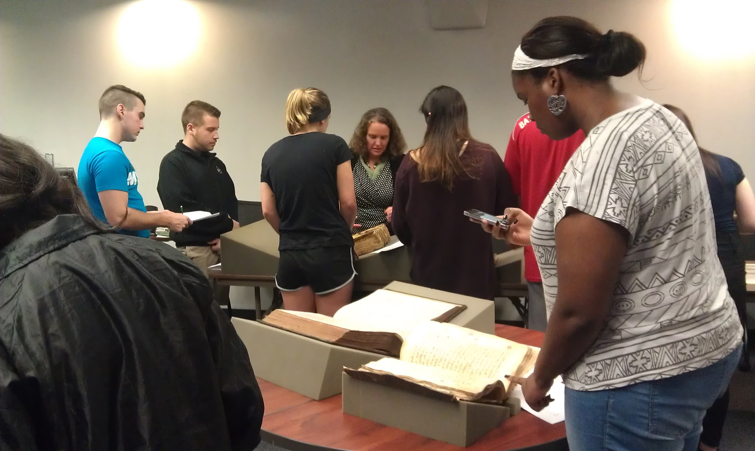
Instruction in Special Collections

Slide 9
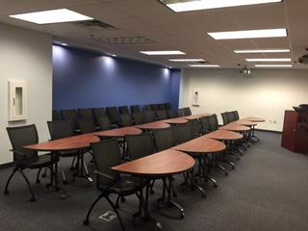
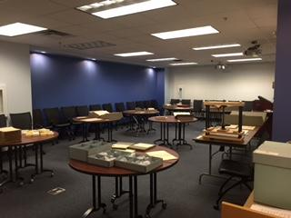
Special Collections Instruction
Before….
After…

Slide 10
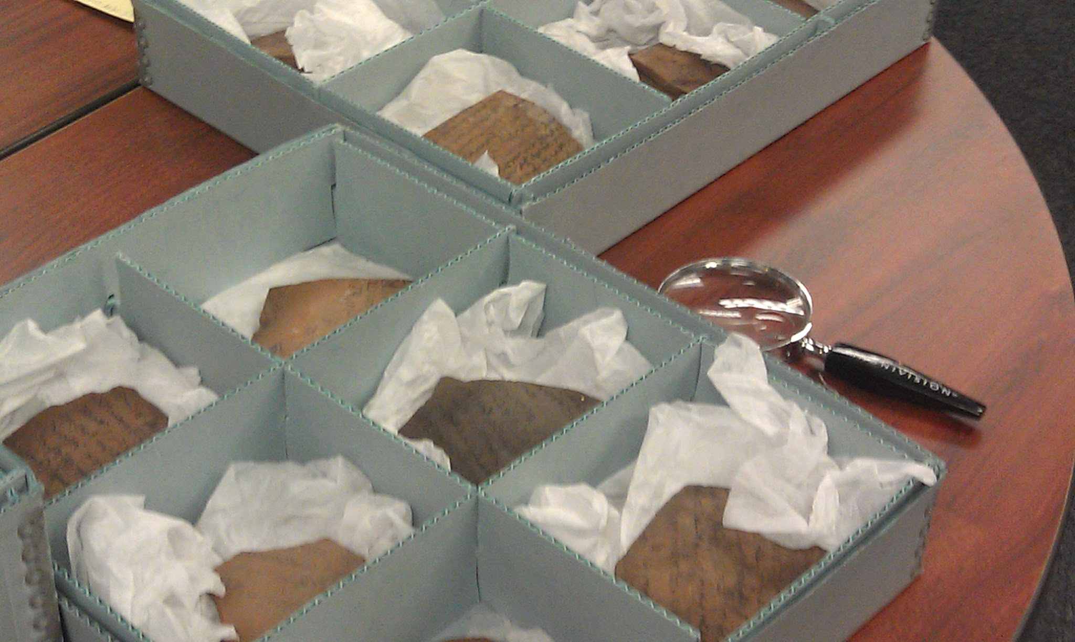
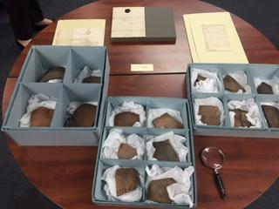
Special Collections Instruction
Ostraka
18th century letters

Slide 11
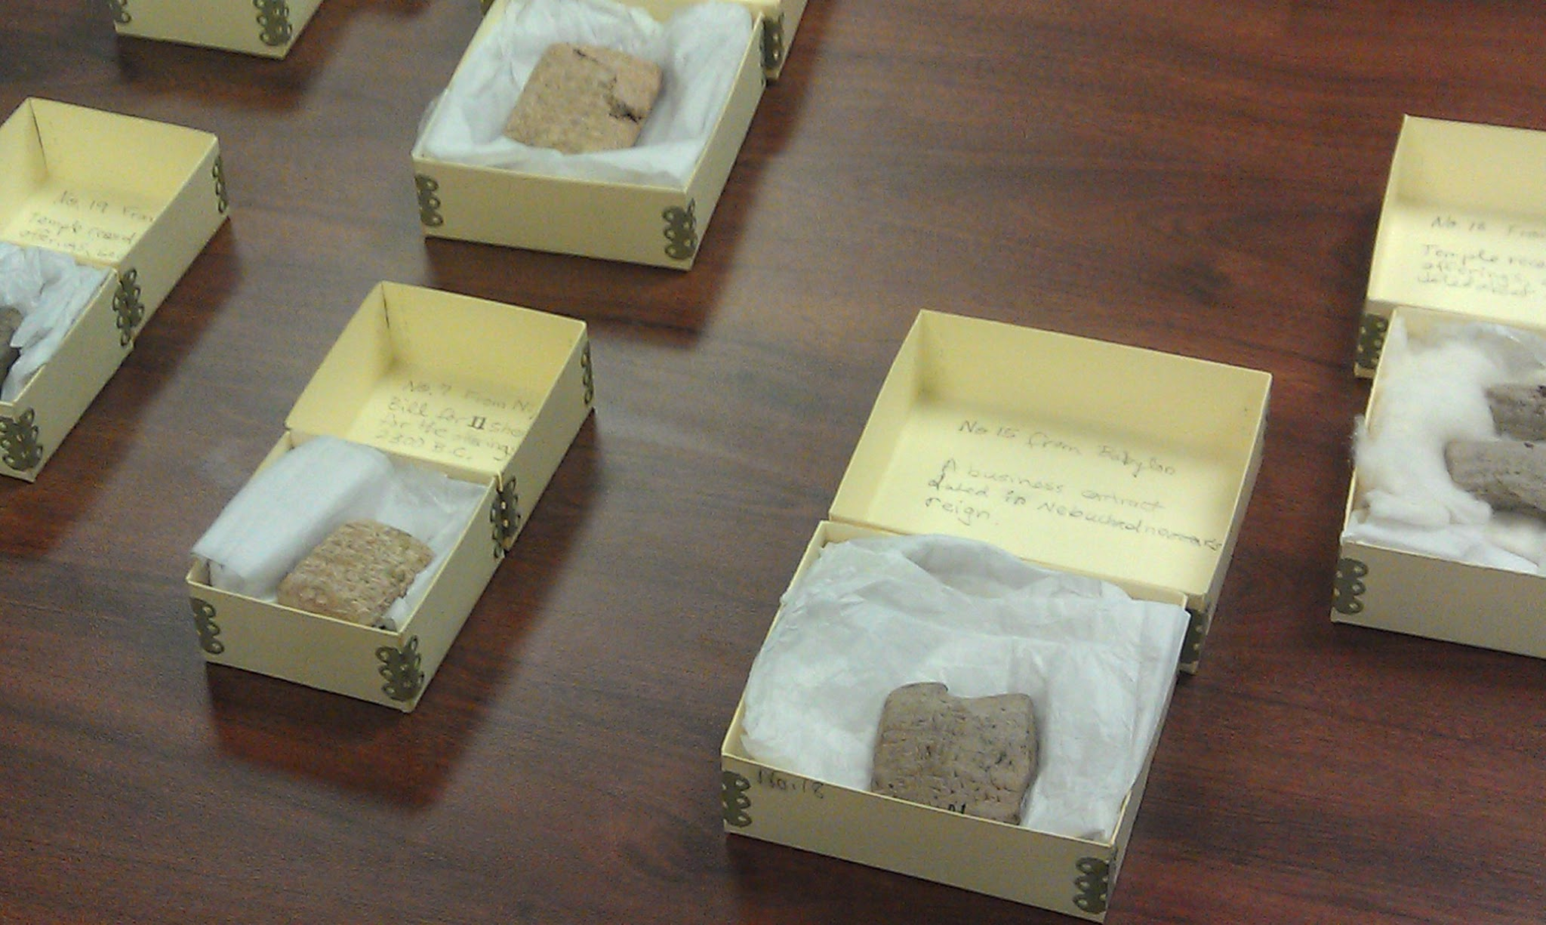
Special Collections Instruction
Cuneiform tablets
compared with 19th century ledgers

Slide 12
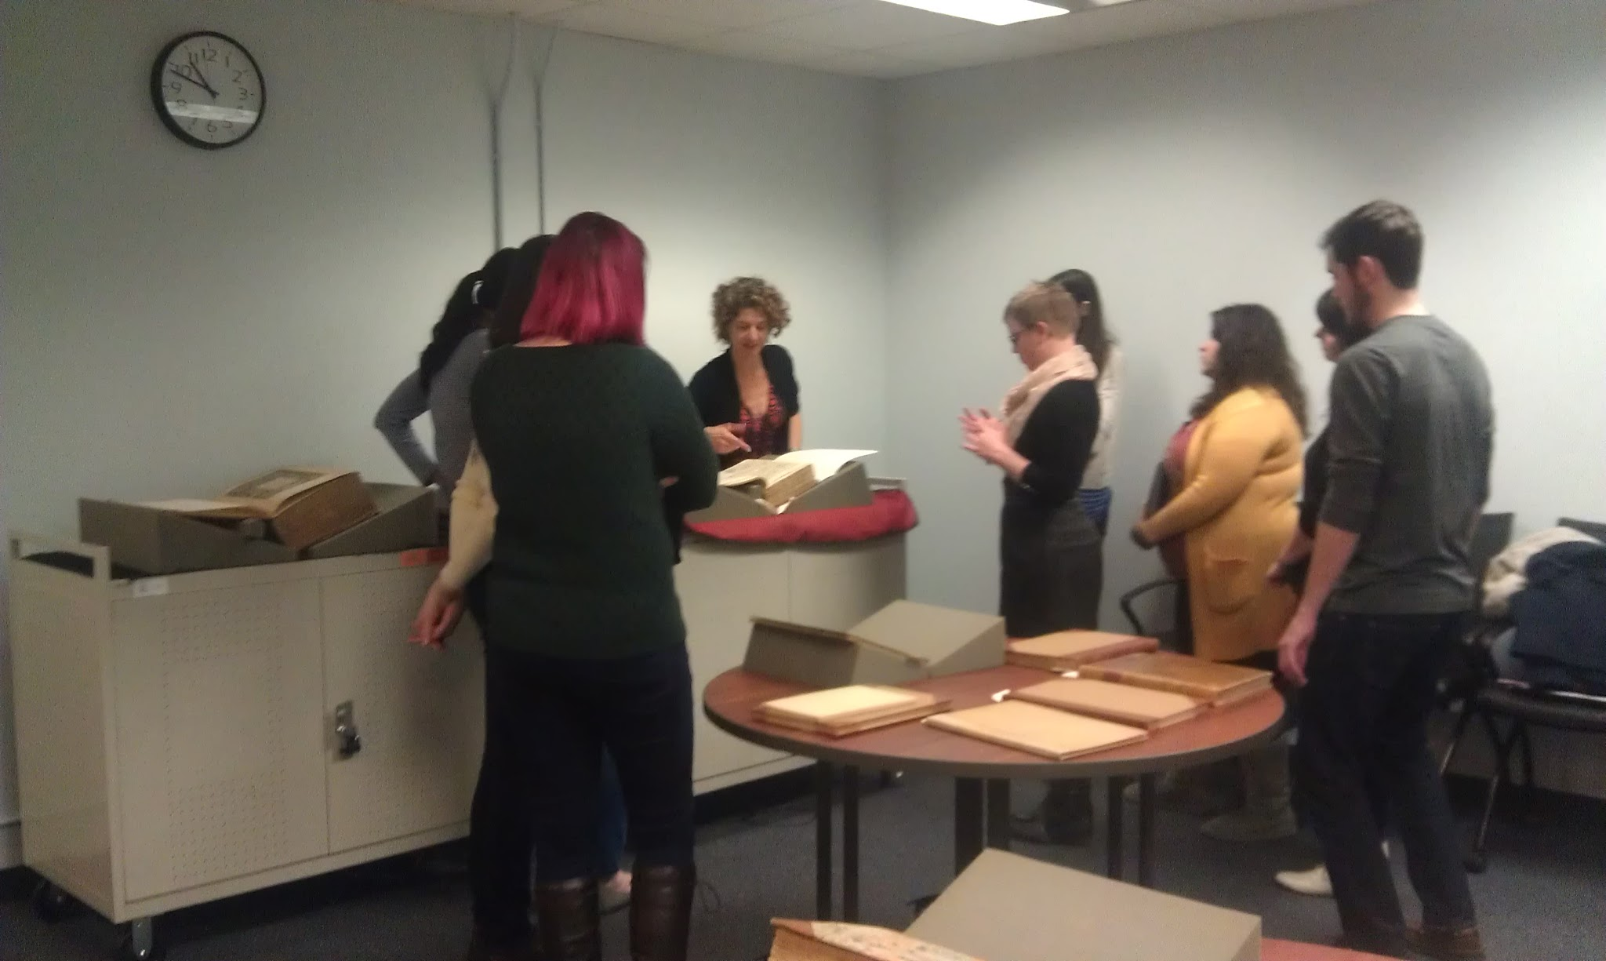
Collaboration in Instruction
1/28/15
Renaissance
Observation
Graduate-
level course
Prof. Leitch

Slide 13
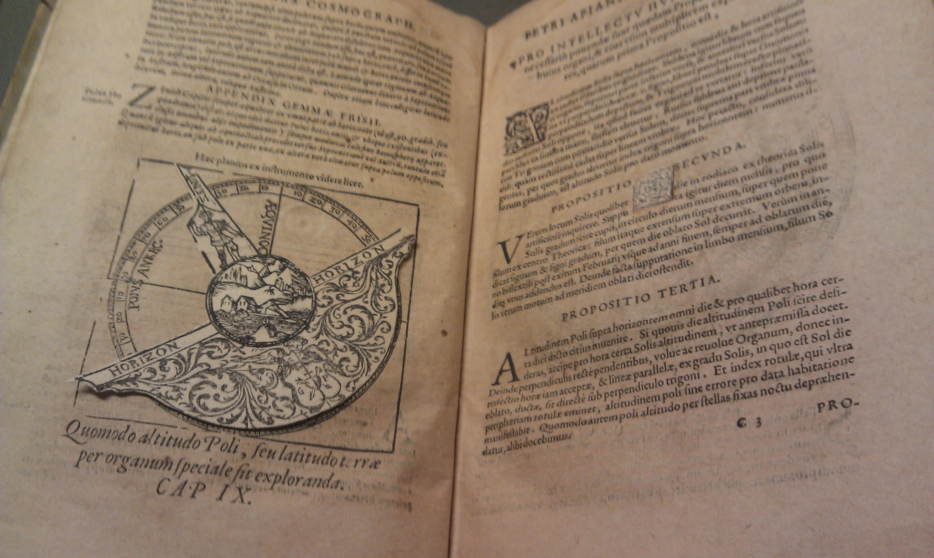
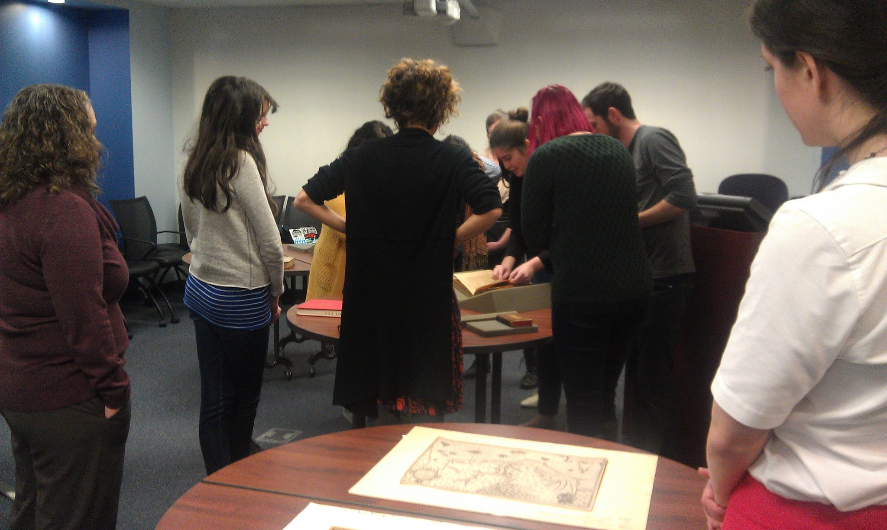
Collaboration

Slide 14
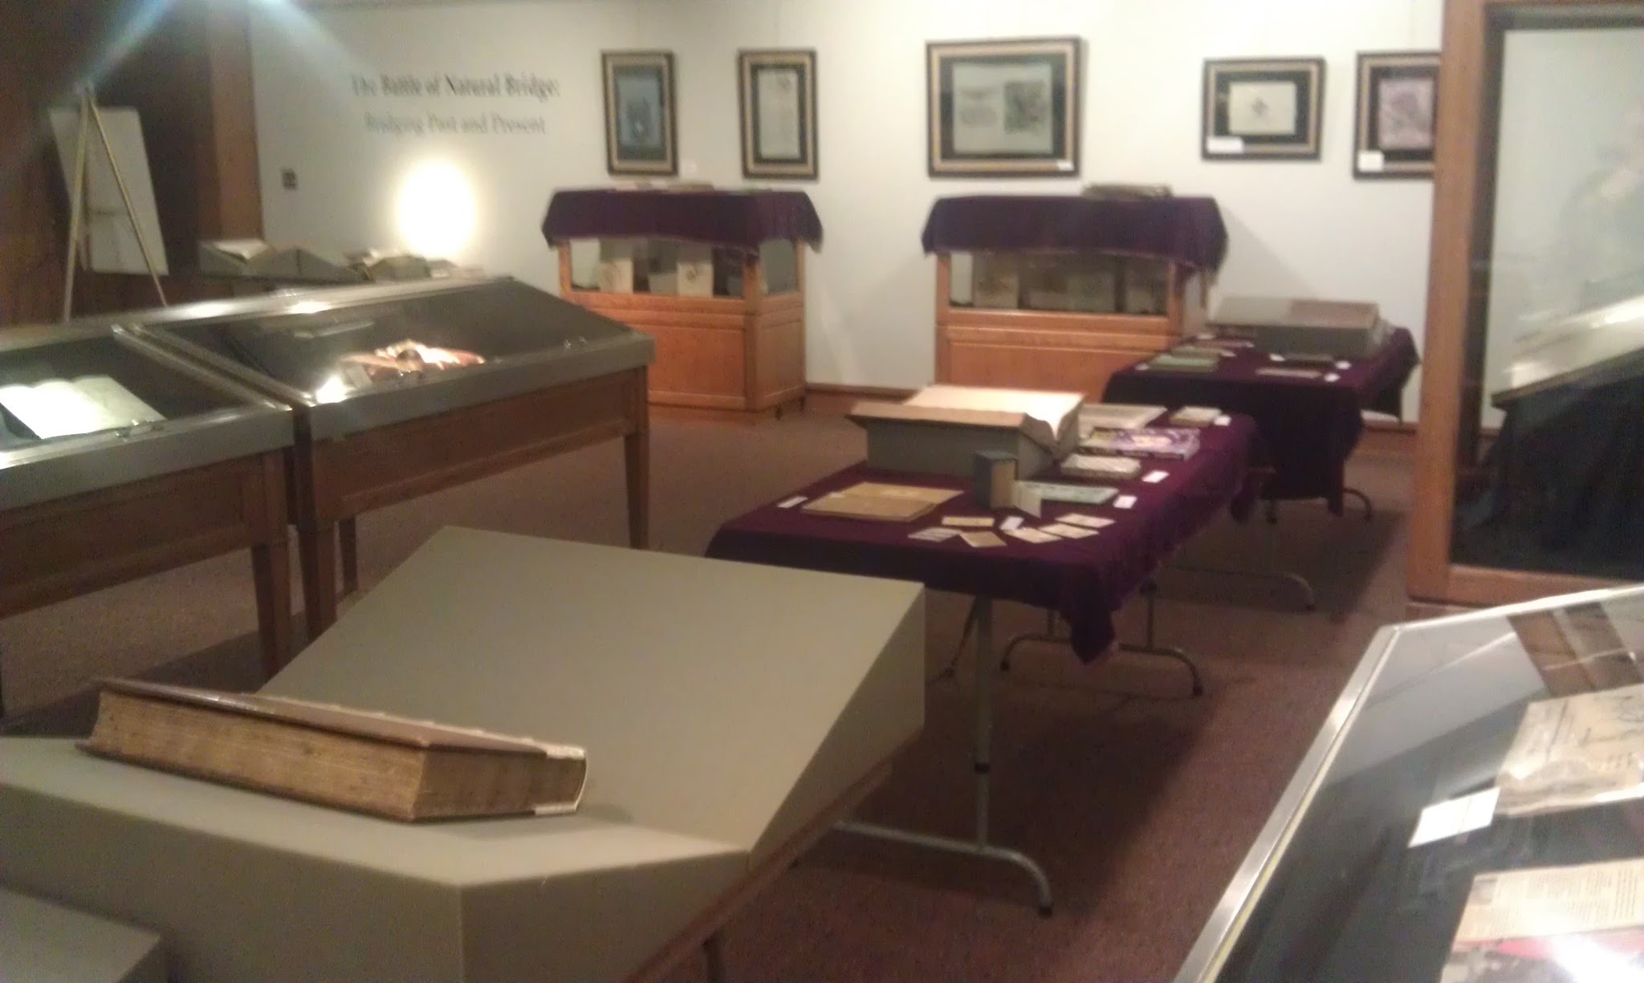
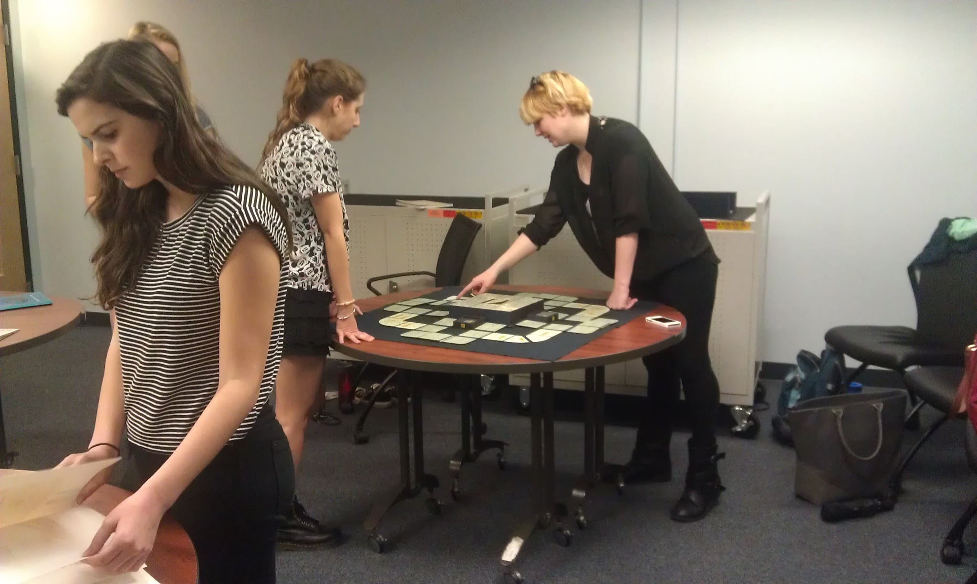
Instruction

