Slide 1
Oral History for Dummies A Guide to Getting Started
Laura Capell, María R. Estorino Dooling, and Béatrice Colastin Skokan
University of Miami Libraries

Slide 2
Oral History
“Oral history is the practice of collecting, preserving, interpreting, and curating individual, social, and collective experiences in story form.”
“[It] requires extensive research and preparation and results in the creation of archives that can be mined for multiple purposes over time.”
From the Columbia Center for Oral History

Slide 3
The Oral History Process
Define the Oral History Project
Collaborate
Funding Options
Planning and Preparation
Conducting Interviews
After the Interview

Slide 4
Project Design
Three Key Questions
What is it that you want to cover?
What does the history you record mean to those who lived through it?
What is the long-term purpose of your project?
Adapted from Documenting and Interpreting Conflict through Oral History: A Working Guide (Columbia Center for Oral History) http://static1.1.sqspcdn.com/static/f/1448391/25473930/1411501433703/Documenting_and_Interpreting_Conflict_Through_Oral_History.pdf

Slide 5
Project Design
Research goals
Timeframe and temporal span
Themes and topics
Project personnel
Language and location
Research community
Transcription/translation
Technology
Ethics
Adapted from Documenting and Interpreting Conflict through Oral History: A Working Guide (Columbia Center for Oral History) http://static1.1.sqspcdn.com/static/f/1448391/25473930/1411501433703/Documenting_and_Interpreting_Conflict_Through_Oral_History.pdf

Slide 6
Defining an Oral History Project Why do you want to document?
Expand the Documentation of Florida’s African Diaspora as a collection development focus.
Support graduate thesis:
Taking Back the Land: Social Mobilization and Radical Politics in Liberty City, Florida. (August 2011) by Rudo Kemper.
Counternarratives of the Diaspora: Haitian Musical Performance in World Beat Markets. (May 2012) by Kevin Mason.

Slide 7
Collaboration Identify Potential Partners in your Community
Serve as community partner * Historias (2009)
* Military Voices Initiative with WarMamas (2015)
Serve as archival partner * UM Law School Historic Black Churches Project
* Immigrant Archive Project
Students & Scholars * Haitian Diaspora Project
* Cuban Medical Professionals Project

Slide 8
Funding Options
Institutional Funding
Community Partners
Private Gifts
Grants

Slide 9
Planning and Preparation
Selecting people to interview
The interviewer
Setting up the interview
Research
Equipment
Documentation
Project forms
Consent

Slide 10
Conducting Interviews
General themes / specific topics
Life histories
The conversation

Slide 11
Documentation

Slide 12
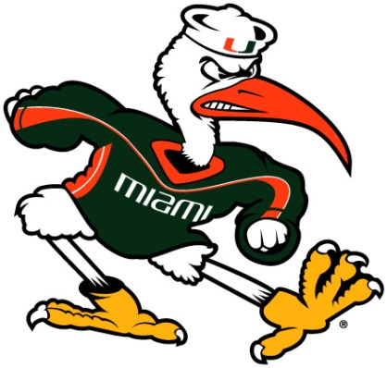
Getting Good Quality Recordings UM Libraries Video Recording Settings
Video frame size: 1280x720
Encoded in H.264 in an mp4 container
Data rate of approximately 7.2 megabytes/second (or 57.65 megabits/sec). This should result in files of about 26GB per hour of runtime
AAC audio encoded at 128kbps, 48.000kHz sample rate
Frame rate at 30 fps
For interviews up to 90 minutes, leave as a single file. For interviews over 90 minutes, split into segments

Slide 13
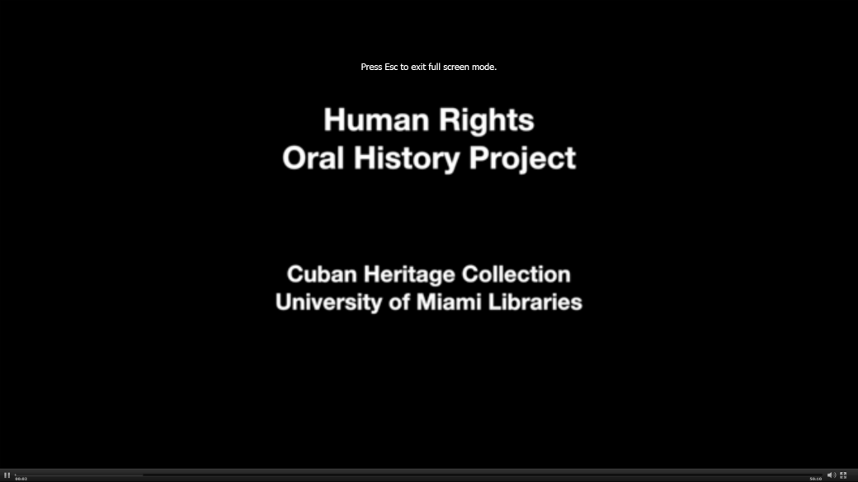
After the Interview
Documentation
Processing the interview
Transcription or indexing
Interviewee review
Preservation
Access
Gratitude

Slide 14
Access at the UM Libraries

Slide 15
Resources
Oral History in the Digital Age:
http://ohda.matrix.msu.edu/
UM Libraries Oral Histories:
http://library.miami.edu/oral-histories/
Columbia Center for Oral History:
http://library.columbia.edu/locations/ccoh.html
Baylor Institute for Oral History:
http://www.baylor.edu/oralhistory/
UNC Southern Oral History Program:
http://sohp.org/
University of Kentucky Louie B. Nunn Center for Oral History:
http://libraries.uky.edu/nunncenter

Slide 16
Thank You
Laura Capell: l.capell@miami.edu
María R. Estorino Dooling: mestorino@miami.edu
Béatrice Colastin Skokan: bskokan@miami.edu

