Slide 1
The Florida Statewide
Digital Initiative
Tom Clareson
Society of Florida Archivists Annual Meeting
May 13, 2015

Slide 2
Statewide Planning Background and Survey
This project is funded under the provisions of the Library Services and Technology Act, from the Institute of Museum and Library Services, administered by the Department of State’s Division of Library and Information Services.

Slide 3
Florida’s Digital Environment
Many institutional digitization projects exist; multi-institution collaborative projects are happening on a local/statewide basis.
Florida Division of Library & Information Services developing the Florida Statewide Digital Action Plan project.
Input from leading Florida institutions and associations.

Slide 4
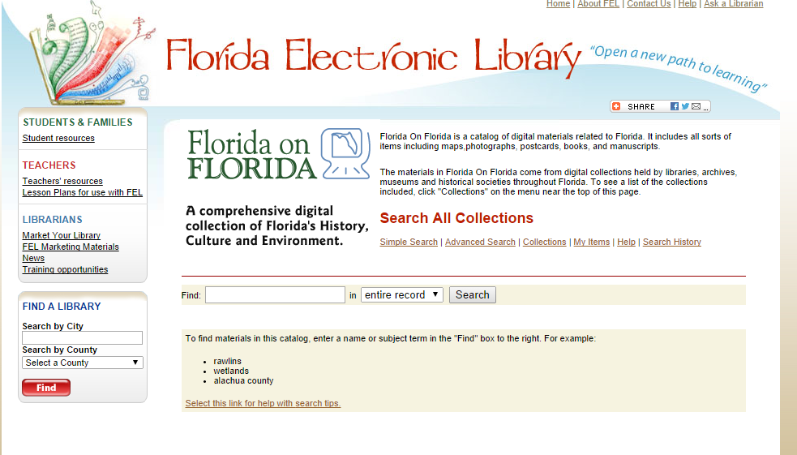
Portal to Florida’s digital collections

Slide 5
2013-15 Statewide
Digitization Planning
Survey of digitization practices and needs
Series of focus groups
Development of Best Practices documents-- Metadata, Content Creation
Recommendation for technology strategy for single point of access to Florida’s digital collections
Development of a Statewide Digital Action Plan
Project Website: http://dlis.dos.state.fl.us/bld/Florida-Statewide-Digital-Action-Plan/
Notes:
The Project began November 2013 and will wrap up in Spring 2015
Project Steering Committee with representatives from all areas of the cultural heritage community
Conducted survey of Florida’s cultural heritage organizations in winter, 2014 to identify digitization practices and needs, more on this later
We’ll be holding a series of focus groups in September and October in locations around the state

Slide 6
Florida Statewide Digital Survey
101 responses received from estimated universe of 583 institutions (17% response rate)
Largest response groups by type:
  Public Libraries (39 responses; 39% of total)
  Academic Libraries (26 responses; 26%)
  Museums (13 or 13%)
  Archives (9 or 9%)
Majority of respondents (57 or 59.4%) had primary role of Administrator/Director/Dean
71 institutions (71%) have digital collections

Slide 7
Digital Collection Development
Why digitizing/collecting born digital (top reasons for public libraries and all other org. types)?
  Provide online access to materials (93.8%)
  Increase access to collections (89.1%)
  Preserve original by reducing handling (82.8%)
  Study/use by local (81.3%) and remote users (71.9%)
Selection criteria:
  Strong local interest in materials/collections (76.6%)
  Materials are fragile/deteriorating (65.6%)
  High-value materials; digitizing increases access (62.5%)
Photographs = the leading format that have been digitized, across all institution types.
Local History (27) and Florida History (24) were most popular subjects for future digitization. Respondents interested in digitizing all formats.

Slide 8
Digital Asset Management
46% of all responding organizations, and a majority of public libraries, do not have a digital asset management system.
Top DAM systems in use in Florida
  CONTENTdm (11 organizations)
  Islandora (8)
  Locally-developed systems (7)
  PastPerfect (6)
  SobeK (5)
  Also: Omeka, DigiTool, D-Space, Fedora, BePress

Slide 9
Key recommendations
Rebuild, modernize and expand participation in Florida on Florida—Statewide portal of digital collection discovery
Expand use of statewide best practices—metadata and content creation
Enable participation of all cultural heritage organization through collaborative programs
  Training
  Need for shared content management
  Shared digital conversion
Assure sustainability of the portal program
Gateway to Digital Public Library of America

Slide 10
Overview of Collection Discovery Value, Portals, DPLA

Slide 11
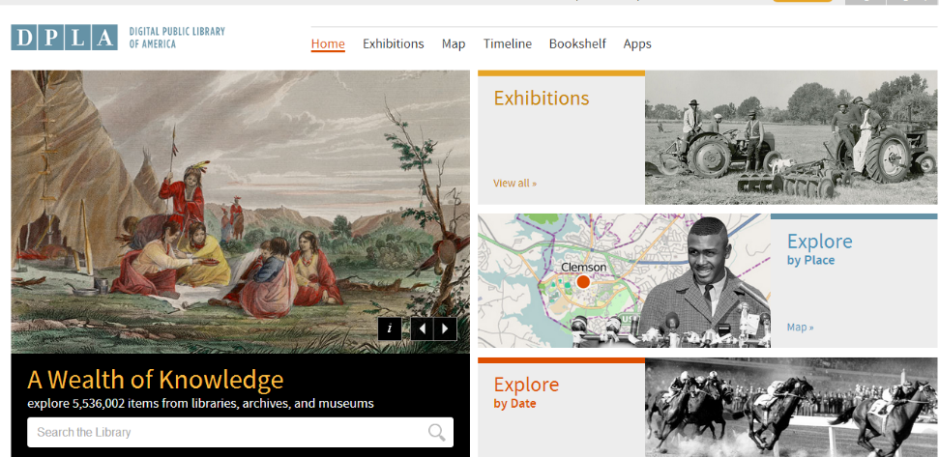
Digital Public Library of America http://dp.la/
Background
  2009-present
  Wide variety of states and institutions participating
Functionality
  Aggregation
  Local hosting
  Hubs
  Metadata
Strategy/Vision
  Portal
  Platform
  Public option

Slide 12
Why should we care; or benefits of statewide digital portal
Move from “many separate collection access points” to an easy way to consolidate searches statewide and nationally.
Expanded visibility of our collections—statewide & national
One stop shopping--Supports research & education
Collaboration—funds working with other libraries, historical societies, archives, museums
Community engagement—demonstrates how to engage those interested in history
Cultural heritage—heritage tourism
“It’s the gateway to DPLA”

Slide 13
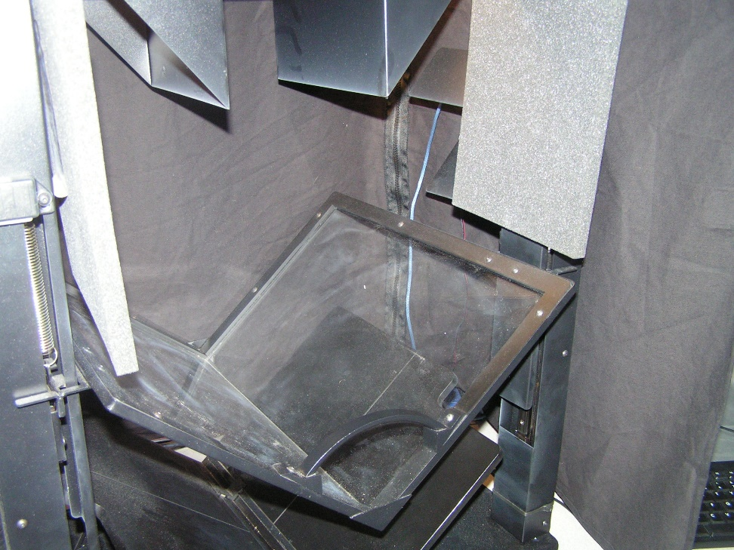
What is needed to implement such a program?
At your Archives?
In your community?
Statewide?
Other ideas?

Slide 14
Focus Groups and
Needs Assessment

Slide 15
Florida Statewide Digital Initiative Mission
“The Florida Statewide Digital Initiative expands access to digital content held by Florida’s archives, libraries, museums, and other cultural heritage organizations.”

Slide 16
What institutions will need to implement this program
Convince directors this is a priority
Nuts and bolts
Integrate existing collections
Metadata best practices
Training
Use current ‘getting started’ info
Funding—state, local, and national
Collections held by Florida institutions
Digitization of local Newspapers
Rights issues training
Notes:
Nuts and bolts on the program, including everything from metadata creation and digitization to “how will my metadata get into the portal?”

Slide 17
Challenges of this program
Who’s in charge?
Ownership/Branding
Learning and working within standards
Need for Training
Need for Funding
Need for Staffing
“Retrospective conversion” of already-digitized materials needed?
Copyright issues present large challenges
Commitment from the state for program sustainability
Let’s get going!

Slide 18
Florida Statewide
Digital Action Plan

Slide 19
Values the Initiative Supports
Celebrates the cultural and geographic diversity of Florida
Believes that history and culture enriches the lives of all
Values all cultural heritage collections
Respects the expertise and judgment of cultural heritage professionals
Recognizes that collaboration is a means of increasing the effectiveness and reach of cultural heritage institutions
A sustainable initiative that provides an on-ramp to the national digital program (DPLA)
Notes:
…And reasons for developing the Digital Action Plan.

Slide 20
Digital Collection Audiences
General users/visitors
Learners/K-16 students
Scholars/researchers
Businesses
Funders/Donors
Cultural heritage organization staff, including boards and volunteers
Notes:
Digital Collections are for WIDE audiences, including but not limited to scholars

Slide 21
Florida Statewide Digital Initiative: Digital Action Plan 2015-2018
Goal 1: Develop and Enhance the capabilities of the archives, library, and museum community to create, promote, and preserve digital collections for use and reuse
  Objective A: Planning activities
  Objective B: Promotion and marketing program
  Objective C: Training and support program
  Objective D: Networking environment
  Objective E: Technology environment

Slide 22
Florida Statewide Digital Initiative: Digital Action Plan 2015-2018
Goal 2: Strategically meet the needs of targeted audiences who can benefit from access to Florida’s digital collections
  Objective A: Understand the information, education, and research needs of Floridians
  Objective B: Tactical strategies for outreach
  Objective C: Products and services

Slide 23
Florida Statewide Digital Initiative: Digital Action Plan 2015-2018
Goal 3: Provide access to digital content held by Florida’s archives, libraries, museums, and other cultural heritage organizations
  Objective A: Portal & “On-ramp”
  Objective B: Metadata harvesting
  Objective C: Accessible portal

Slide 24
Florida Statewide Digital Initiative: Digital Action Plan 2015-2018
Goal 4: Support growth and sustainability of the Florida Statewide Digital Initiative
  Objective A: Governance structure
  Objective B: Project management structure
  Objective C: Collaboration and expertise-sharing
  Objective D: Funding/sustainability program
  Objective E: Implement marketing plan

Slide 25
Questions and Comments?
Please contact for further information:
  Tom Clareson, tom.clareson@lyrasis.org

