Slide 1
Route Maps and First Flights: Working with the Pan American World Airways, Inc. Records
IN DEFIANCE OF ORIGINAL ORDER
Emily Gibson,
Society of Florida Archivists 2015 Annual Meeting, Miami FL

Slide 2
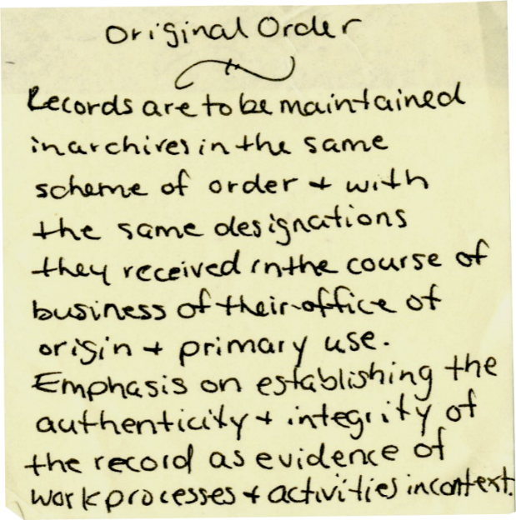
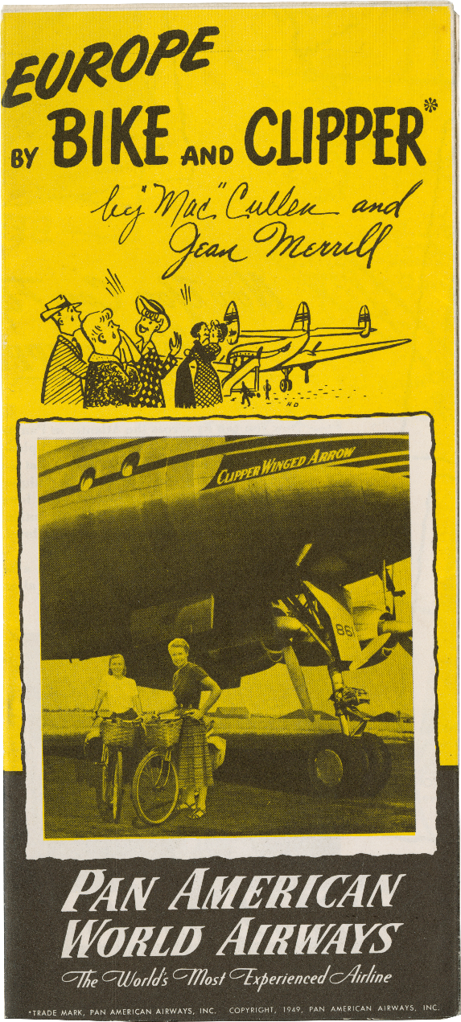
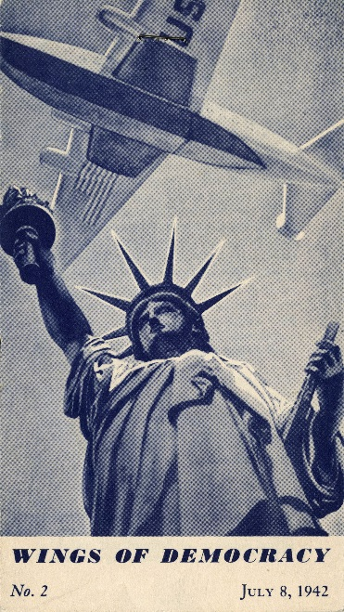

Slide 3
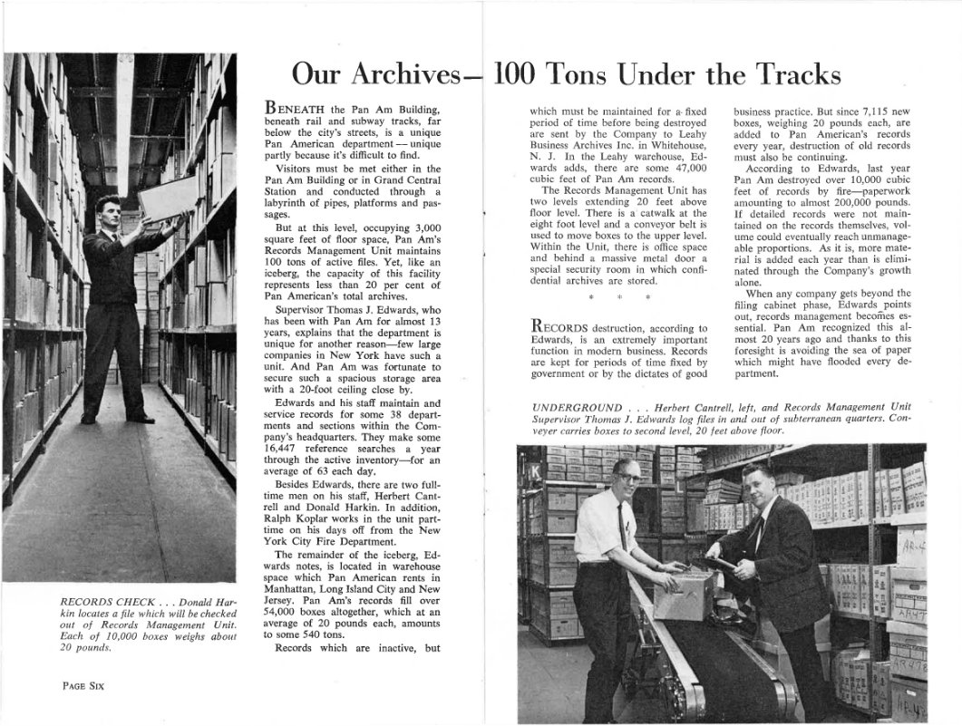
The Collection
1,600 boxes
Originally 84,000 boxes
50% of research requests pertain to Pan Am
Includes administrative, legal, financial, technical, and promotional materials as well as internal publications, photographs, audiovisual material and graphic material

Slide 4
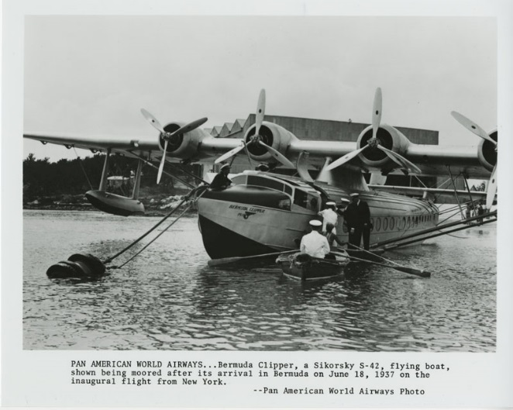
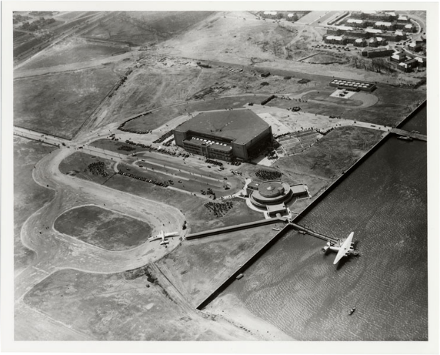
Grant objectives
Process at least 80% of collection
Catalog all periodicals
Create EAD finding aid
Create MARC record and add to Ibisweb and WorldCat
Add finding aid to ArchiveGrid
Track rate of processing
Publications/presentations

Slide 5
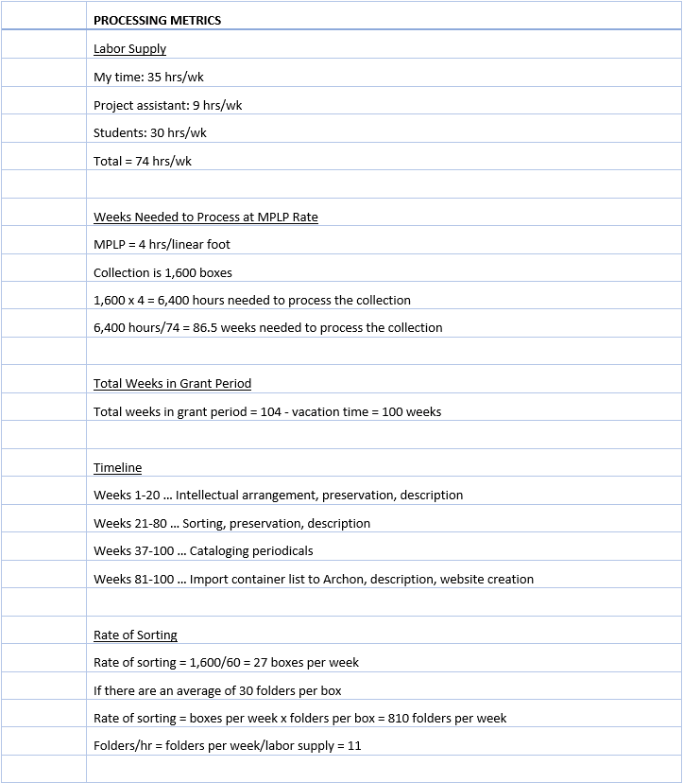
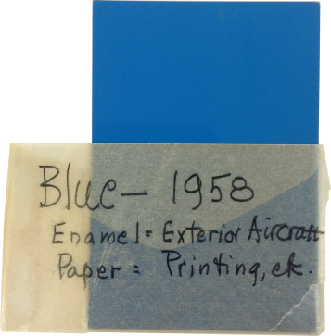
Planning
Some math

Slide 6
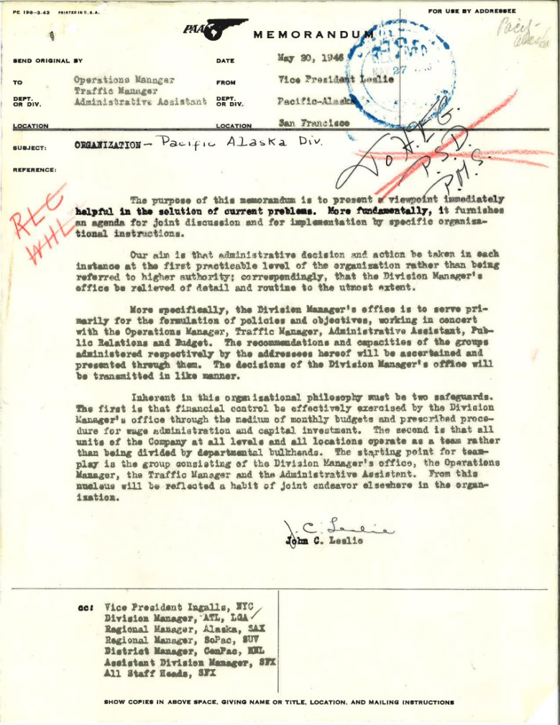
Search for original order
Compare obsolete inventories to folder inventory
Look for runs
Look for numbering systems in folder titles
Go inside folders for names/offices on memos and compare to employee directories
Conclusion: It would take too long to reassemble original order

Slide 7
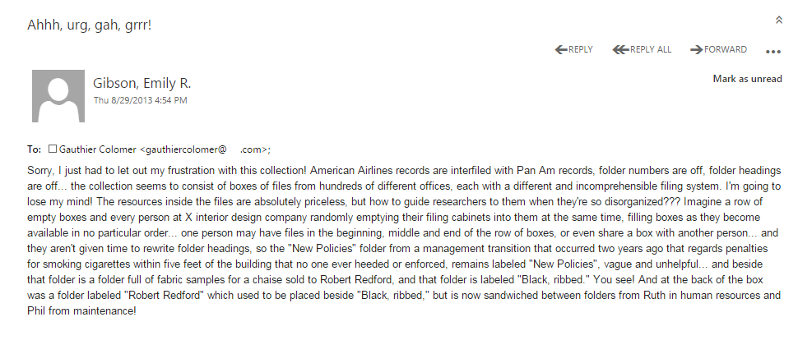
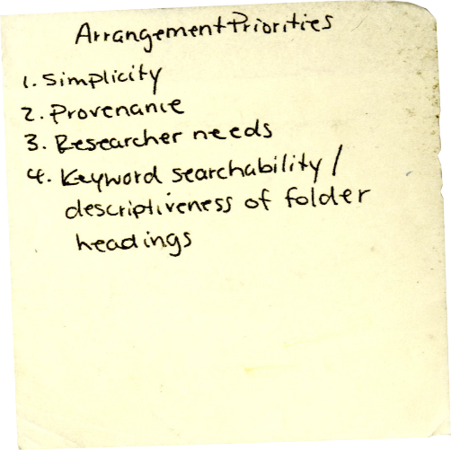
Thumbing my nose at original order
Ahhh, urg, gah, grrr!
Grant stipulation
Arrangement priorities
Simplicity
Provenance
Researcher needs
Keyword search-ability/descriptiveness of folder heading

Slide 8
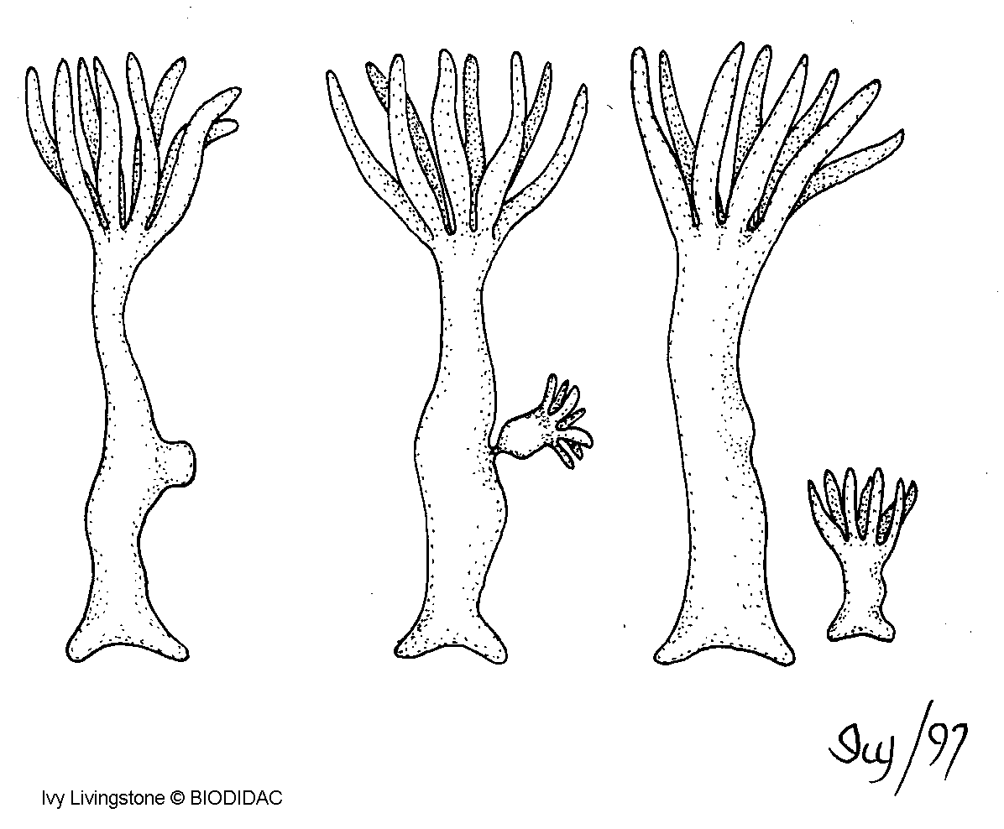
Thematic Arrangement/ Budding
Analyze folder titles for keywords
Trace patterns among keywords
Describe patterns as themes
Create a bud, i.e. subseries, when patterns occur within series
Topic modeling confirmed relevance of themes

Slide 9
Sorting
Getting Started
Verifying that folder headings reflect folder contents
Recording new location information
Recording date span
Separating unrelated periodicals
“See-also” references
References to noteworthy material
Noting photographs, graphic material and audiovisual material
Sleeve photographs
Removing duplicates
Noting preservation problems
Identifying sensitive information
Dividing overstuffed folders
Physically moving folders
Identifying linked folders within box
Placing box on shelf
Enter data into ARRANGEMENT_PLAN spreadsheet
Recording statistics

Slide 10
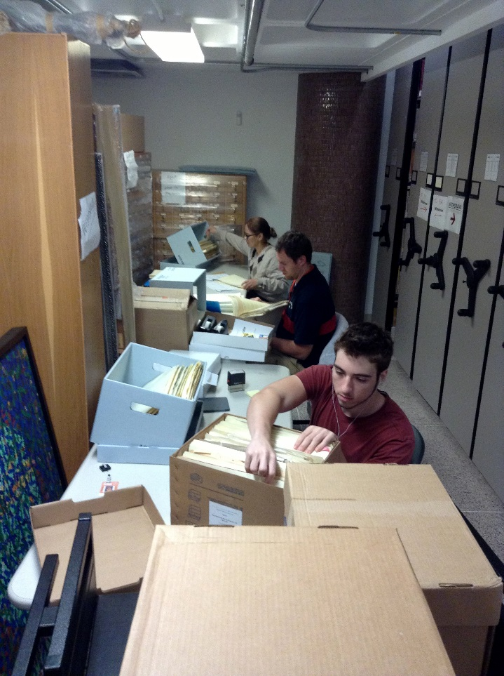
Managing Student Assistants
Keep the process as simple as possible
1 day orientation/training
Work beside students
Encourage student ideas
Optional steps
Biweekly meetings
Multiple choice quizzes
Close review of work
Work logs
Candy

Slide 11
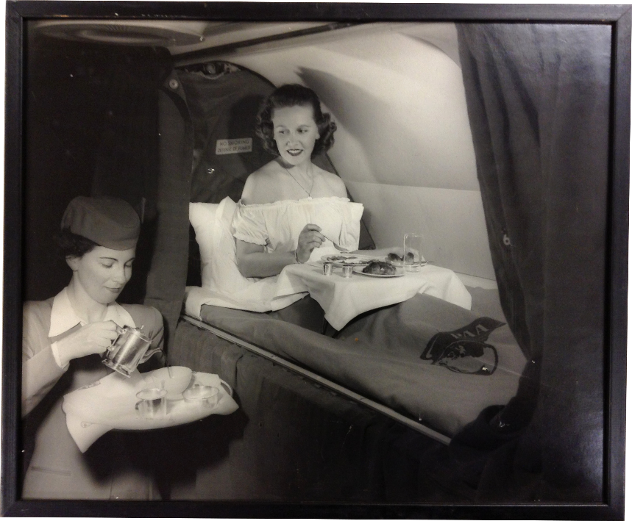
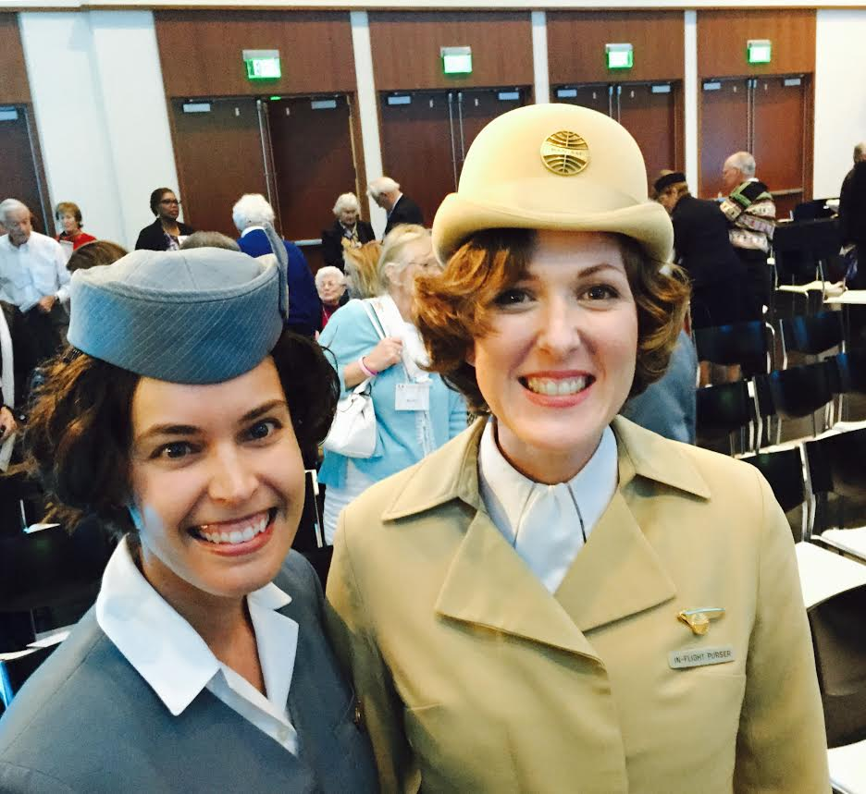
Results
All grant objectives, plus:
DACS multi-level added value description
Dendrogram
“Cleared to Land” grant completion event
Strengthened relationship with Pan Am family
Researchers love it
Honorary stewardesses Laura Capell and Emily Gibson at the Cleared to Land event, 2015
All Pan Am images courtesy of Special Collections, University of Miami Libraries, Coral Gables, Florida

