Slide 1
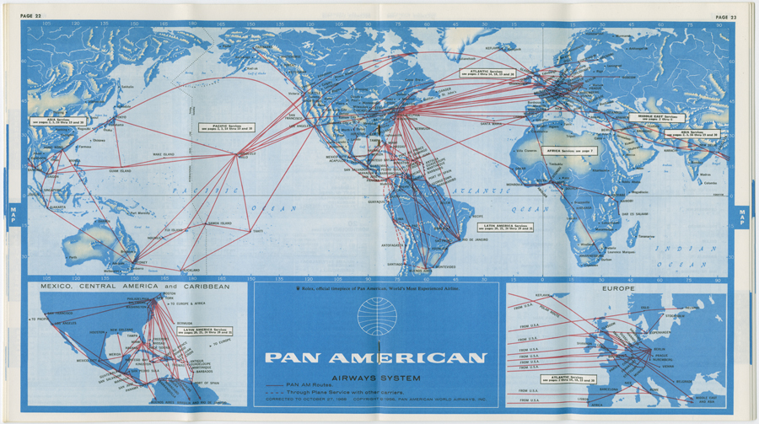
Route Maps and First Flights: Working with the Pan American World Airways, Inc. Records
Steve Hersh
Society of Florida Archivists
2015 Annual Meeting

Slide 2
Research Services for Pan Am records
Departmental policy is to allocate 20 minutes per reference request. Around 5 folders are pulled.
Most patrons are understanding of the limitations, given the size of the collection (1,500 linear feet.)
All patrons register with Aeon, which allows tracking of requests. Very useful when returning to old patron questions.

Slide 3
Answering Questions vs Providing a Collection Overview
Some questions can be answered easily using the finding aid or digital exhibition.
Other patrons have very broad requests, and are better suited to receive an overview of the collection’s holdings that fit their research interests.

Slide 4
Photograph and Document Scans
Some patrons don’t necessarily have a question. They simply need a document or photograph(s) scanned for either research or publication purposes.
The University of Miami Libraries has a duplication and use fee/licensing schedule set up for patrons to understand costs clearly.

Slide 5
Difficult questions and requests
Flight manifests. The collection contains very few.
Personnel records. The collection does not contain the official personnel/HR records. Finding documentation of individual employees is possible, not necessarily probable, within the records.
Digitization of audio/visual material. The collection has a large amount of these materials, but we cannot currently digitize many of the formats.

Slide 6
After the 20 minutes
Patrons are always reminded that they can visit in person to conduct in depth research.
The department keeps a contact list of local proxy researchers, who can work on patrons’ behalf.
Photoduplication services can be provided for a fee, if a patron is interested in looking at certain documents without visiting.

Slide 7
Recent requests
Scans of photographs of Cuban airports.
Thomas Plaskett’s (former Pan Am executive) address to shareholders in 1990.
Scans of photographs of Pan Am planes, for personal use to hang in home.
Ephemera from the Peninsula Kowloon Hotel in Hong Kong.

Slide 8
Sample Request
For many years, I'd heard stories about a Pan Am pilot from the "boat" days named Steve Bancroft. By all accounts he was a real wild and crazy guy. One story: He collected snakes and would bring them back to the States in a sack, so that he would have their skins made into boots. There were lots of stories, and I heard them from more than one person. He was known as a crack "seat of the pants" flyer when he flew down in South America. When he was transferred to the Pacific, he told another pilot, "You know, this is a man's job here!" - meaning he didn't feel all that confident about flying the Pacific. Anyway, I'd never seen any photo, or any official PA document mentioning him. Do you think there might be any way you might find any mention or picture in the archive? (Received February 23, 2015)

Slide 9
Bancroft Fights a Boa Constrictor

Slide 10
Boeing B-377 scan for patron

Slide 11
Questions?

