Slide 1
Working Memory
Celebration, Succession Planning, and Lessons Learned in Florida’s Archival Institutions
---
Erin Mahaney, CA
University Archivist
Harry P. Weber University Archives
Evans Library
Florida Institute of Technology
(321) 674-7632
emahaney@fit.edu

Slide 2
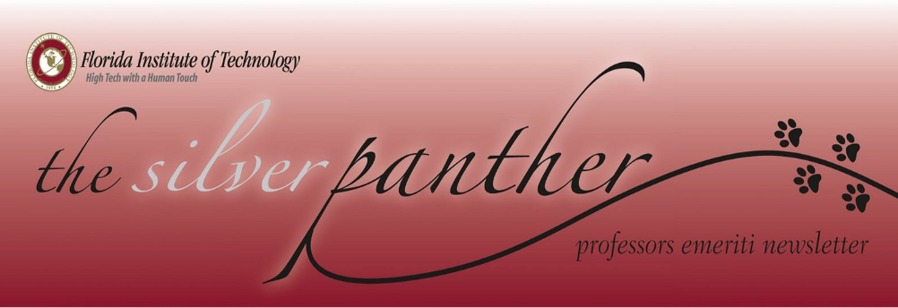
“Silver Panthers”

Slide 3
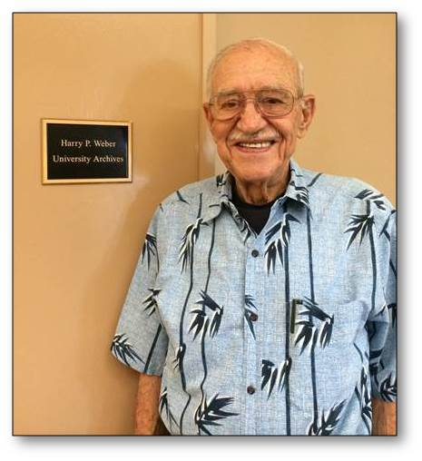
Archival Advocates
“We were so busy looking ahead we didn’t look back.”
-Dr. Harry P. Weber
Photo courtesy of Kathy Turner. http://blogs.fit.edu/blog/campus/library/dr-harry-weber-visits-harry-p-weber-university-archives/

Slide 4
Goals and Objectives
Maintain ongoing positive engagement
Capitalize on enduring commitment
Validate investment
Channel strengths

Slide 5
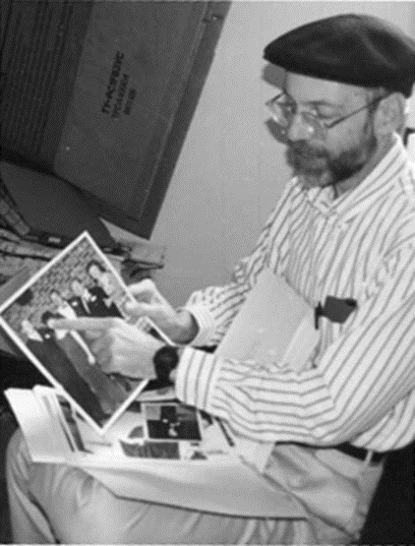
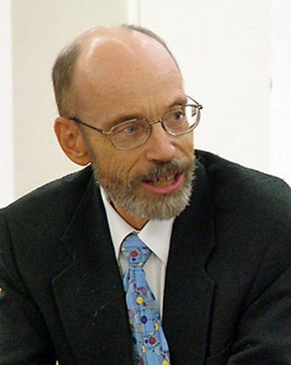
Advocacy and Support
Advocate
Campus
Broader community
Support
Share Knowledge
Fundraise
Volunteer
Dr. Gordon Patterson, upper right photo c.2000 from The Communicator, Winter 2008, Vol XI, Issue 1.

Slide 6
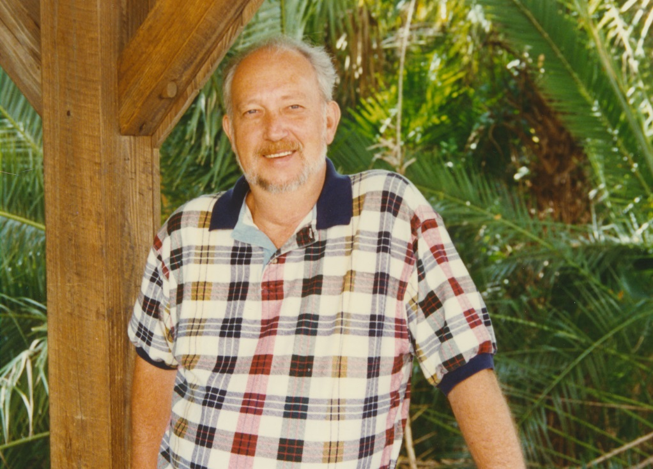
Emeriti Volunteering
“I'm part of the history of the university, and it's important for the faculty to be involved. I want to be part of the archiving process, the university, it's a big part of my life.”
- Dr. John Morris
Photo courtesy of Creative Services, Florida Institute of Technology.

Slide 7
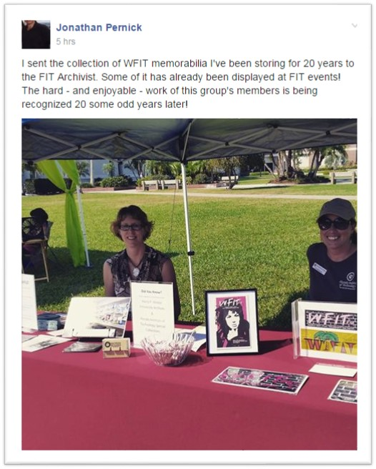
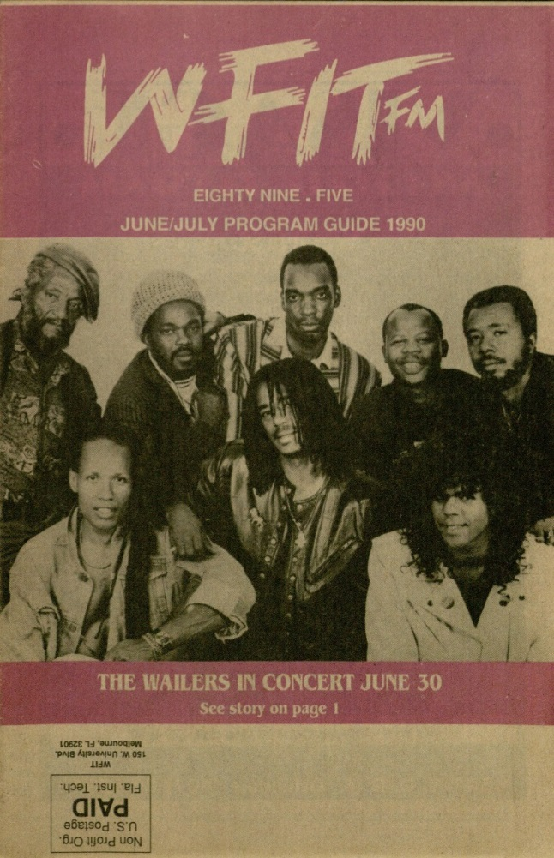
WFIT 89.5 FM
WFIT Collection, Harry P. Weber University Archives.

Slide 8
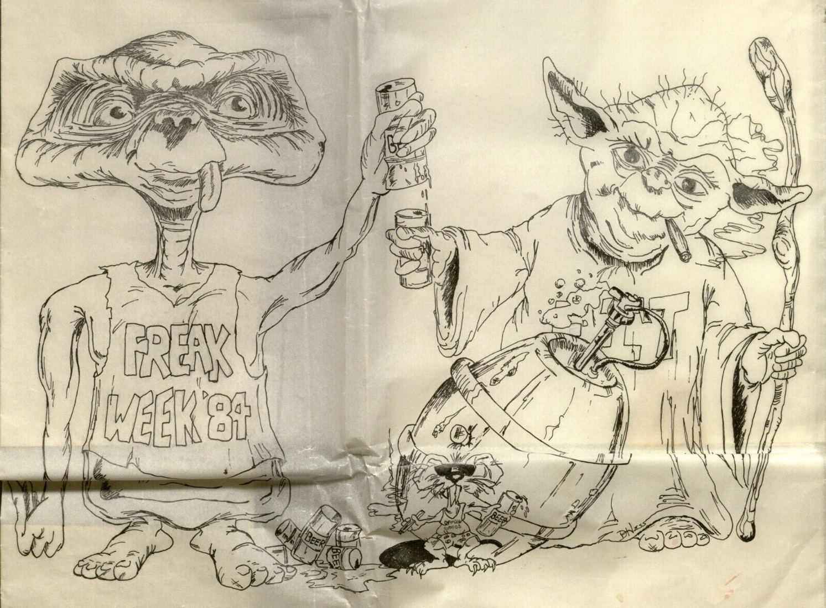
Sub- and Counter-Cultures
This item is part of the Squamish Collection, artist Dan Hess, donated by Jonathan Pernick.

Slide 9
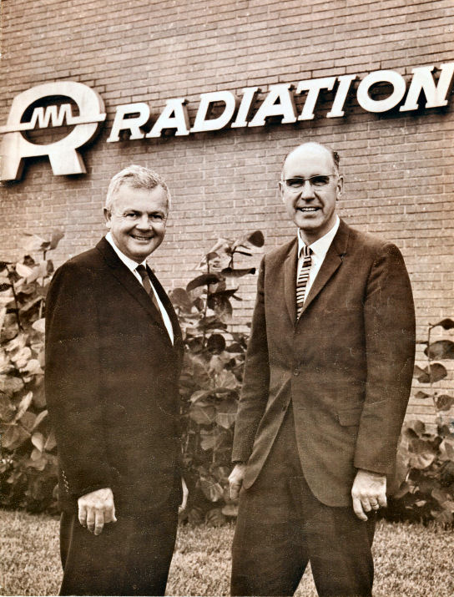
Radiation Inc.
Photo courtesy of Frank Perkins http://radiwiki.wikispaces.com/

Slide 10
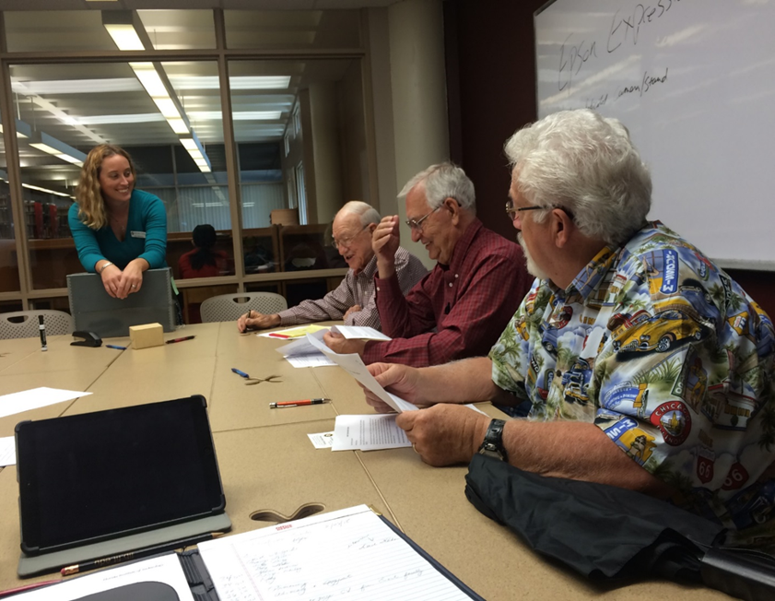
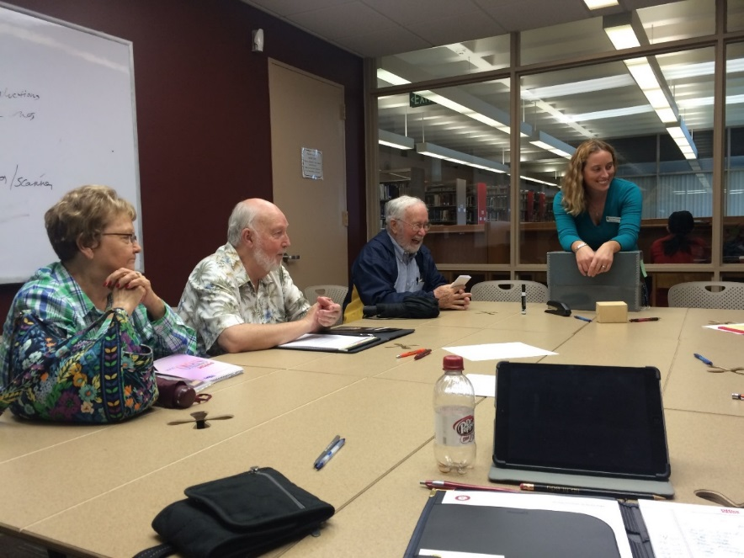
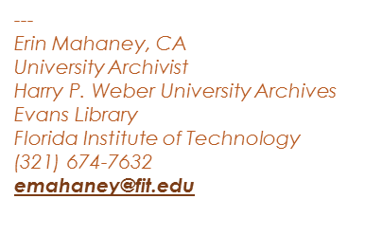
Working Memory

