Slide 1
You want what?
Responding to patron duplication requests
Society of Florida Archivists
May 15th, 2015
Notes:
Hello, thanks for inviting us
Intro Garret
Intro Mary
Show of hands:

Slide 2
Orange County Regional History Center Patron Duplication Policy
By Garret B. Kremer-Wright, CA
Archivist

Slide 3
Patron Duplication Request
We have a policy and procedure in place
We make photocopies and digital scans for researchers
Unless restricted by copyright we will provide duplication of material
  Fees charged
    $0.25/page for photocopies (paper size and type of output does not matter)
    $10/image to provide high resolution digital scan (300 or 600 dpi)

Slide 4
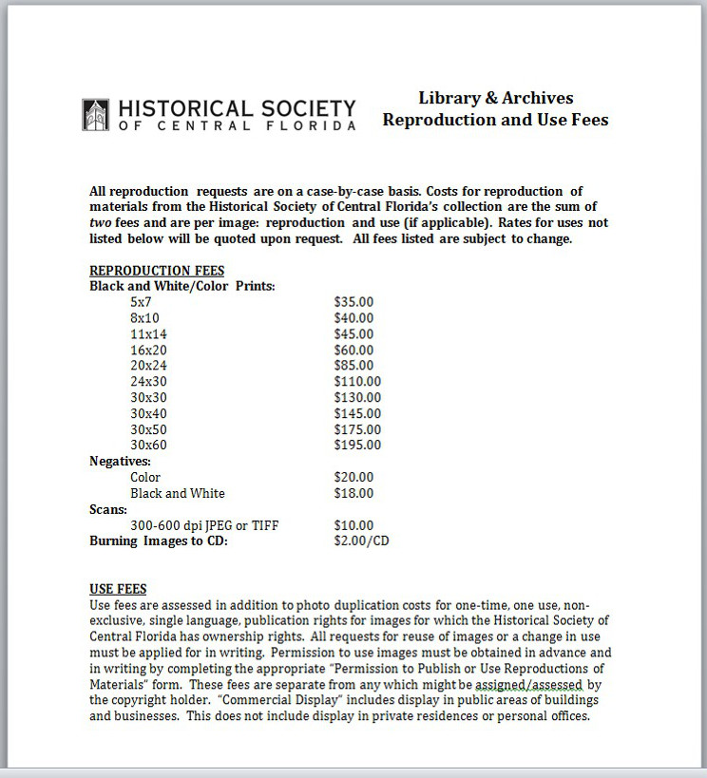
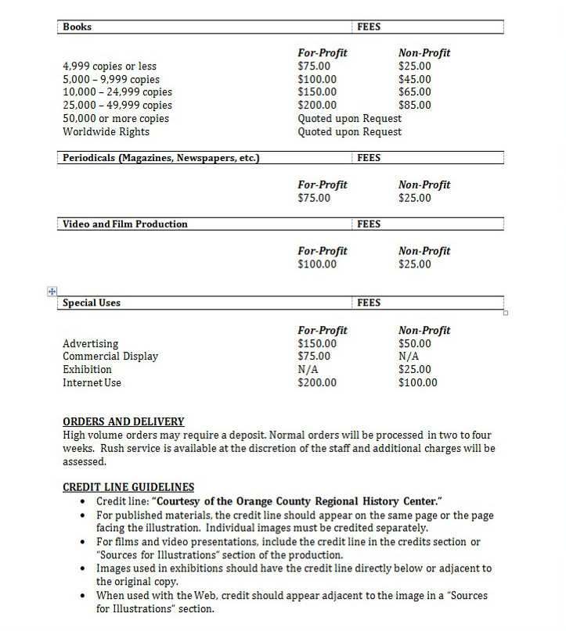
Library and Archives Reproduction and Use Fees

Slide 5
Duplication vs. Usage Fees
Duplication Fees
  Used to cover staff time and continue ongoing preservation of collections held in our repository
  Are able to charge a nominal fee for services provided (as a non-profit)
  Duplication for research purposes only

Slide 6
Duplication vs. Usage Fees
Cont’d
Usage Fees
  Prices were determined after consulting other similar organizations in the region
  Have different fees for for-profit and non-profit organizations
  Waiver of these fees can only be done by Executive Director of organization
  Copyright must be obtained by researchers; we have an additional “Permission to Reproduce” form they sign

Slide 7
Issues regarding Duplication
Material can end up on social media sites or publications without proper credit
Organizations can not control what researchers do with material once it leaves repository

Slide 8
UCF’s Established
Duplication System
Mary Rubin, Senior Archivist

Slide 9
UCF’s Background
University of Central Florida is the 2nd largest university in the nation with 61,000+ students.
  Founded in 1963 and located in Orlando, Florida.
Special Collections & University Archives (SCUA) in the John C. Hitt Library
One Archivist for Special Collections & One Archivist for University Archives
    One Assistant to run the Reading Room, manage statistics, pull materials, etc.

Slide 10
University Archives
60+ Collections covering University History, Presidential Records, Athletics, Branches, Offices, Services, and Programs
  Finding Aids: http://ucfarchon.fcla.edu/
  ~915 linear feet of materials: ~600 processed, ~315 unprocessed (as of June 30, 2014)
Limited materials in Digital Collection
  http://digital.library.ucf.edu/cdm/landingpage/collection/ARC

Slide 11
Philosophy
If it can be done, it will be done!
Things to consider:
  Control
  Copyright
  Deadlines (patron’s & department’s)
  Delivery Options (photocopies, photoduplication, digital copies | low or high res)
  Outstanding Duplication Requests
  Priority

Slide 12
Copyright
UCF’s General Council is drafting a copyright policy, involving Business Services, Marketing, Athletics, and SCUA
Commercial endeavors are referred to Business Services
Non-Commercial users must go through the appropriate department, depending on the materials they want
  SCUA & Marketing share materials

Slide 13
Charges
Pricing Schedule determined prior to my arrival
  http://library.ucf.edu/SpecialCollections/Forms/ReproductionCostForm.pdf
  Link to change in July ☹
Fees are not handled in-house, must go through:
  Interlibrary Loan for American Express, Discover, MasterCard, or Visa
  Accountant in Administration for internal payments through departments
Use fees differ, non-profit vs. commercial
  In certain circumstances, waived for UCF students, faculty, & staff

Slide 14
Building a consistent duplication program – the UF approach
Cathy Martyniak
Digital Asset Manager

Slide 15
Background
UF Special and Area Studies Collections (SASC)
15 collections including Florida History, Children’s Literature, University Archives, Popular Culture, etc., containing all formats
Historically, no coordination when responding to duplication requests
New SASC management approved creation of consistent system, including drafting of policies, work flows, fees, forms, etc.
Reproduction process group started April 2014
Notes:
Many years, loosely affiliated collections, not strong central management
needed to be consistent in order to lower risks
RPG had digital production person on it,
Working slowly, amongst other responsibilities for a year
Updates regularly with supervisor, occasionally to larger group

Slide 16
General questions we asked
  How ‘available’ do we want to make our content?
  Who will do the work? What are the work flows?
  Do we have enough documentation to understand limitations with our collections??
  Do we want to charge any fees? What kinds of fees to charge? How can we accept funds?
  How best to deliver requested content?
Notes:
Philosophy – how open do you want to be?
Duplication fee (somewhat to recover the cost to actually do the work)
Use/license/permission fee (a fee [usually] to help the organization holding the materials
We chose to do no more photocopying, because it is hard physically on the materials – scan only, keep digital copy and maybe even make it available online if copyright allows

Slide 17
Early work
Interview curators
Conduct a peer review
Consider technology
Start drafting guidelines
Notes:
Interviewed all 15
to determine their specific issues
scope of their work
If you are a lone arranger, can obviously skip this step
Who counts as peer?
I got list from library admin office, national peers
For you it could be locals, other house museums, etc.
What to review:
Policies
Fees
Delivery method
If I saw something I really liked, I copied or saved link
Logistics
spreadsheet
web site
Phone calls

Slide 18
Notes:
Summarized outcome of peer review in the area of fees

Slide 19
Now and in the future…
Applying centralized guidelines to all requests within all 15 units
Assessment effort
Expand payment options
Monitor over time
Notes:
NOW:
Looking at research assistance: 15 minutes free? 30? Where to draw THAT line..
Assessment stage – tracking jobs, hours, money
FUTURE:
Want to accept credit cards – very difficult in our environment
Is it even worth it to charge? we could modify – only charge commercial patrons for instance..

