Slide 1
Wrangling a Ringling: The Personal Art Library of a Circus Magnate

Slide 2
Circus King
Ringling Brothers poster, c. 1898

Slide 3
The Ringling Museum

Slide 4
The John Ringling Library

Slide 5
The John Ringling Library

Slide 6
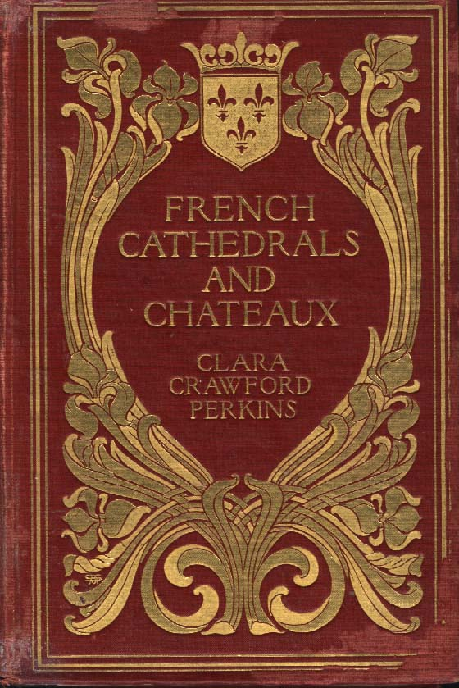
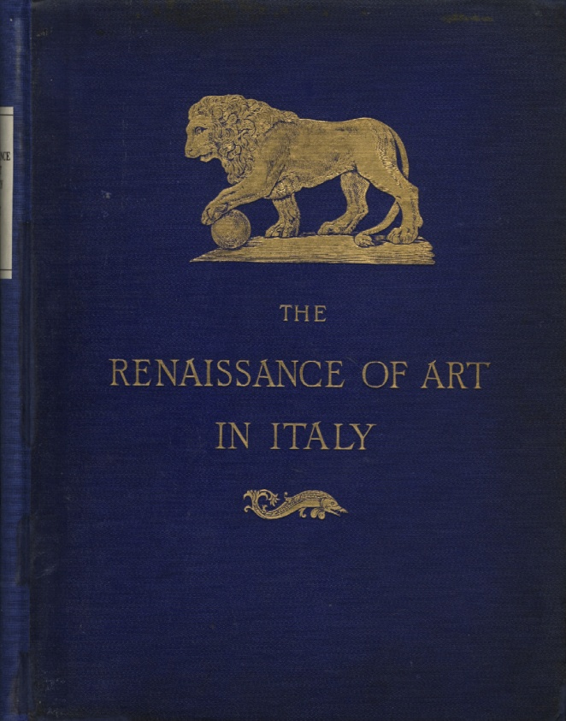
Collection Analysis
By Franz Reber, 1890
By Leader Scott, 1883
By Clara Crawford Perkins, 1903

Slide 7
Collection Analysis

Slide 8
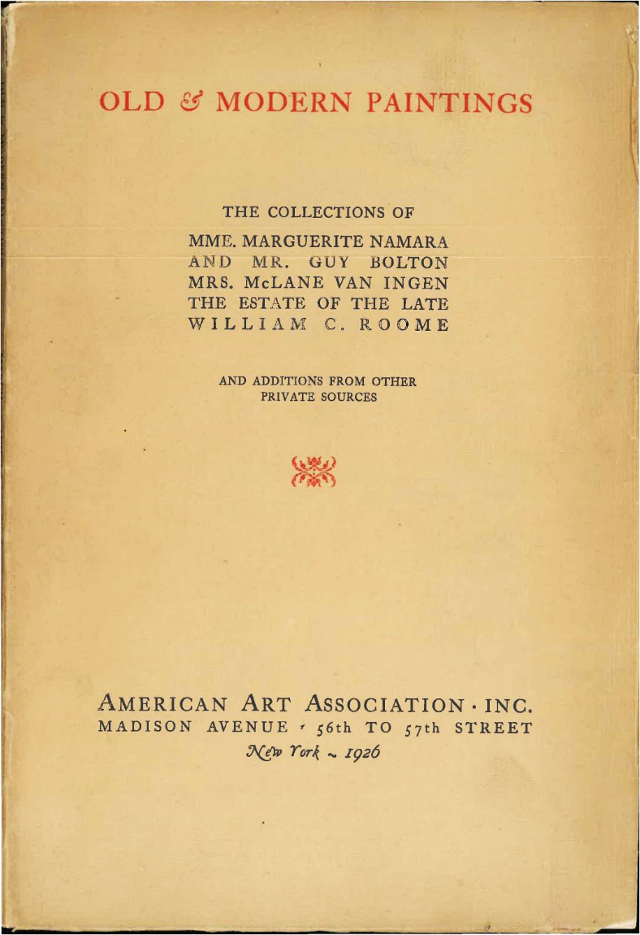
Library Archives

Slide 9
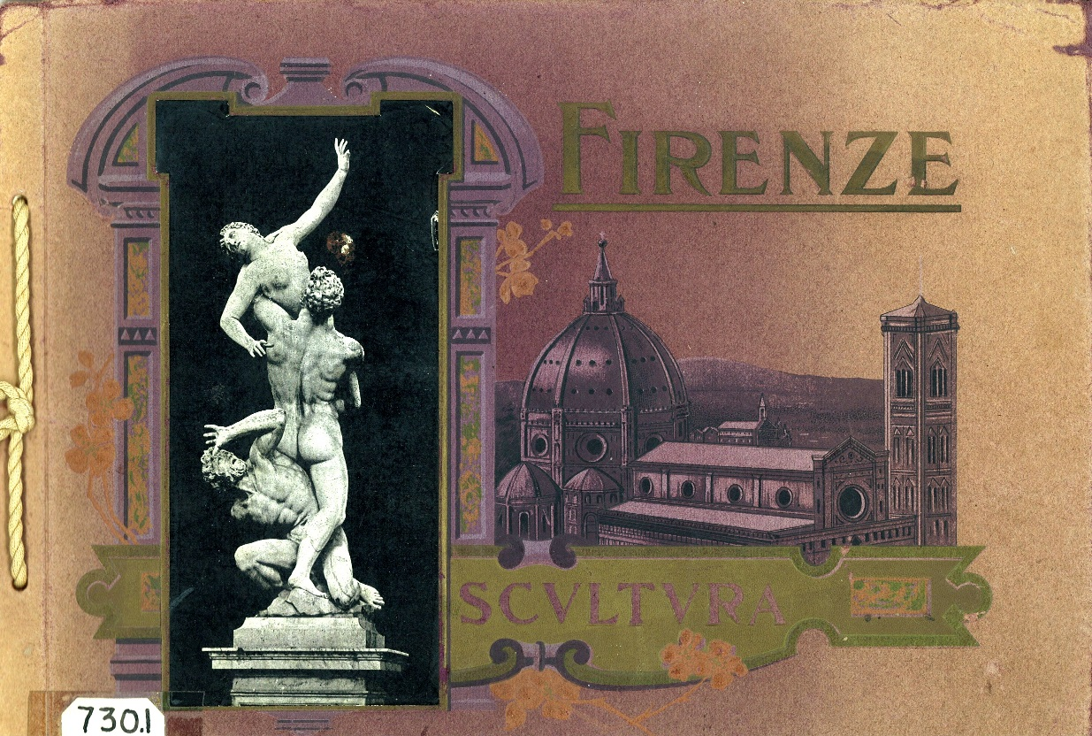
Project Results
Sculture artistiche delle gallerie di Firenze, c.19??
Christie's : Season 1928-31., c. 1929

Slide 10
Thank You!

