Slide 1

Metadata at the Museum:
Processing Visual Materials
at the Wolfsonian-FIU.

Slide 2
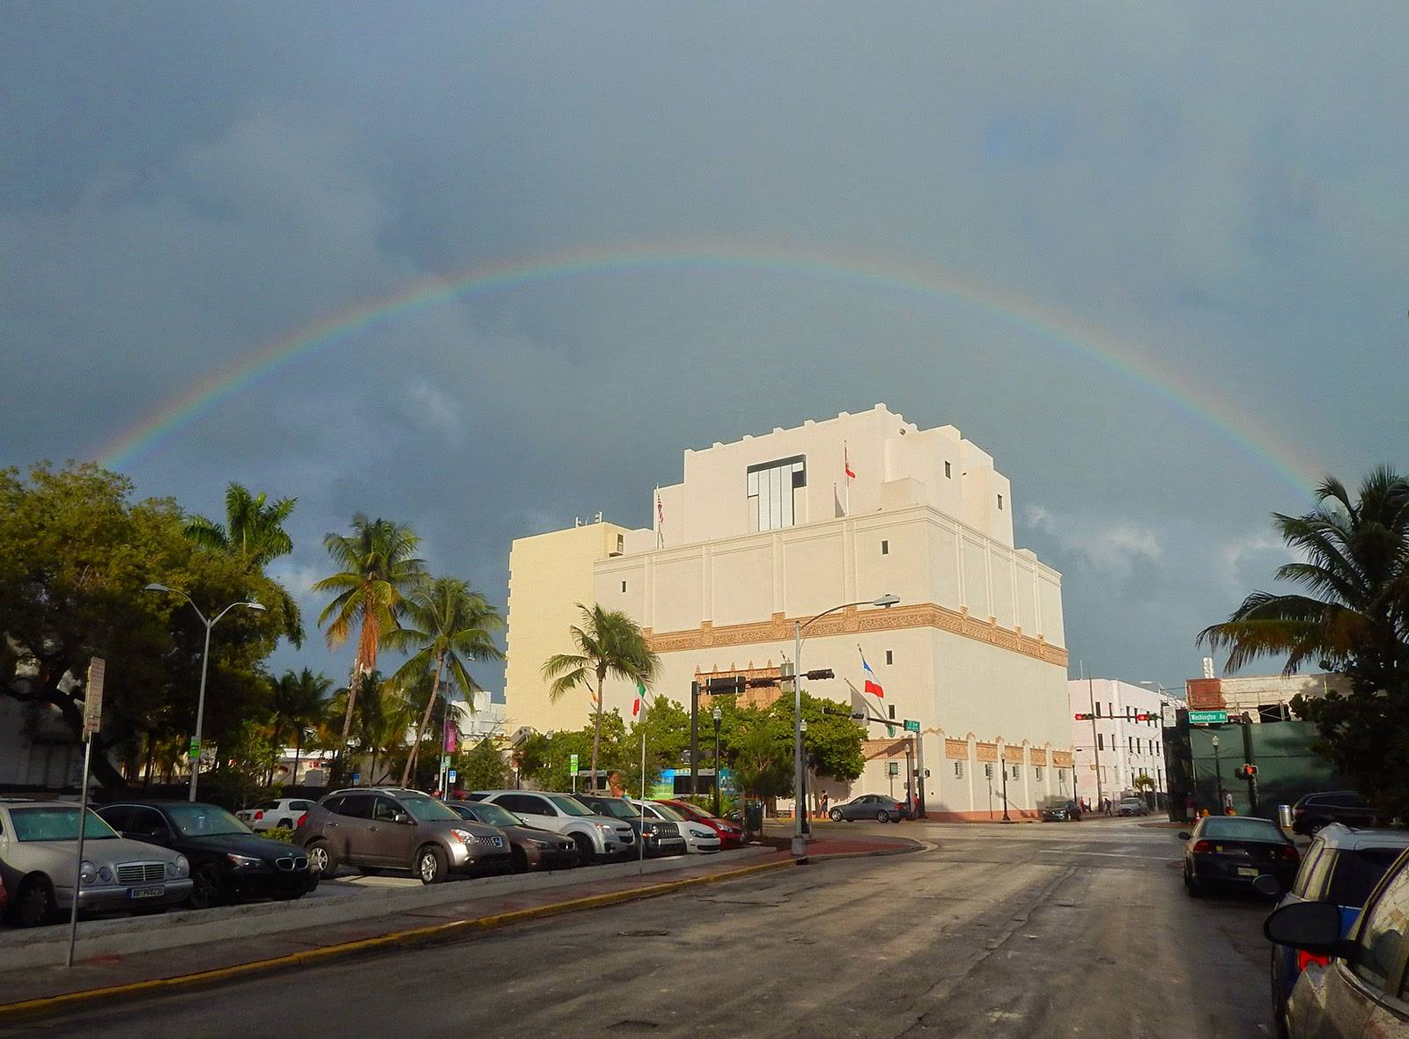
The Wolfsonian-FIU collection consists of approximately 120,000 objects and 60,000 books, plus thousands of pieces of ephemera.

Slide 3
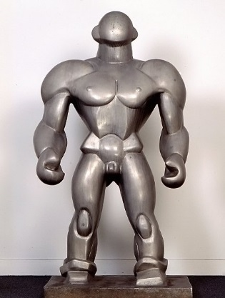
These works were primarily made during the advent of modernity through World War II. Thematically and historically, pieces speak toward design, industrialization, propaganda, fascism, and international decorative arts.
The Wrestler.
Dudley Vaill Talcott (1899-1986), American sculptor.
Aluminum, 1929. Shown at the 1932 Olympics, Los Angeles, CA.

Slide 4
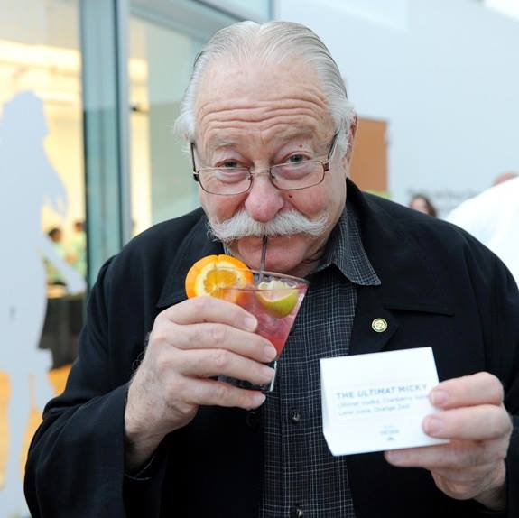
Where did all this stuff come from?

Slide 5
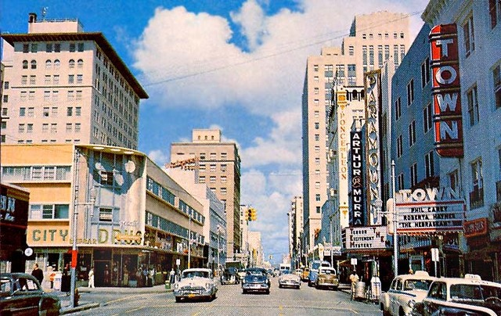
Mitchell Wolfson, Jr., known as “Micky,” possesses the means, education, artistic eye and contextual insight to acquire meaningful books and objects. As a child Micky purchased souvenirs on his many exotic travels with his family. His father, who passed away in 1983, was an entrepreneur. Wolfson Sr. founded the Wometco movie theater chain, which sold for $1 billion at the time. Thus the younger Micky’s cultivated habit of collecting escalated with his sizeable inheritance as an adult.

Slide 6
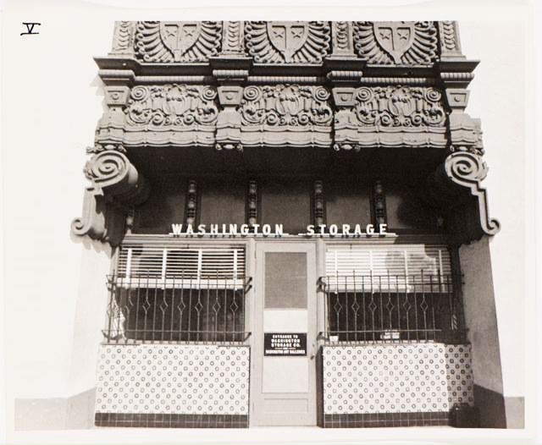
Micky soon needed storage space for his purchases. It didn’t take long for him to fill the Washington Storage Company on Miami Beach.

Slide 7
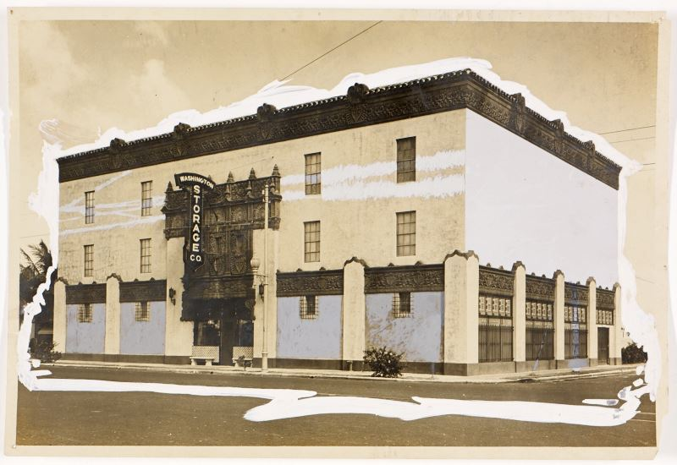
As a result, it was necessary for him to buy the building.

Slide 8
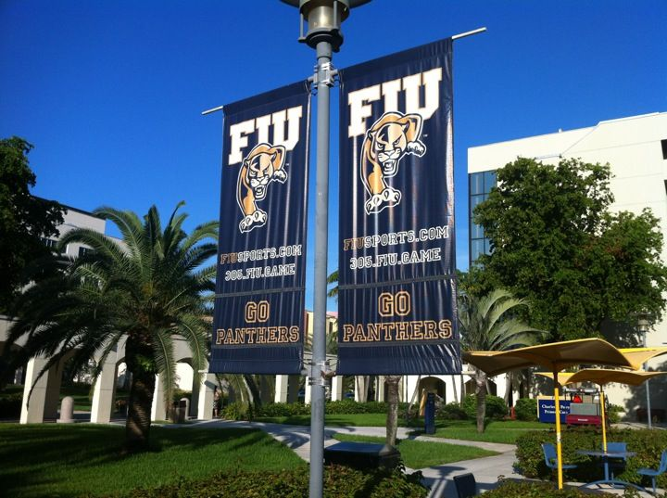
Micky hired an architect to renovate the building and added staff to catalog the massive collection. Eventually the museum opened to the public, and later became part of Florida International University.

Slide 9
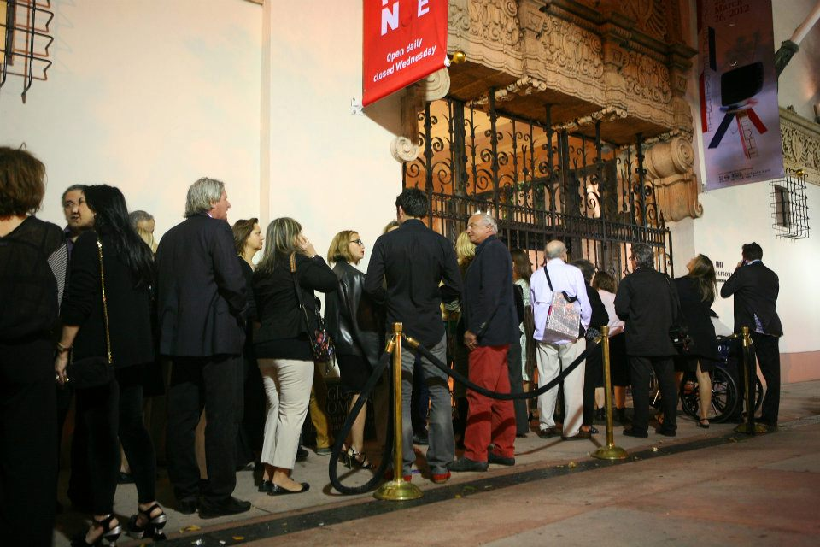
The Wolfsonian-FIU became a mecca for art & culture on South Beach.

Slide 10
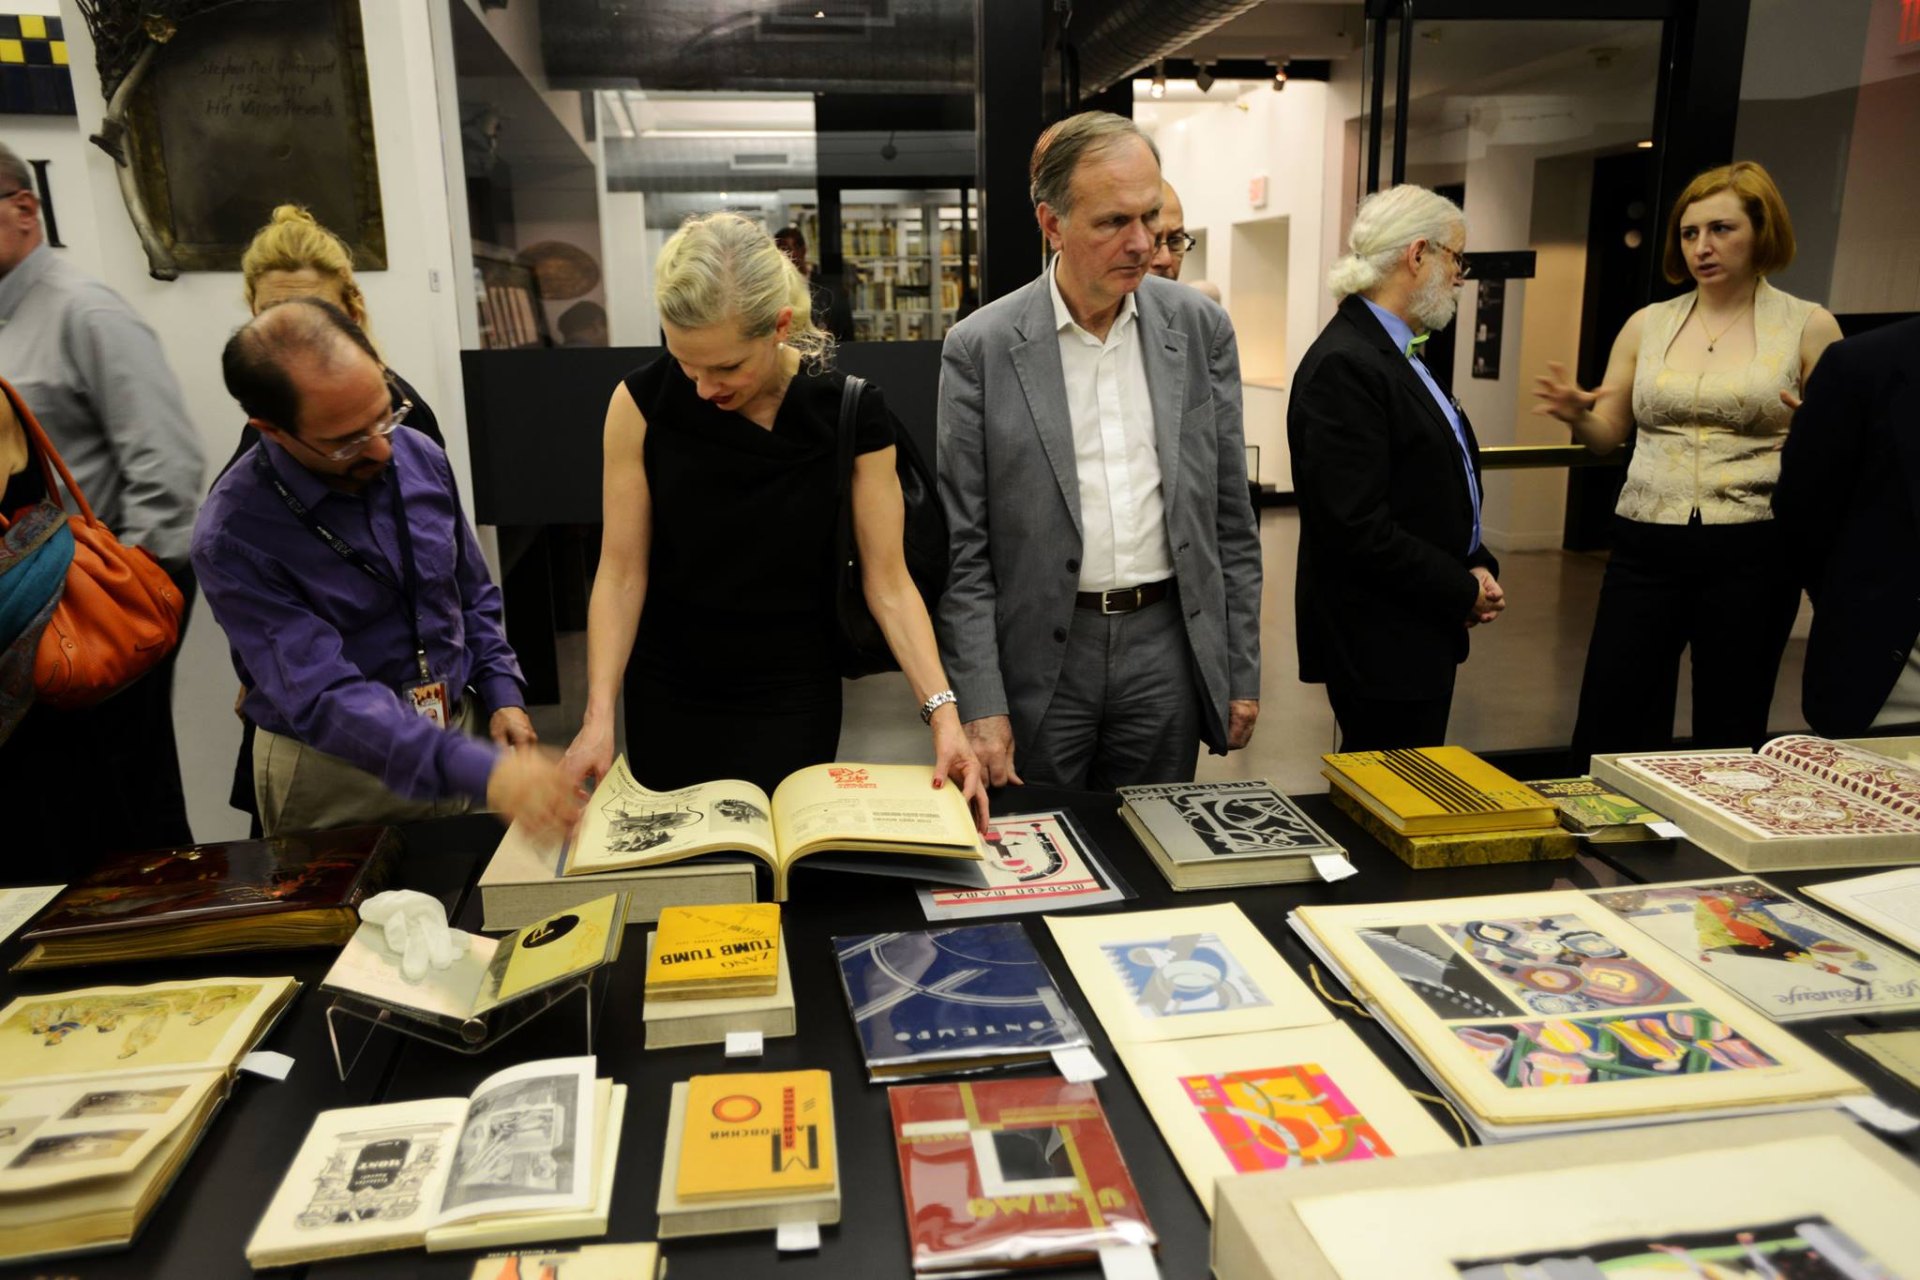
The Library is a popular stop on the Art Basel circuit. The materials spark creativity in visitors.

Slide 11
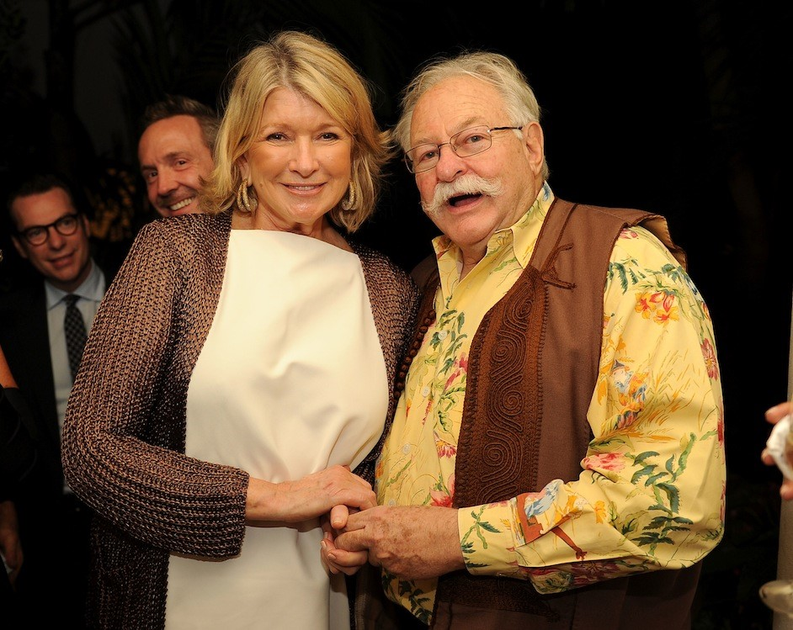
This photo is from Anthony Bordain’s historic ocean liner feast at the Wolfsonian-FIU. Bordain came to the library during the South Beach Wine and Food festival to see antique menus from our extensive cruise company collection. He was inspired to host a seven course affair in our lobby.

Slide 12
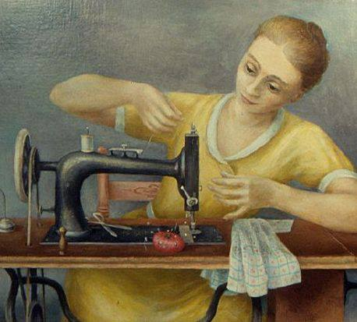
The museum, then, presented an interesting equation of art and objects + books and images. Registrars and historians were employed at the outset to create inventories and catalogs of items. Educational programming and exhibits made use of all parts of the collection.
Currently curators oversee the object collection, http://digital.wolfsonian.org/WOLF020405/00001
Girl Sewing.
Doris Emrick Lee (1905-1983), American painter.
Oil on canvas, 1931.

Slide 13
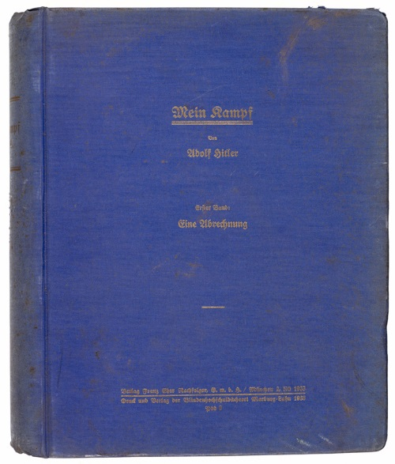
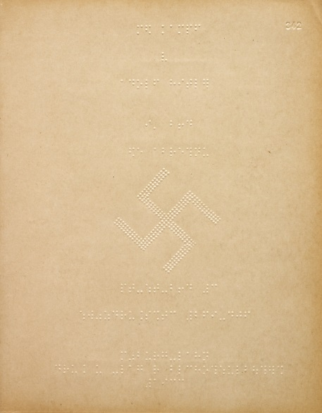
while librarians oversee the book collection.
http://digital.wolfsonian.org/WOLF049536/00001
Once technology came into play, records for both collections were entered into different databases.
Objects were loosely described in “Rediscovery,” while books were cataloged using MARC code in EOS.

Slide 14
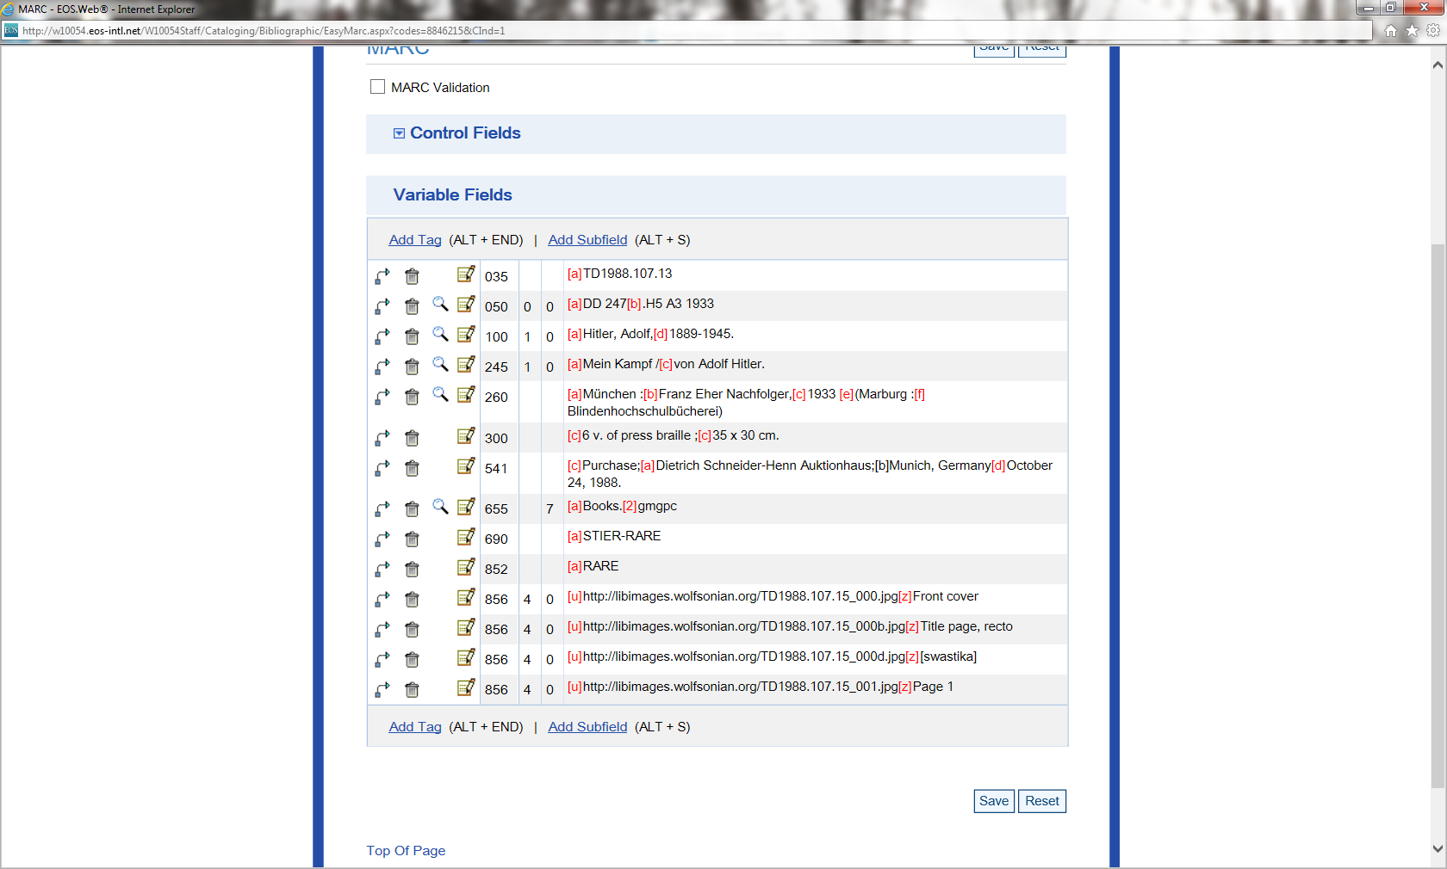

Slide 15
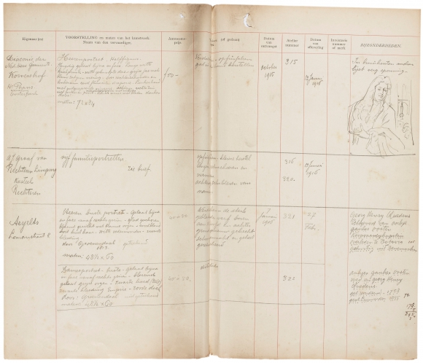
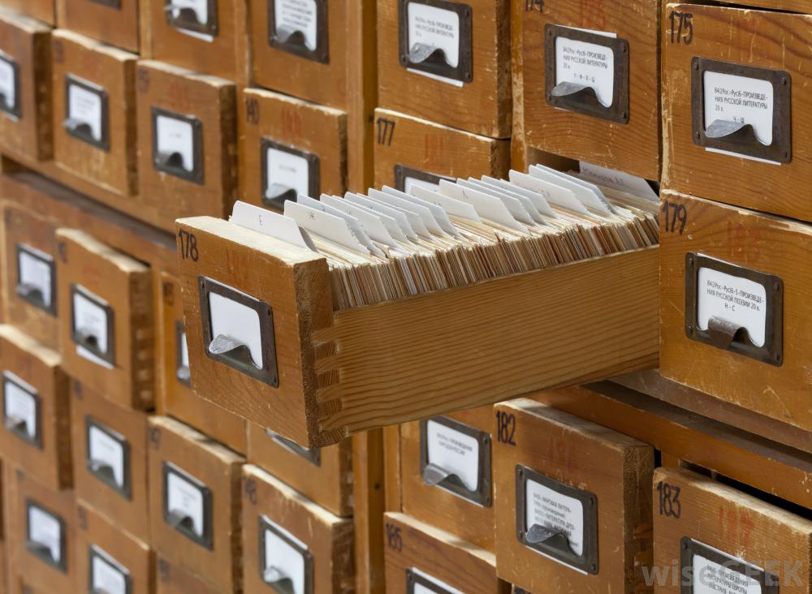
Brief History of Information Systems at The Wolfsonian - FIU
Library Catalogs:
Legacy DOS/MARC system
EOS (now owned by sirsidynix)
Collection Inventory Database:
ReDiscovery (now called ReDiscovery Proficio)

Slide 16
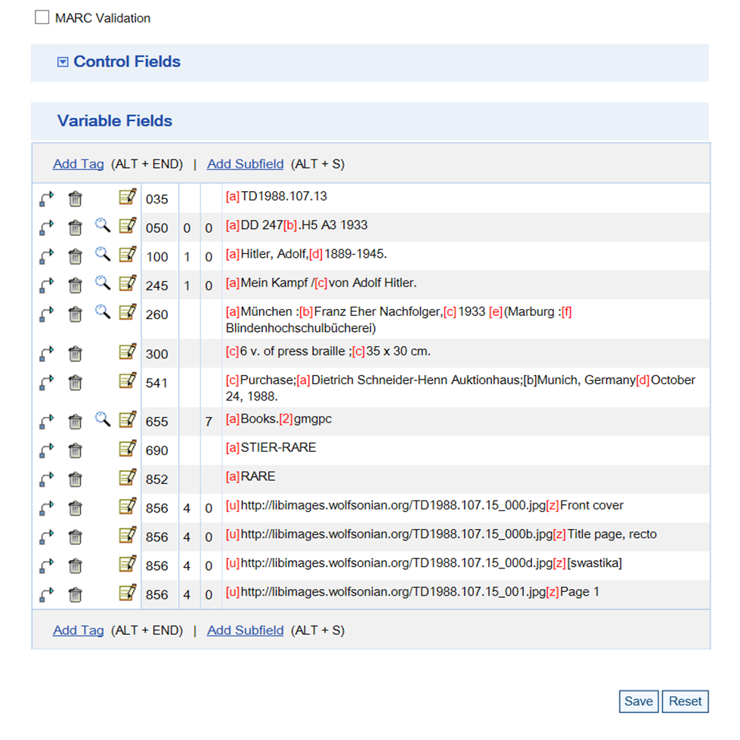
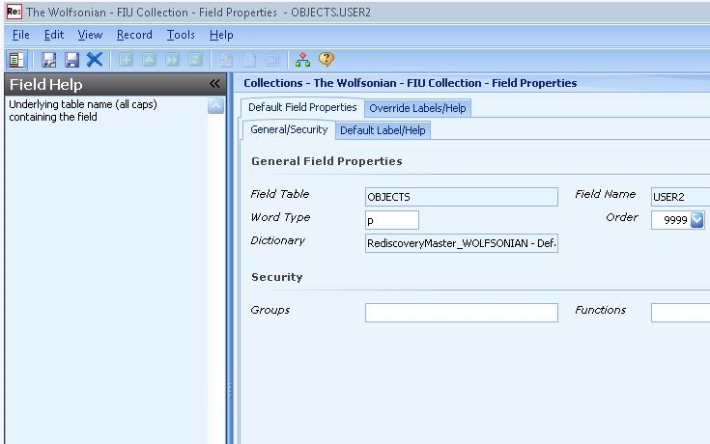
Librarians Catalog
MARC
LOC subjects
Book-centered
Registrars Inventory
Format dictated by software
Object/Item-centered

Slide 17
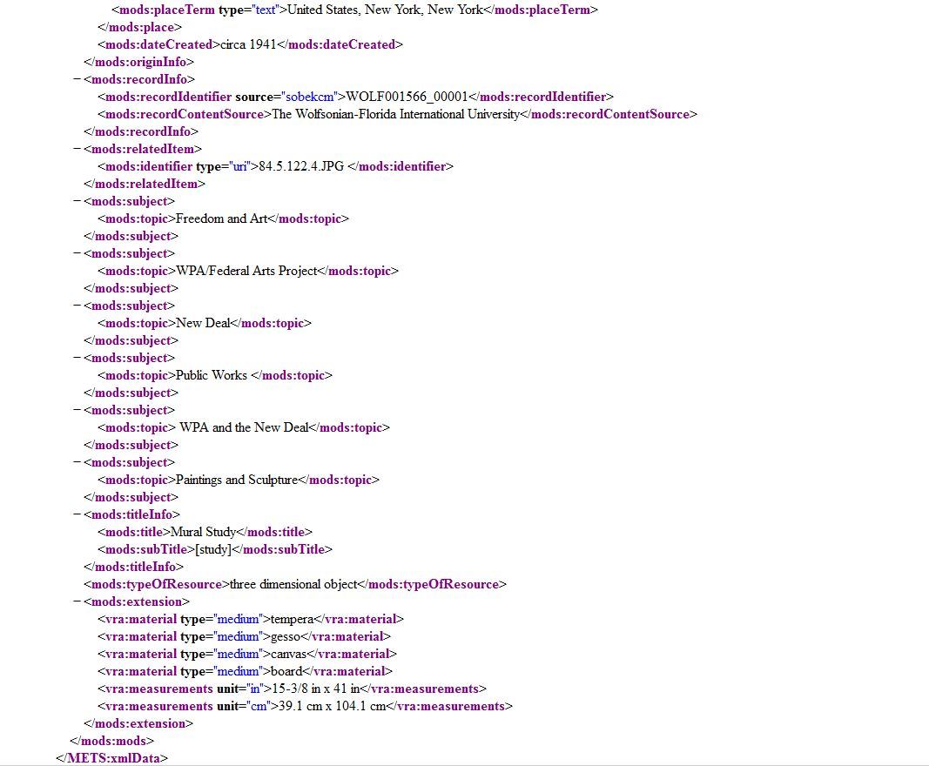
Shared catalog records in the digital collection:
Crosswalk MARC -> MODS (LOC stylesheet) Crosswalk Object DB to MODS (made it up)

Slide 18
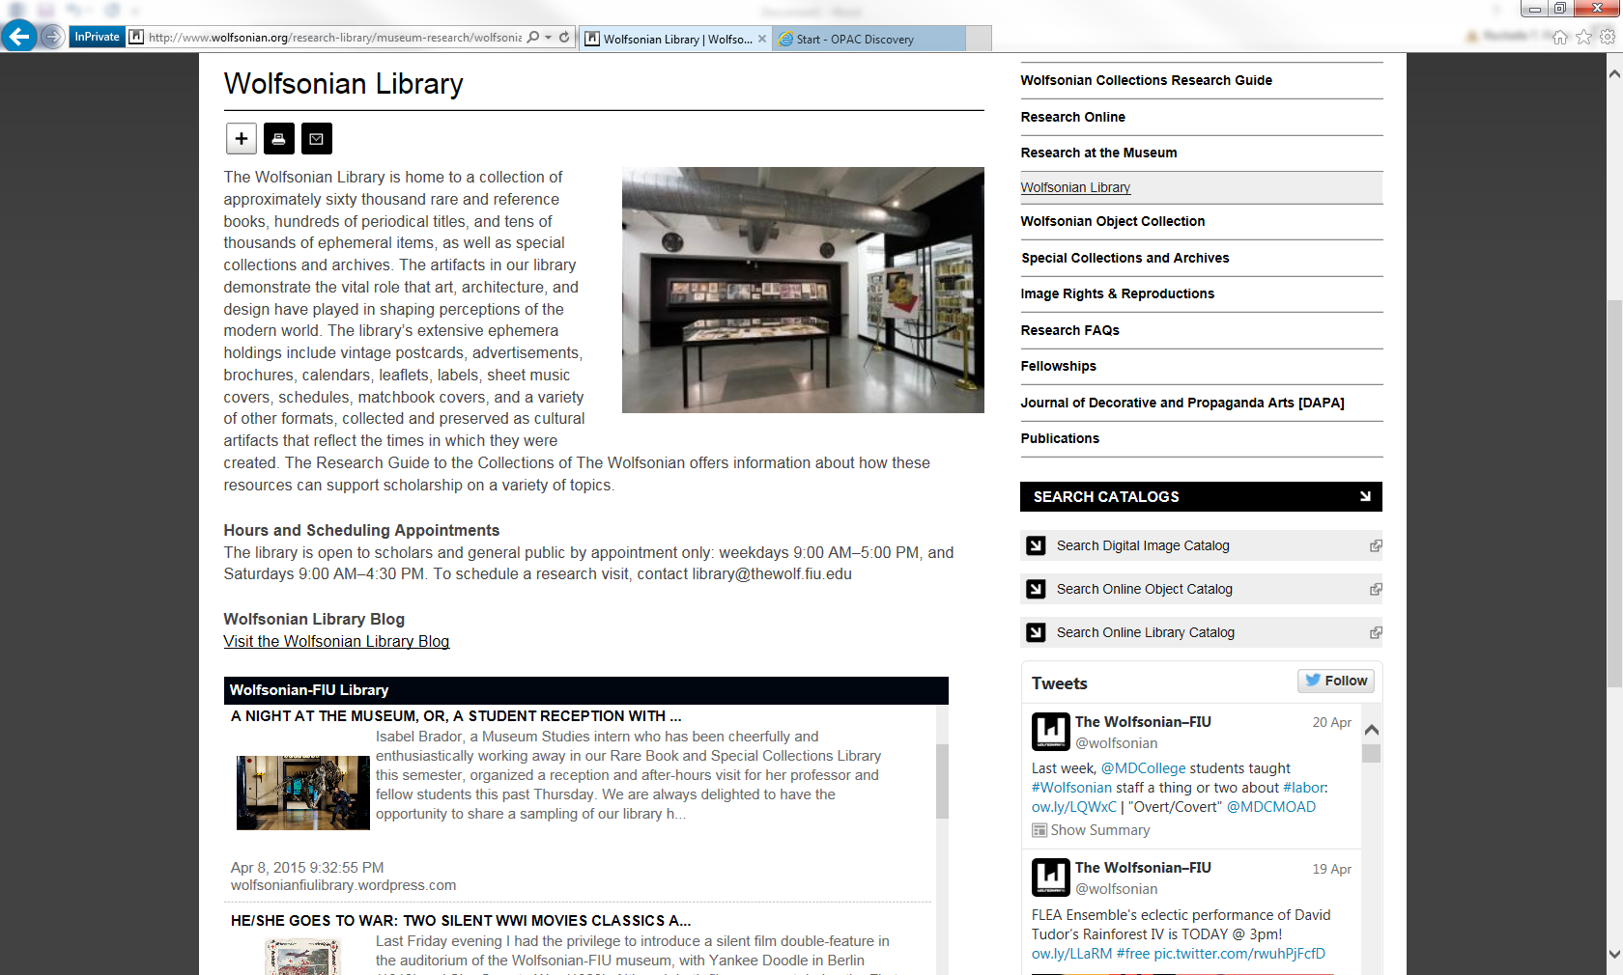

Slide 19
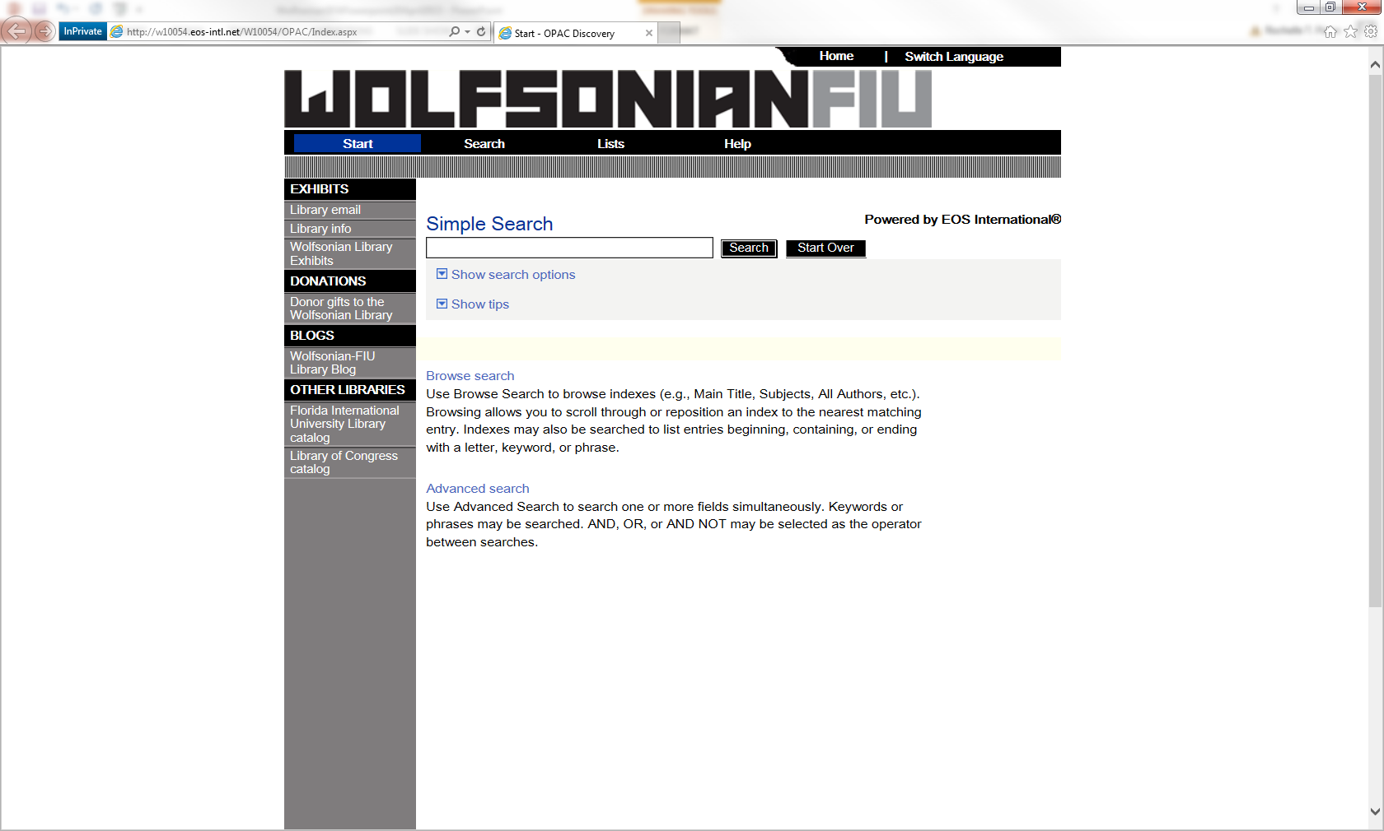

Slide 20
Early library staff focused on getting as much of the collection in the online catalog as possible for the sake of public access.
Often what was generally understood in the profession as best practices would be curbed as a result of unique filing systems from the past, shortcomings of the EOS system, lack of specialized staff, or the library’s actual physical organization.
Brief records entered disregarded even the nominal respect for use of delimiters in tech format – in non-cataloging speak, stuff was just typed in, often without proper coding.

Slide 21
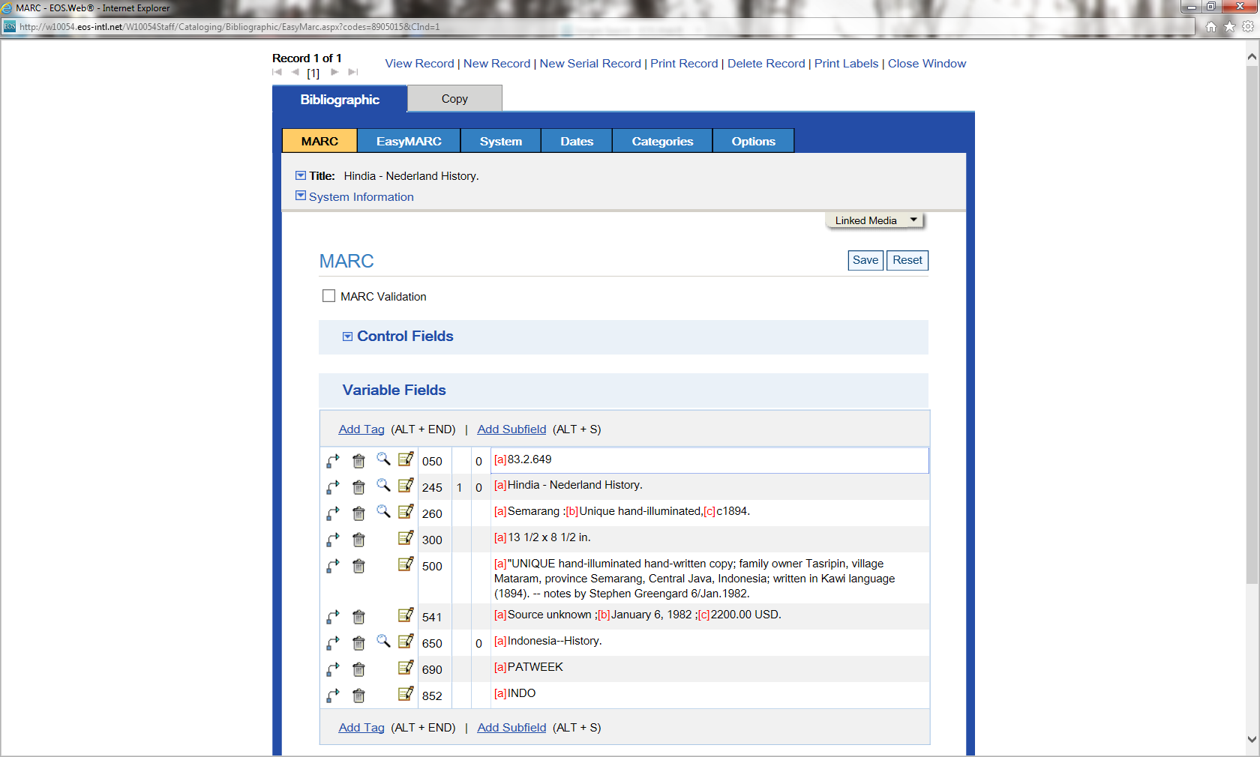

Slide 22
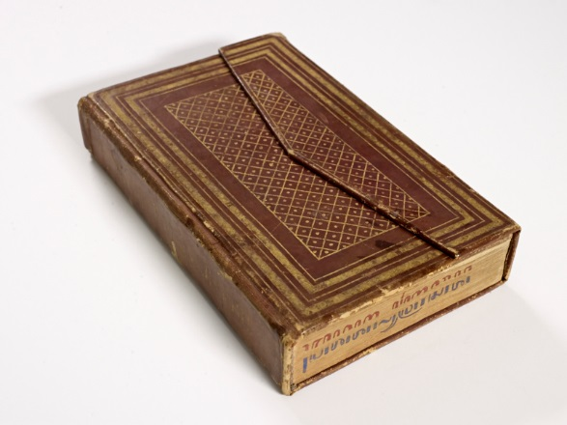
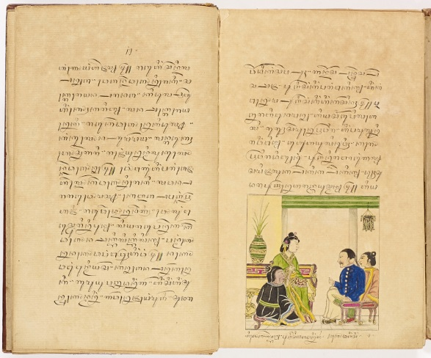
There’s actually little known about this volume, but perhaps a clean record could increase access.

Slide 23
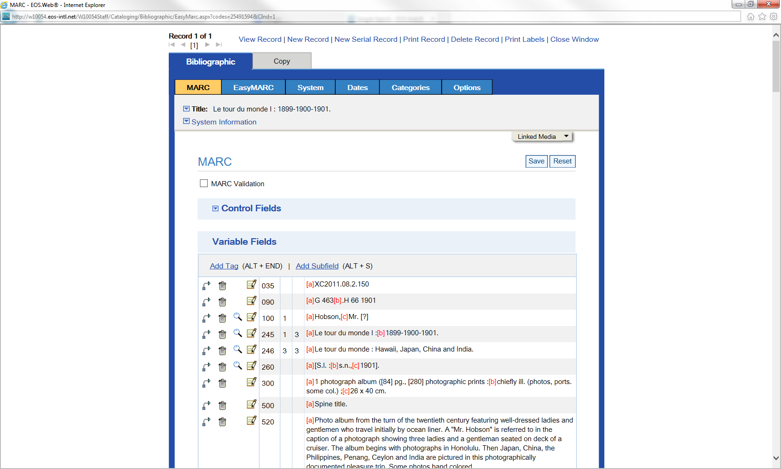
More recent records, such as this original one I created for a photograph album in the Jean S. and Frederic A. Sharf Collection, are clean in MARC code, rich in subject headings, and bottom-heavy with metadata links.

Slide 24
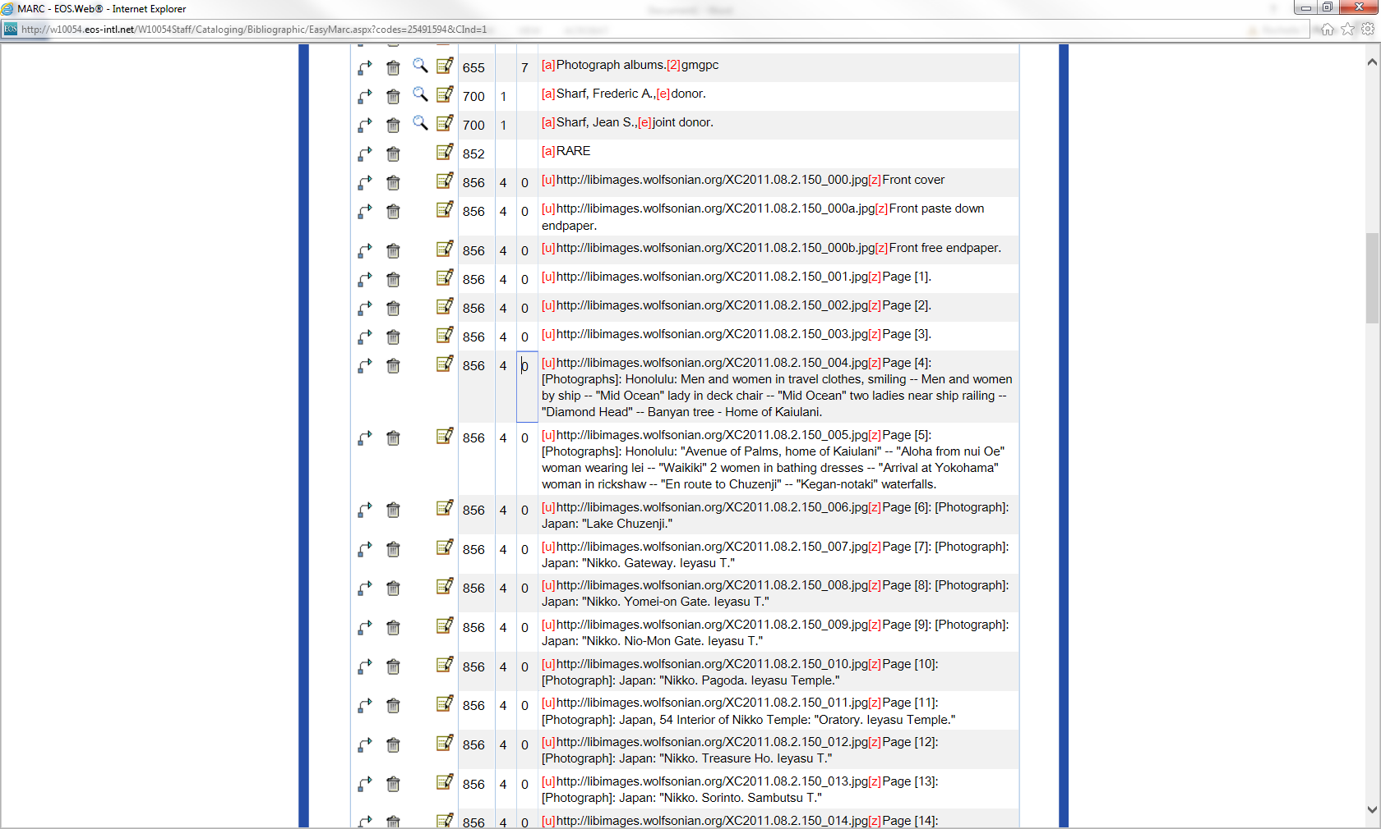
This record has eighty-seven 856 fields, which were all manually entered into the MARC record. Each corresponding image was photographed and stored on a server.

Slide 25
This same record now can have one single link that points to the Digital Collection record

Slide 26
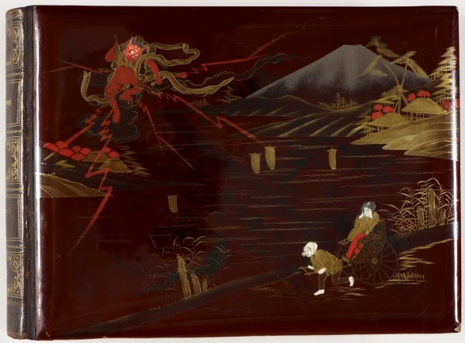

Slide 27
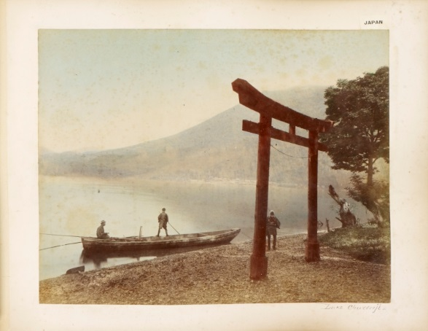
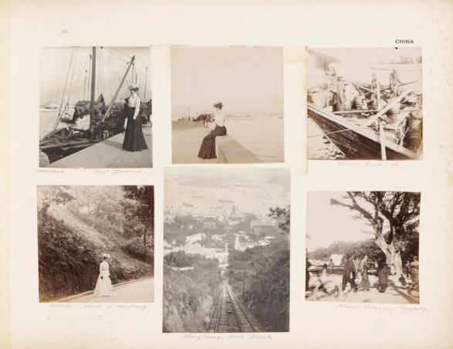

Slide 28
New and updated records from EOS and Rediscovery are loaded to SobekCM on a regular basis
http:library.wolfsonian.org
http://digital.wolfsonian.org
Librarians post original blogs incorporating new images into contextual narrative
https://wolfsonianfiulibrary.wordpress.com/2015/04/08/a-night-at-the-museum-or-a-student-reception-with-wolfsonian-fiu-rare-book-librarians/
New 360 degree virtual exhibitions allow distance patrons to “walk through” displays and link to digital records where they can “page through” scanned items
http://labs.wolfsonian.org/exhibits/panama/

Slide 29
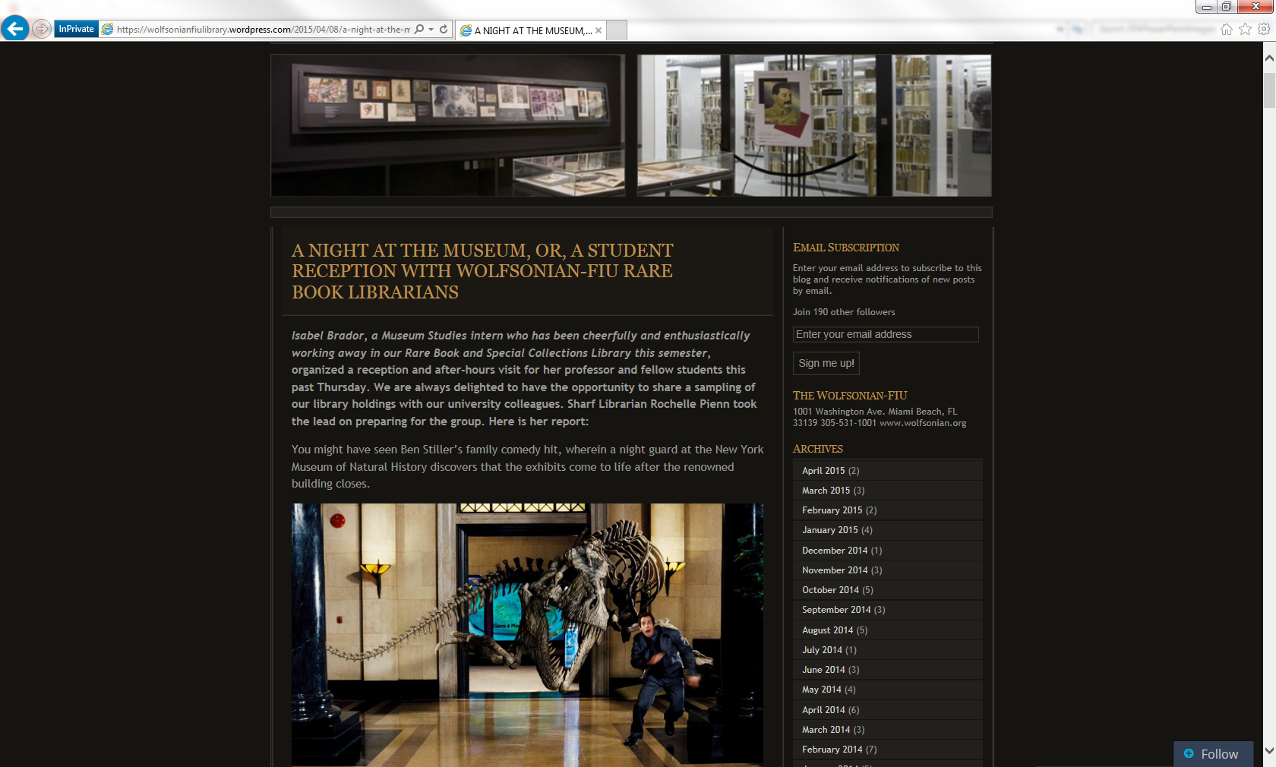

Slide 30
Thank you. Come visit us!
Derek Merleaux
Digital Asset Manager
derek@thewolf.fiu.edu
Rochelle T. Pienn
Sharf Associate Librarian
rochelle@thewolf.fiu.edu

