Slide 1
THE COMMENTS SECTION
A Story of Butterflies, Sunny Days, and Cruises

Slide 2
@um_spec_coll background
First post July 15th, 2013
100 followers in September 2014
Developed daily posting routine
Identified other Special Collections profiles
Identified local and collecting focused profiles

Slide 3
@um_spec_coll background
First post July 15th, 2013
100 followers in September 2014
Developed daily posting routine
Identified other Special Collections profiles
Identified local and collecting focused profiles

Slide 4
@um_spec_coll background
First post July 15th, 2013
100 followers in September 2014
Developed daily posting routine
Identified other Special Collections profiles
Identified local and collecting focused profiles

Slide 5
Dueling Butterflies
Les papillons: métamorphoses terrestres des peuples de l'air

Slide 6
En Guarde!

Slide 7
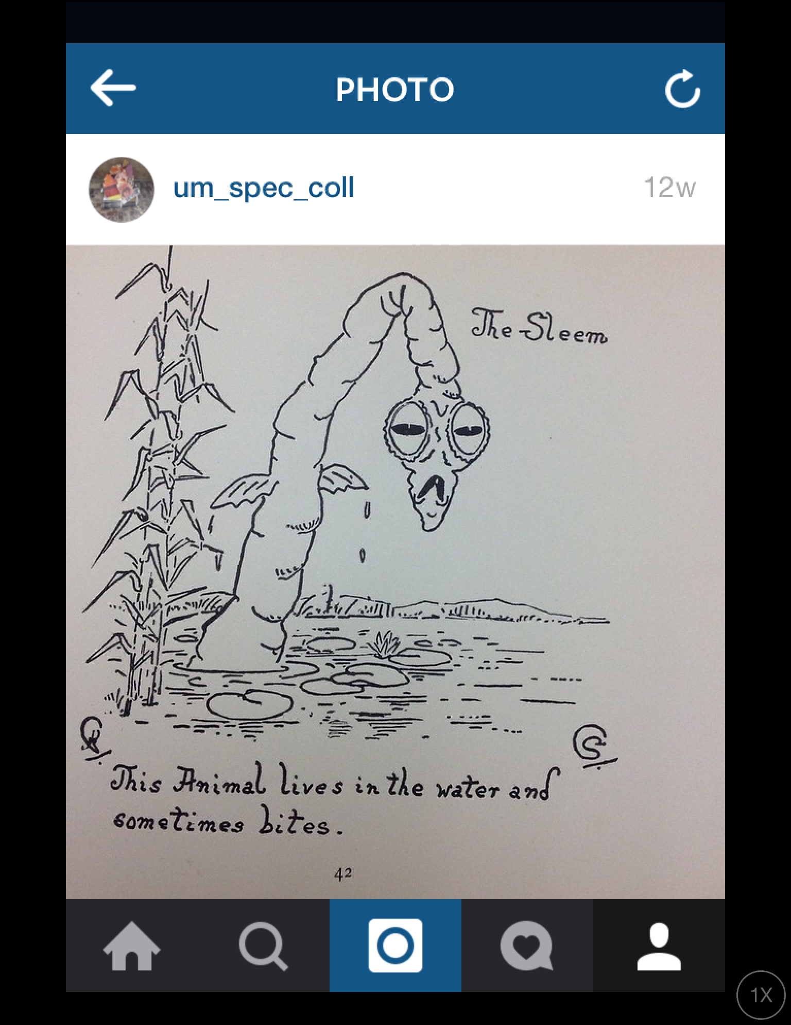
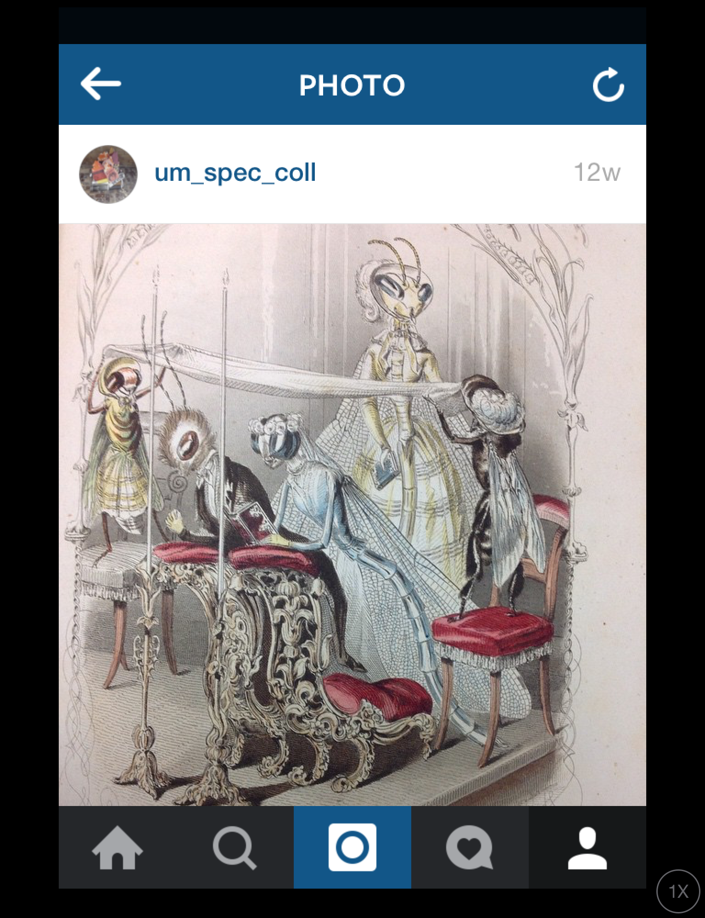
#BugginOut
Animal land where there are no people
Les papillons: métamorphoses terrestres des peuples de l'air

Slide 8
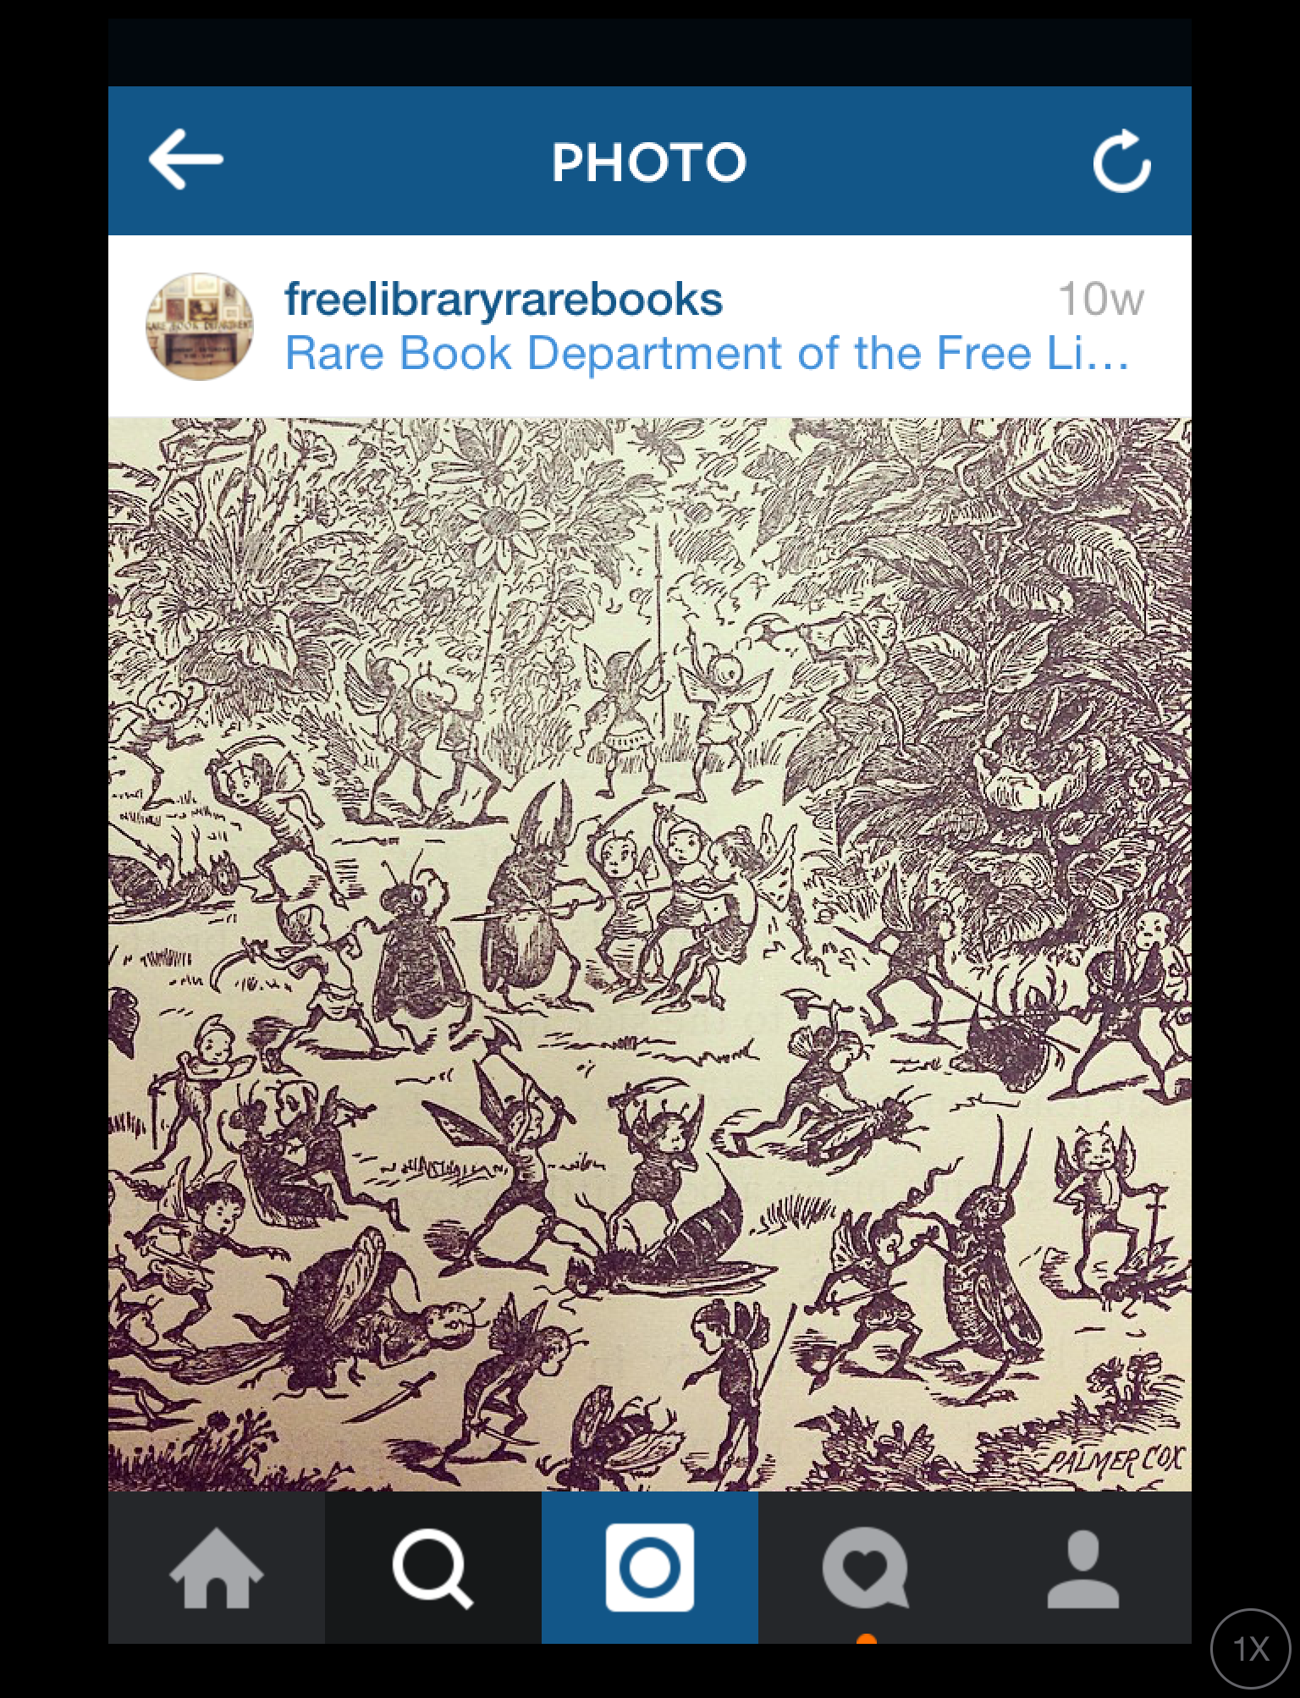
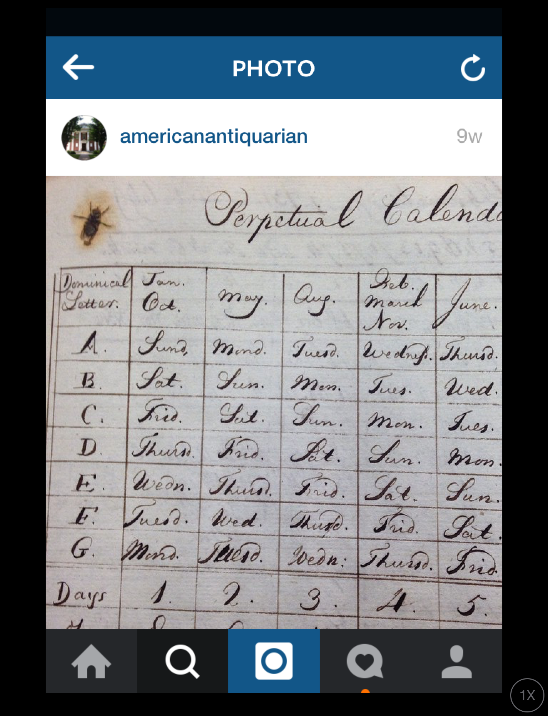
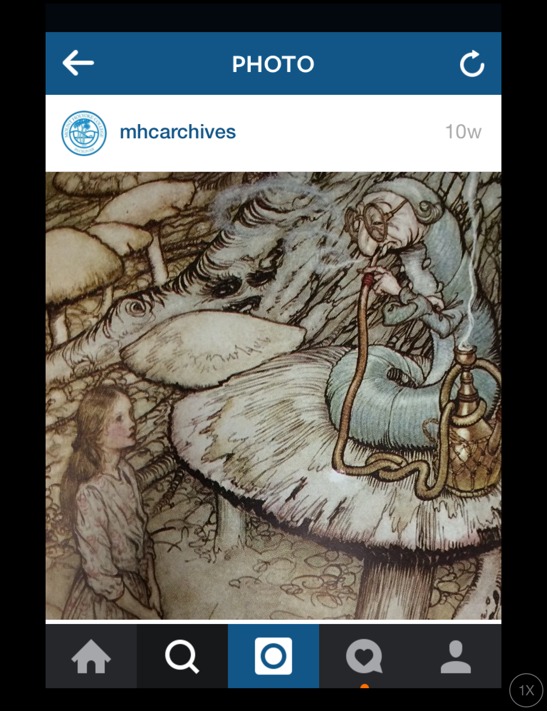
#BugginOut

Slide 9
#FindingNewHashtags
Community Developed Hashtags
Initial Hashtags
#MarbledMonday
#ManuscriptMonday
#MapMonsterMonday
#TypeTuesday
#tbt
#MorbidMonday
#WorldofWendesdays
#HereComesTheSunday

Slide 10
#MarbledMonday
#MapMonsterMonday
A selection of poems on the theme of water
A food map of the United States, 1932

Slide 11
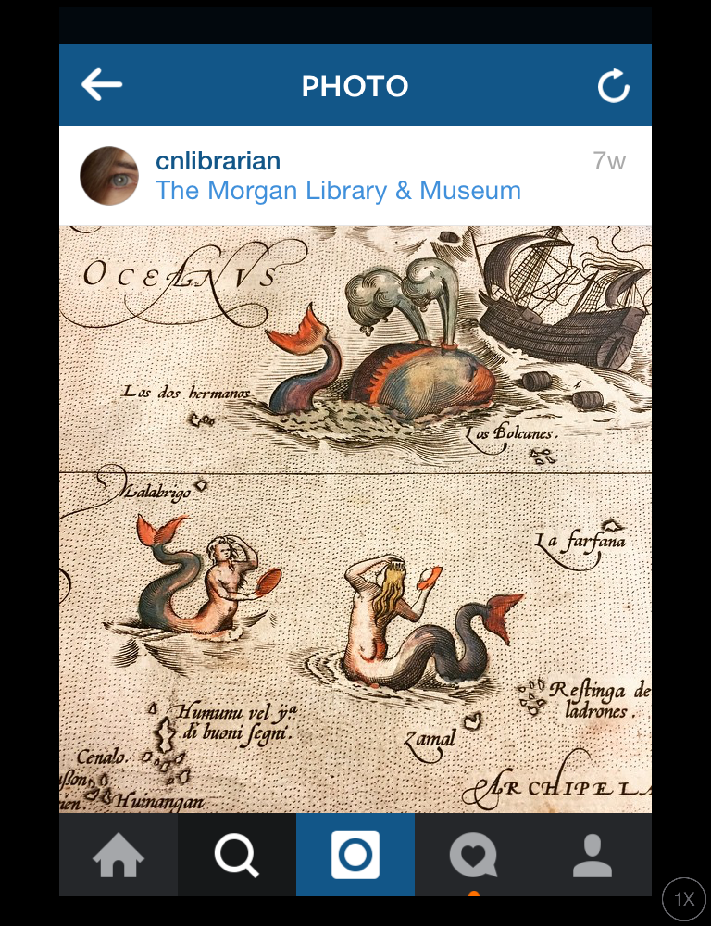
#MapMonsterMonday

Slide 12
#MorbidMonday

Slide 13
#MorbidMonday
#HereComesTheSunday
The Encyclopaedia of death and life in the spirit world.
From the Jackie Gleason Collection
The Florida Postcard Collection ASM0299

Slide 14
#HereComesTheSunday

Slide 15
#WorldofWednesdays
Westindienfahrt

Slide 16
#WorldOfWednesdays

Slide 17
Final Thoughts
Identify materials already digitized
Be flexible! Allow new and unique items to take over a planned post.
Find your audience! Following people is a great way to get them to follow you.
#Don'tBeAfraid

