Slide 1
SFA in the World:
Dispatches from SFA members in the international world of archives
Society of Florida Archivists 2015 Annual Conference
Many Trails Across Florida
May 14, 2015
Brooke Wooldridge, Digital Library of the Caribbean
Miguel Asencio, Florida International University
www.dloc.com
Email: bwooldri@fiu.edu
Phone: 305.348.3008

Slide 2
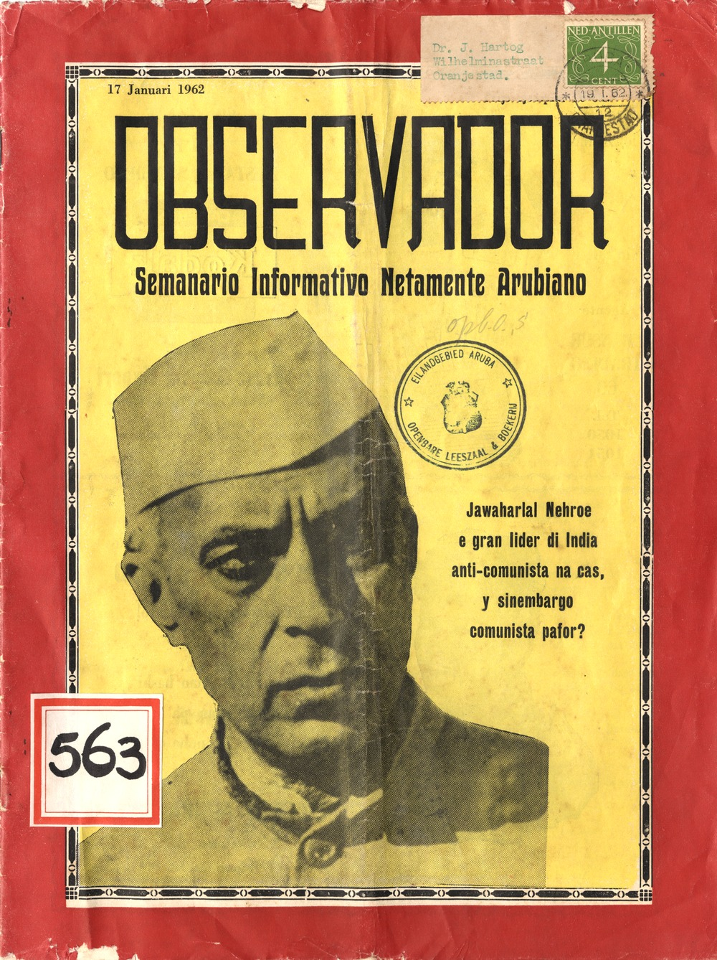
Pop Quiz – Name the Contributor
Question 1:
A) National Library of Panama
B) Florida International University
C) National Library of Aruba
Title: Observador semanario informativo netamente Arubiano

Slide 3
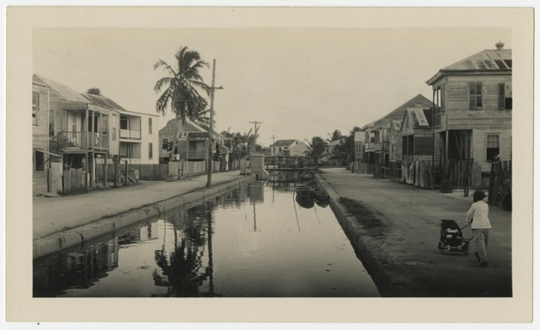
Pop Quiz – Name the Contributor
Title: View of a canal in Belize
Question 2:
A) National Library of Panama
B) University of Miami
C) Belize National Library and Heritage Service

Slide 4
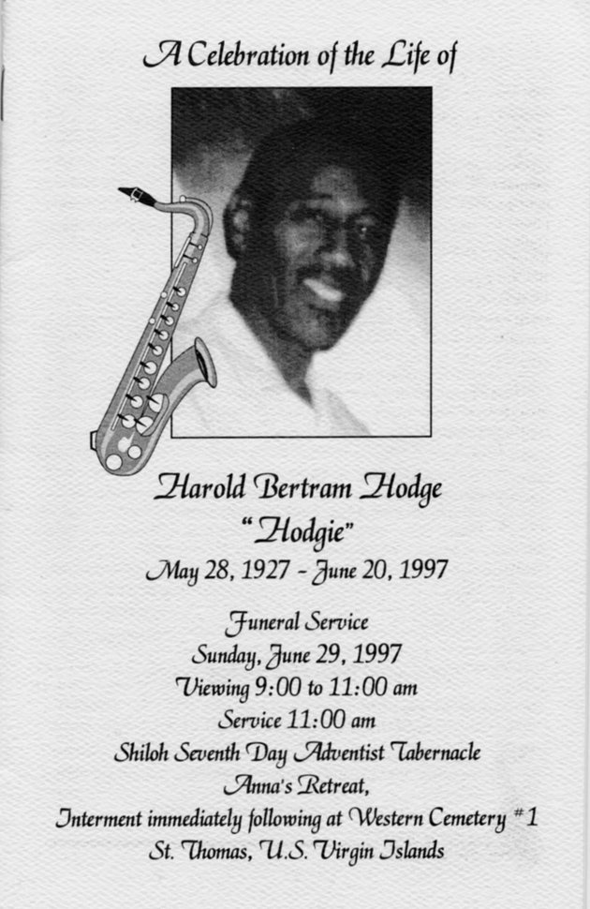
Pop Quiz – Name the Contributor
Question 3:
A) University of the Virgin Islands
B) University of Puerto Rico
C) University of Florida
Title: Funeral Booklet for Harold Bertram Hodge

Slide 5
Digital Library of the Caribbean
35 Content Contributing Partners
14 Supporting Members
Nearly 6 Million page views
95,000 Items; 2.3 Million Pages
dLOC's diverse partners serve an international community of scholars, students, and citizens by working together to preserve and to provide enhanced electronic access to cultural, historical, legal, governmental, and research materials.

Slide 6
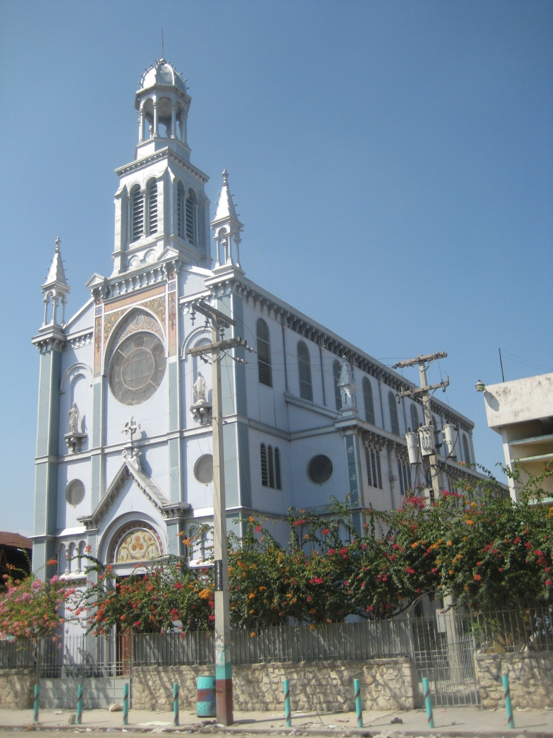
Haitian Library of the Brothers of Christian Instruction
25.102 pages of newspapers digitized
L'Opinion : 1324 pages
Le Papyrus: 886 pages
Le Temps: 3841 pages
L'Information: 1112 pages
Le Soir: 5888 pages
La Vérité: 349 pages
L'Action Nationale: 2316 pages
Haïti Journal: 9386 pages
More Info:
Digital Library of the Caribbean - Haiti Presentation with Compiled Presentations by Partners (2012). www.dloc.com/AA00011914/00001

Slide 7
University of Curacao
Dutch Caribbean Digital Platform builds upon the experiences with dLOC to:
Increase availability of local content
Increase volume of local digital content
Create and share local digital learning material
Stimulate and diversify use of local digital content
Facilitate local digitization initiatives
Preserve Cultural Heritage
Irwin Korstjens and Margo Groenewoud (2014). Building the Dutch Caribbean Digital Platform: a community-based approach (Poster). www.dloc.com/AA00024212/00001

Slide 8
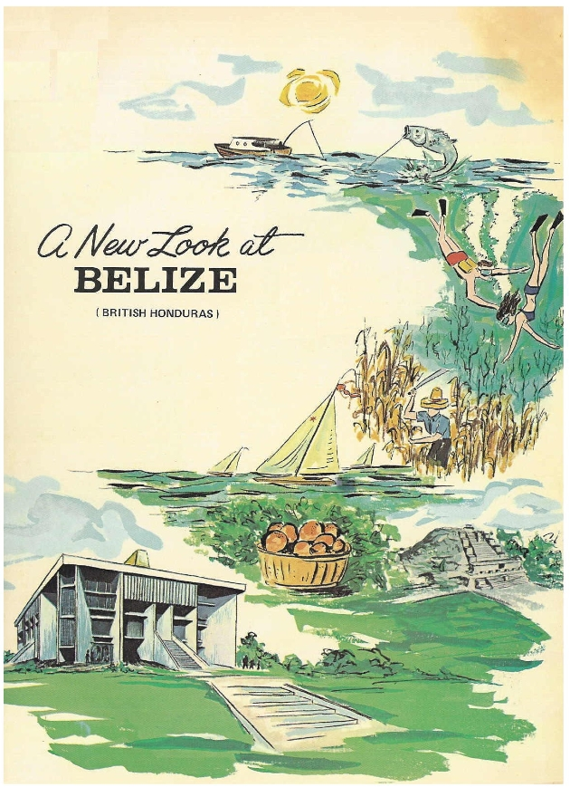
Belize National Library & Heritage Service
Established 1935
43 titles online
The Belize National Library Service and Information System through its National Heritage Library contributes to the Digital Library of the Caribbean from its small but diverse collection, including maps, postcards, rare books, newspapers and stamps.

Slide 9
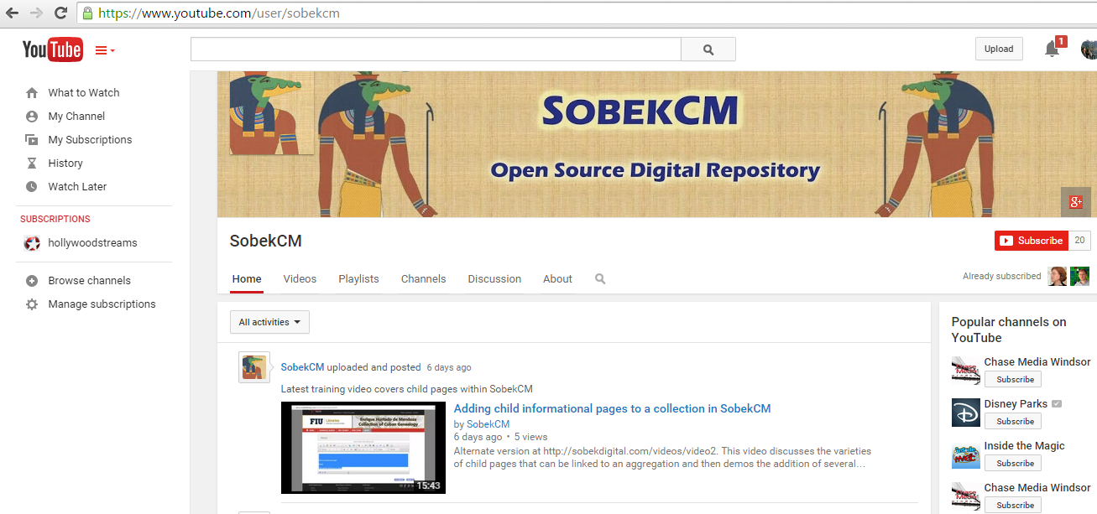
SOBEKCM Webinars and Videos

Slide 10
SAA Latin American and Caribbean Cultural Heritage and Archives Roundtable
Webinar Series organized by Natalie Baur, University of Miami, and Margarita Vargas Betancourt, University of Florida.
March 6 Webinar Available Online: http://ufdc.ufl.edu/AA00029584/00002

Slide 11
Center for Research Libraries

Slide 12
dLOC Seed Grants
The College of the Bahamas (COB) - $5,000 for “No Ordinary Time: Bahamians in the Allied Fight during the Second World War”
Educa Vision - $2,500 for “Advocacy and Activism in Haiti: 1915-2004”
National Library of Aruba (BNA) - $2,000 for “Digitization Postcards collection 1960-1986 / Missing early issues of Aruba Esso News”
University of Curacao (UOC) -$2,500 for “Zikinzá Collection of Curaçao Oral History Recordings”
University of Suriname (UOS) - $5,000 for “University of Suriname Online Thesis Collection”

Slide 13
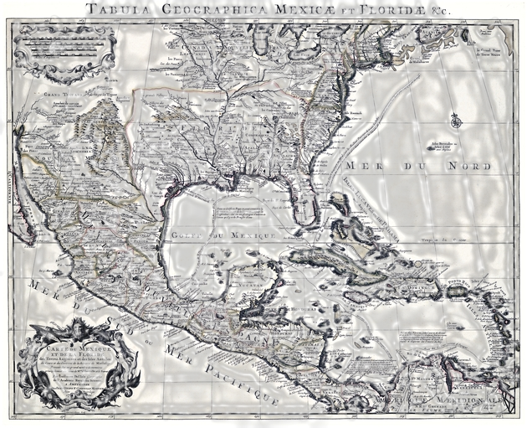
Connections to SFA
Florida/Caribbean Collections Speak to Each Other
Problems and Challenges are Similar
Ample Opportunities for Sharing and Collaboration
Carte du Mexique et de la Floride des terres angloises et des Isles Antilles, du cours et des environs de la riviere de Mississippi from the University of Florida George A Smathers Libaries Special Collections Department. http://ufdc.ufl.edu/UF90000043/00001

