Slide 1
Connecting Archives to a Global Audience with Wikipedia

Slide 2

Wikipedia?
Wikimedia?

Slide 3


296 language Wikipedias
Dozens of other Wikimedia projects
Wikimedia Commons: free-use image and file repository
Wikidata: knowledge base/metadata repository

Slide 4
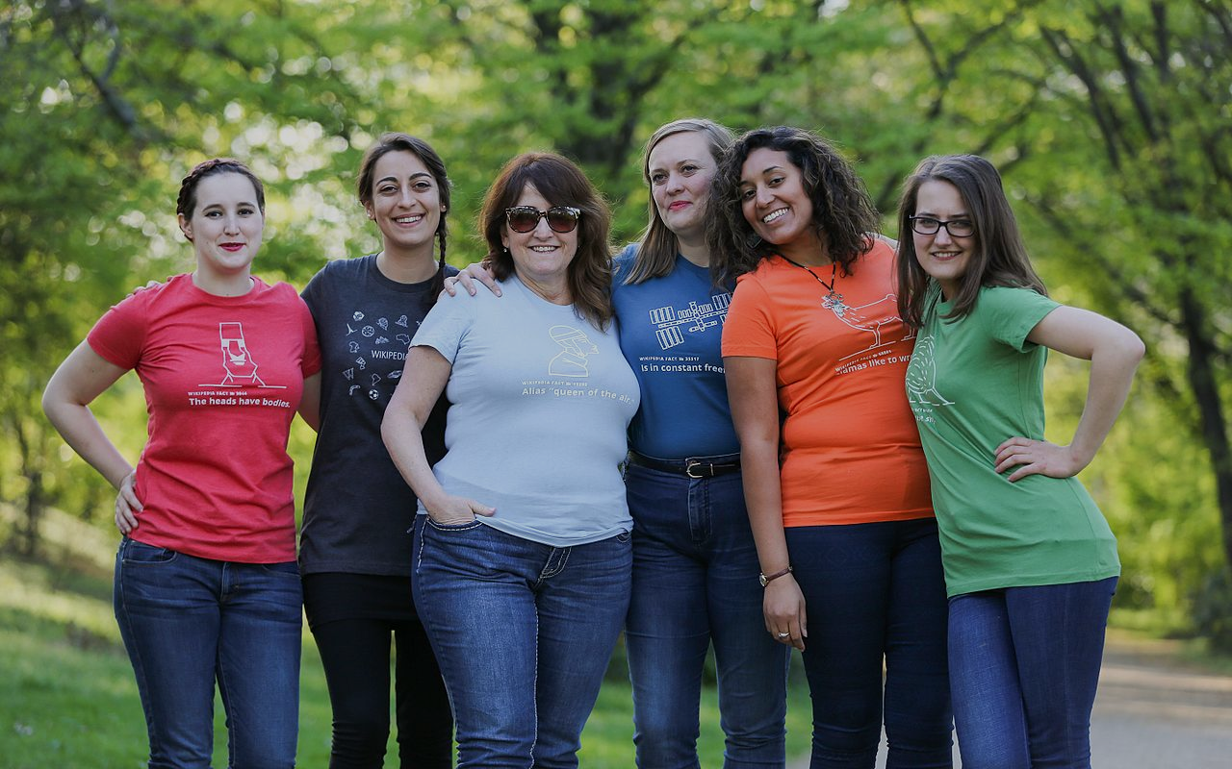

Over 80 thousand active volunteers a month worldwide
CC by SA 4.0, Zachary McCune

Slide 5
Promote your mission not your institution.

Slide 6
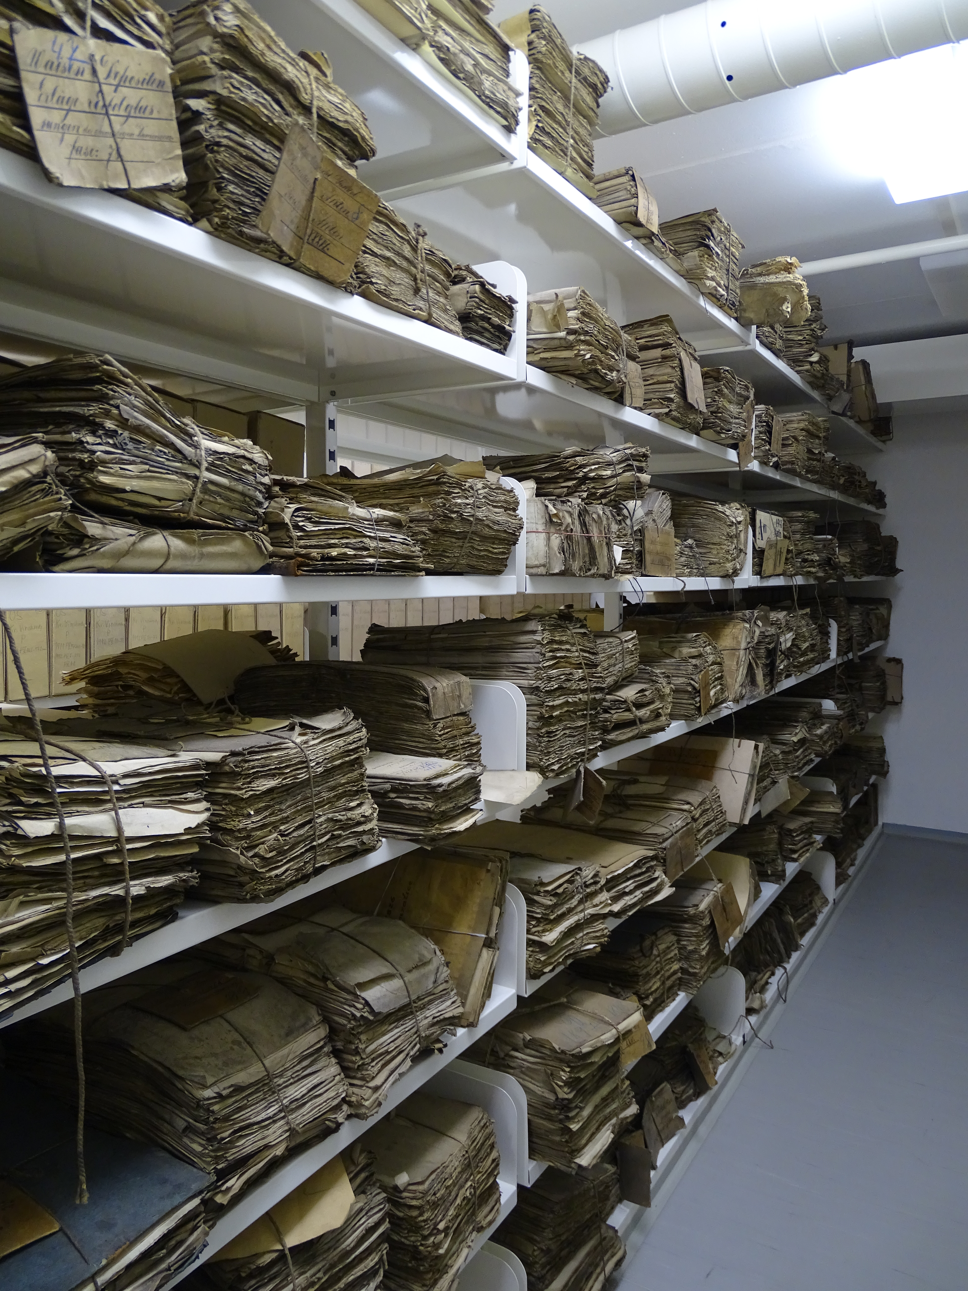
Use your finding aids
* Just don’t cut and paste them into Wikipedia
CC by SA 4.0, ŠJů

Slide 7
Uploading images
Images must be public domain or Creative Commons by, sa, and by-sa (no nc or nd).
No control or copyright of images.
Attribution required, but not always used, or used in a way that benefits your institution.
Immediate potential worldwide audience.
No storage or upkeep costs.
Connections to other projects and potential collaborators.
Control/consistency of metadata.

Slide 8
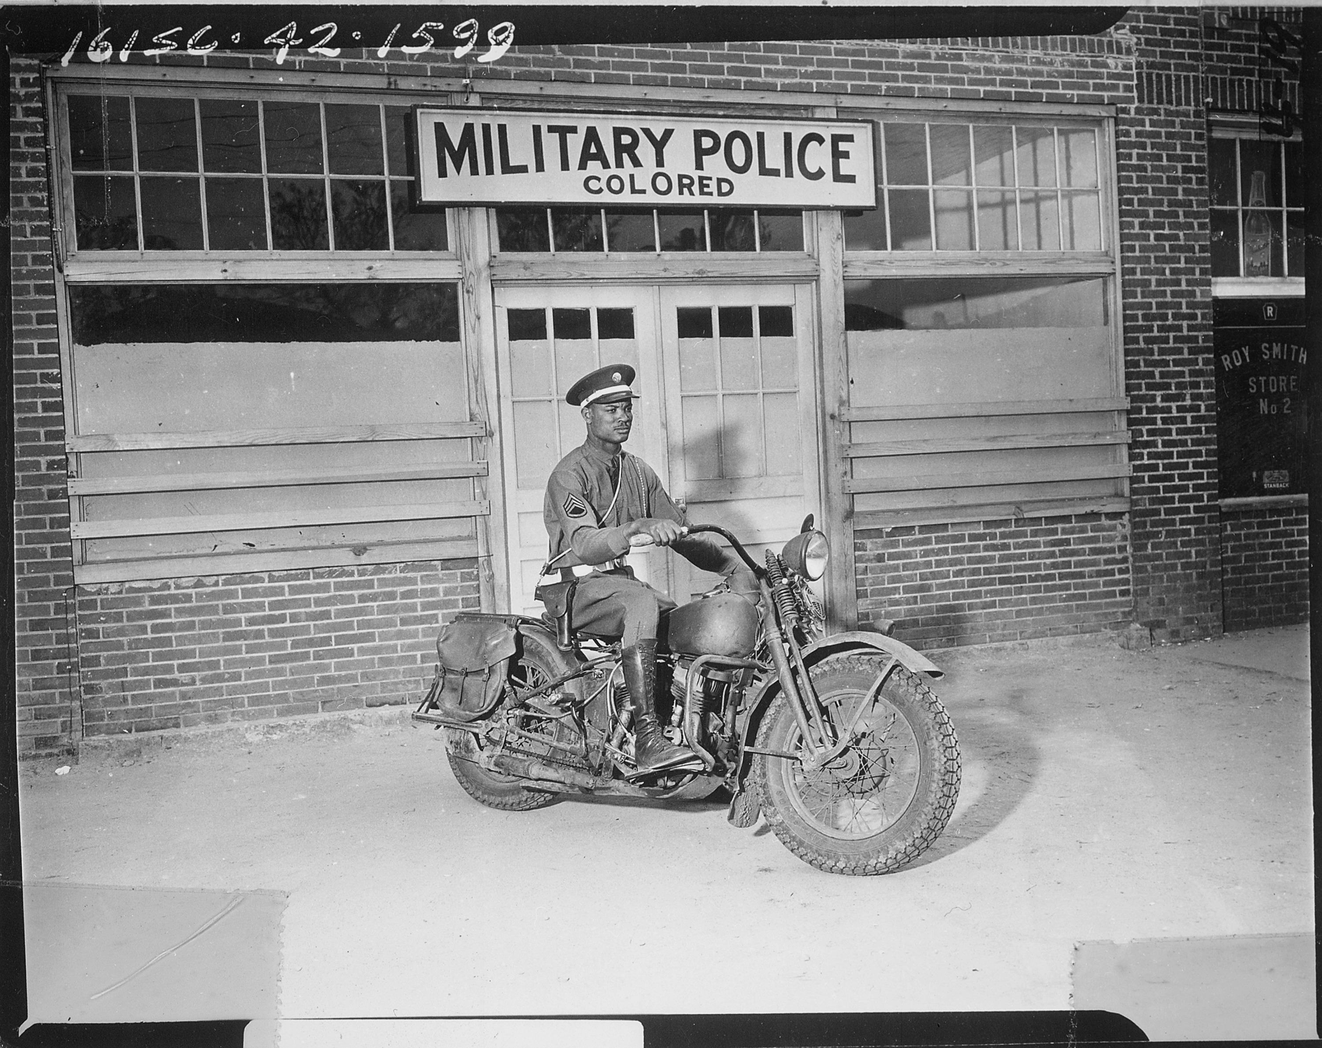
ce
Liberty
Absolution
Redemption
Nachos
National Archives and Records Administration collection: Records of the Office of the Chief Signal Officer, 1860 - 1985
Taken April 13, 1942 in Columbus, Georgia

Slide 9
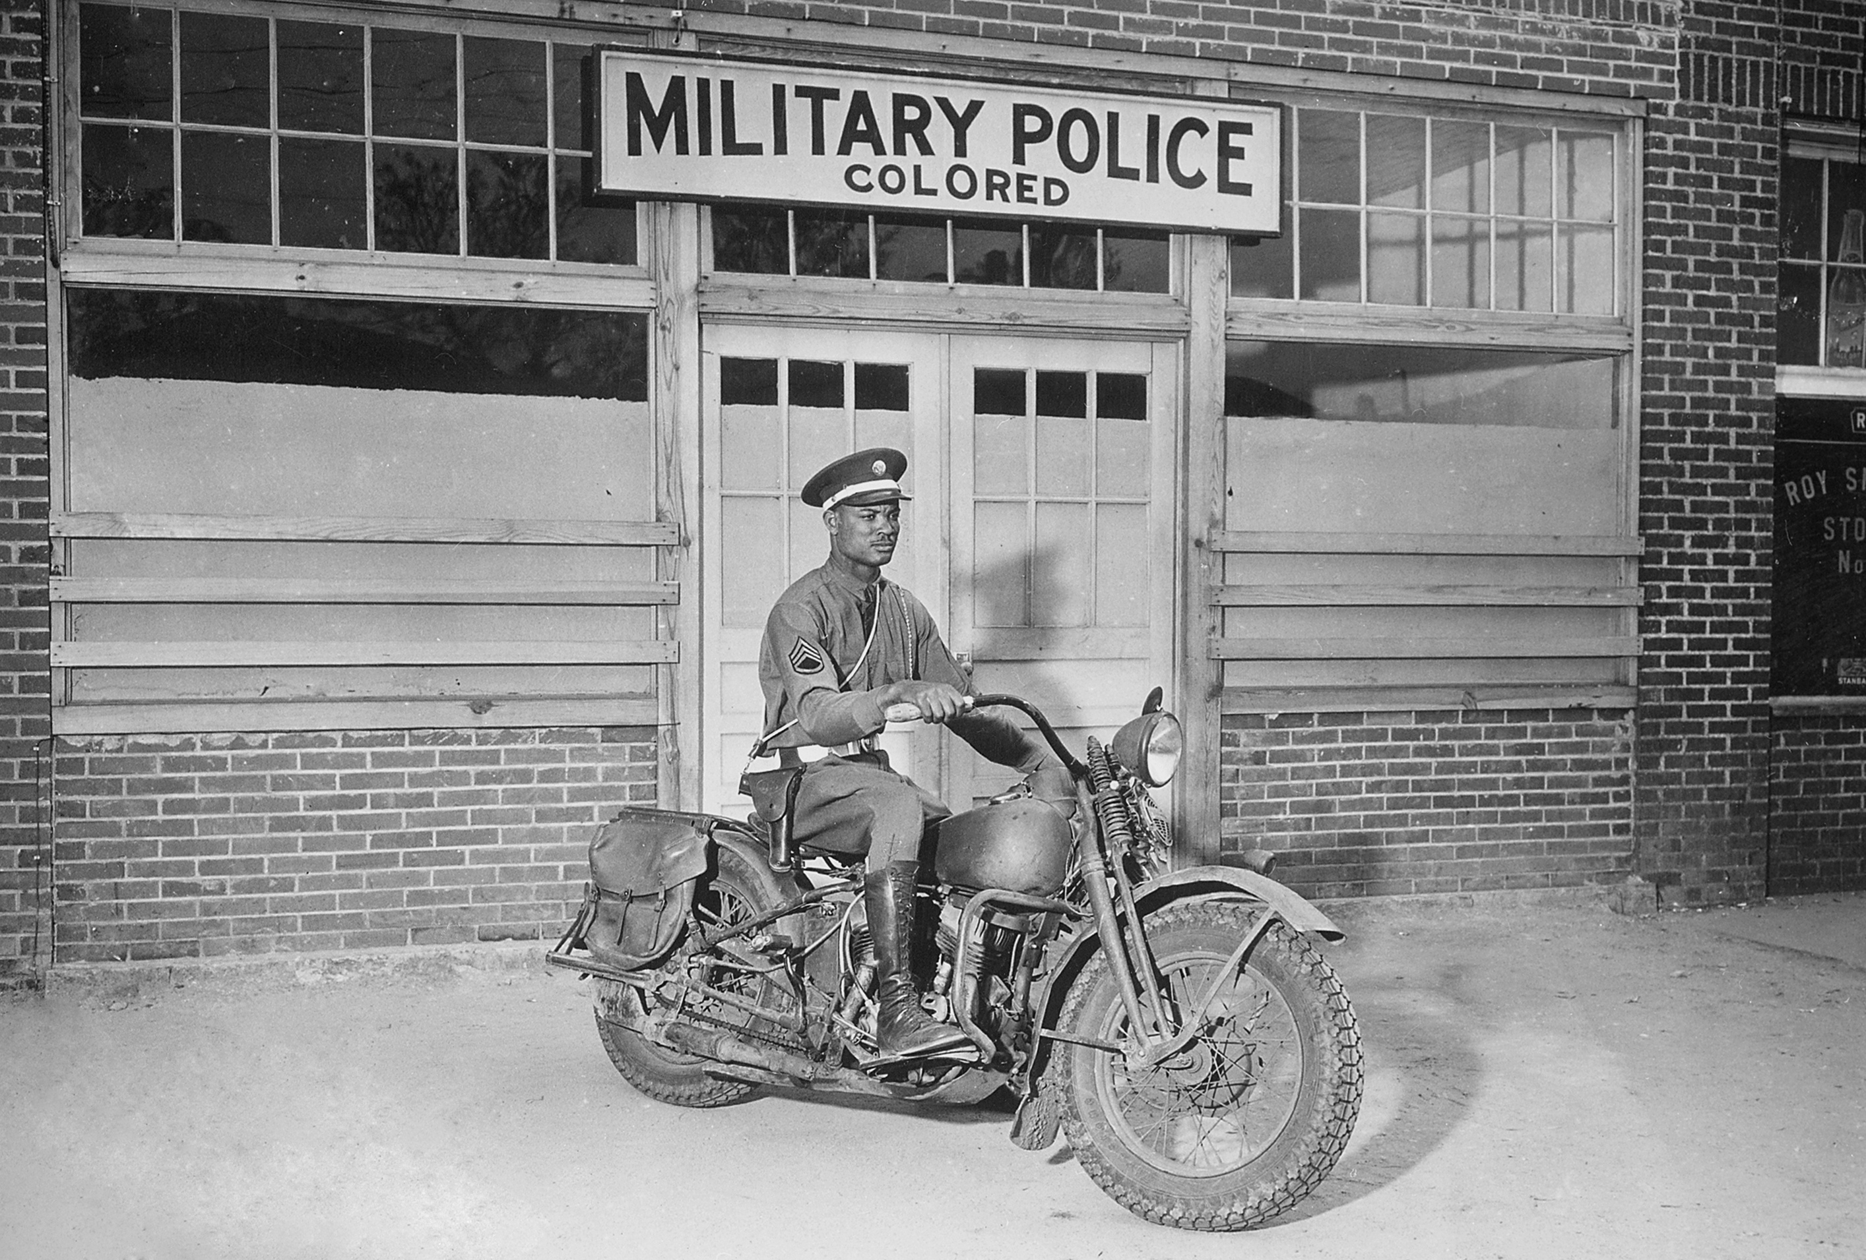
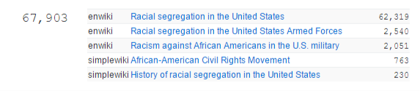
ce
Liberty
Absolution
Redemption
Nachos

Slide 10
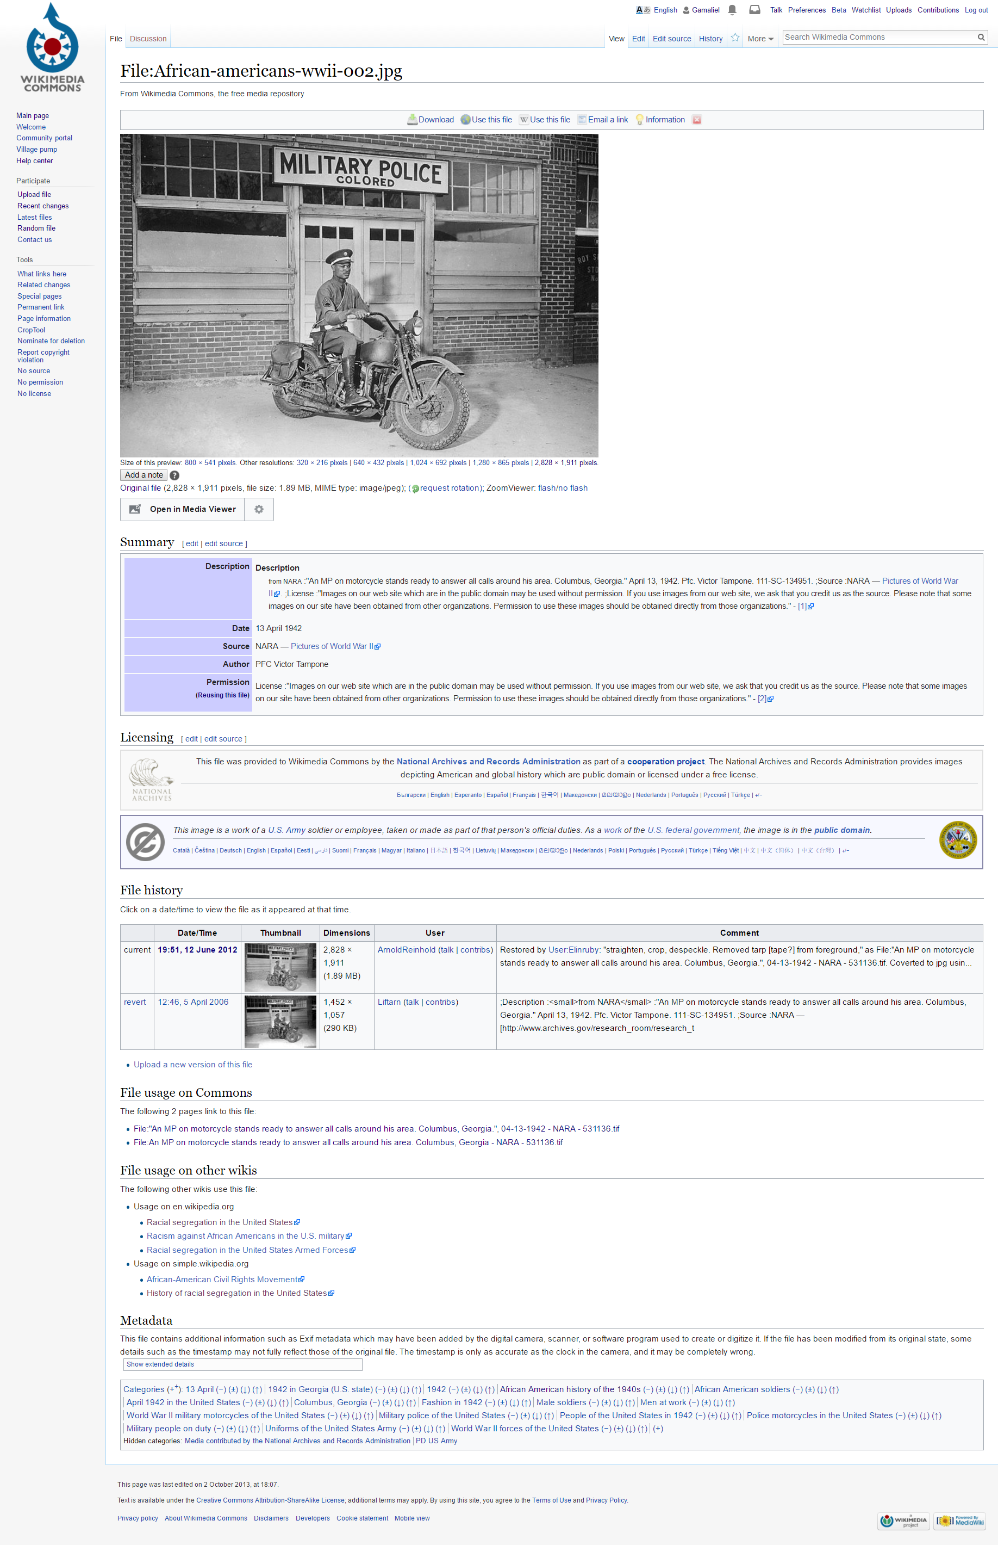
Usability and reusability
Quickly download, embed, and attribute images on Wikimedia projects or other webpages.
Description, attribution, and metadata.
File history.
File usage on all Wikimedia projects.
Camera/image metadata.
Categories.

Slide 11
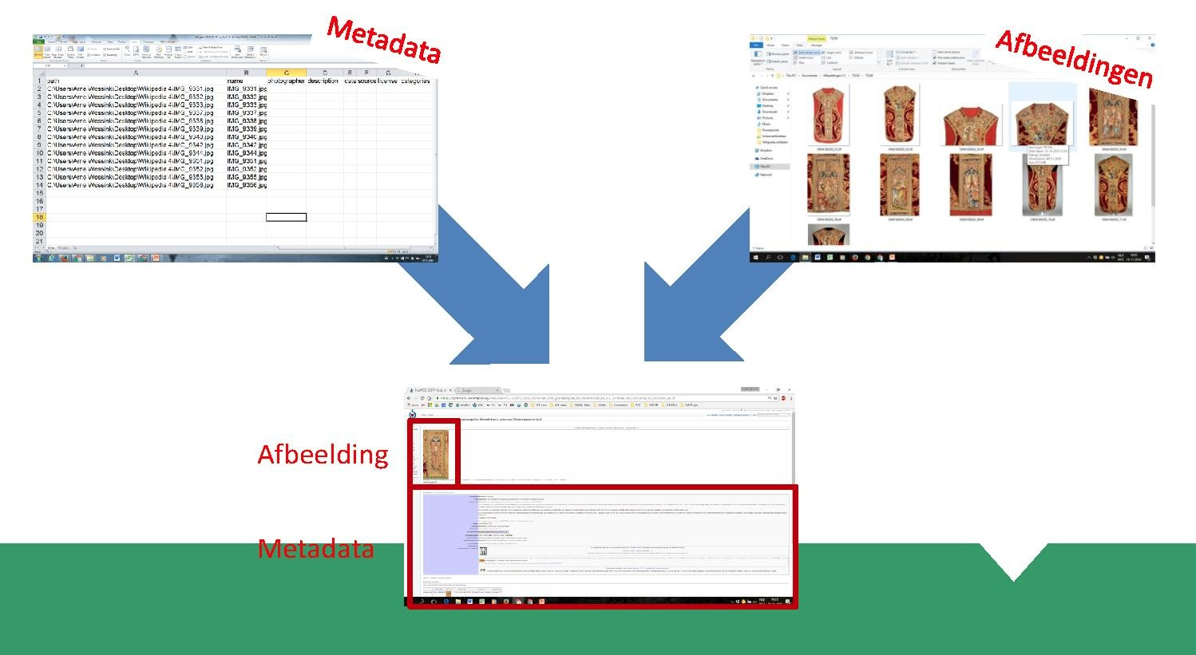
Mass uploading of images with Pattypan
https://commons.wikimedia.org/wiki/Commons:Pattypan
https://github.com/yarl/pattypan
CC by SA 4.0, Arne Wossink

Slide 12
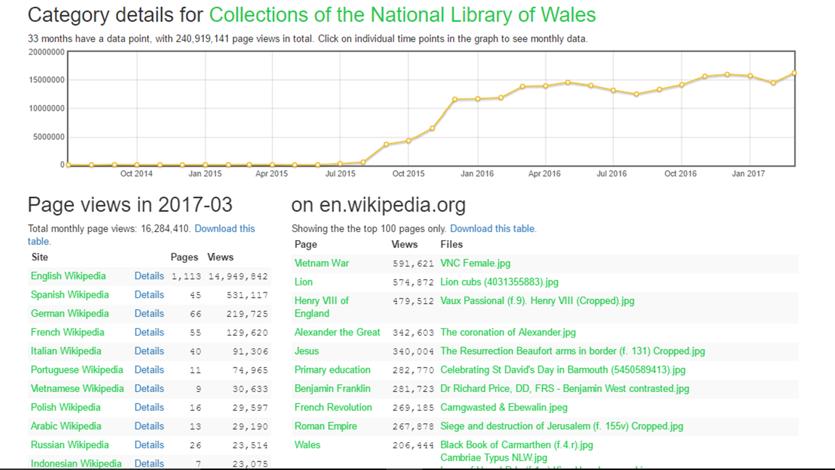
BaGLAMa2 metrics tool
https://tools.wmflabs.org/glamtools/baglama2/index.html

Slide 13
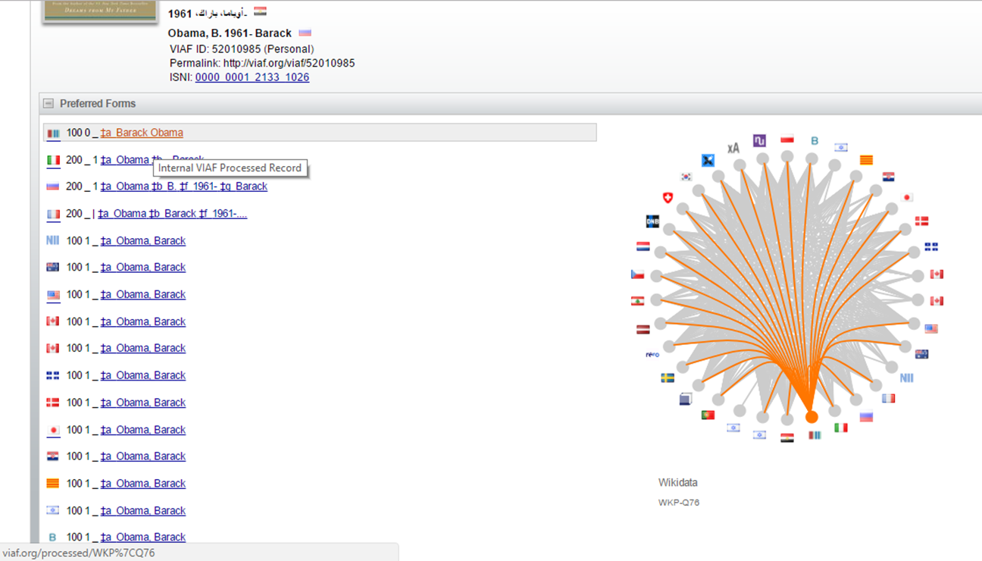

Slide 14
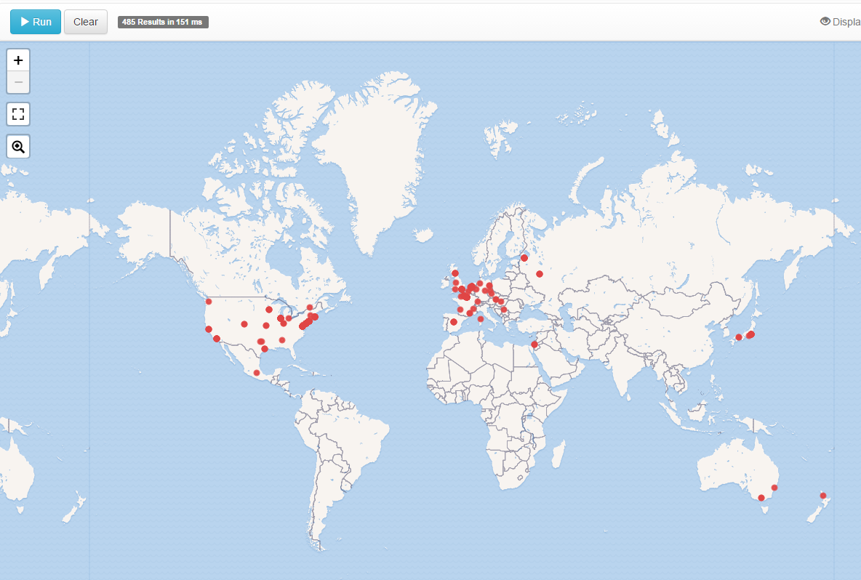

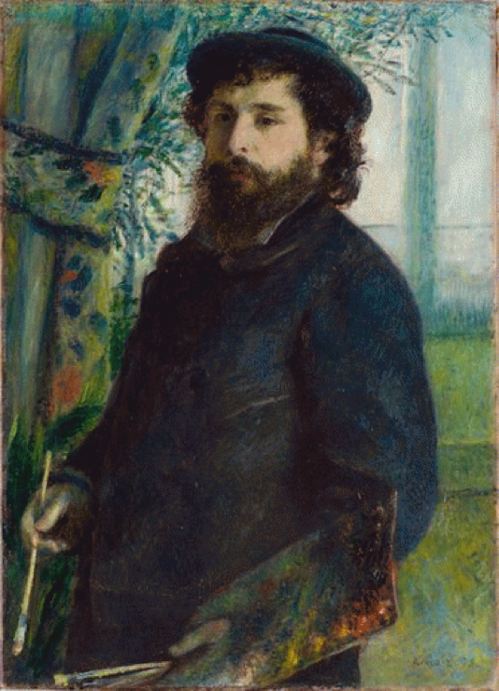
https://query.wikidata.org/

Slide 15
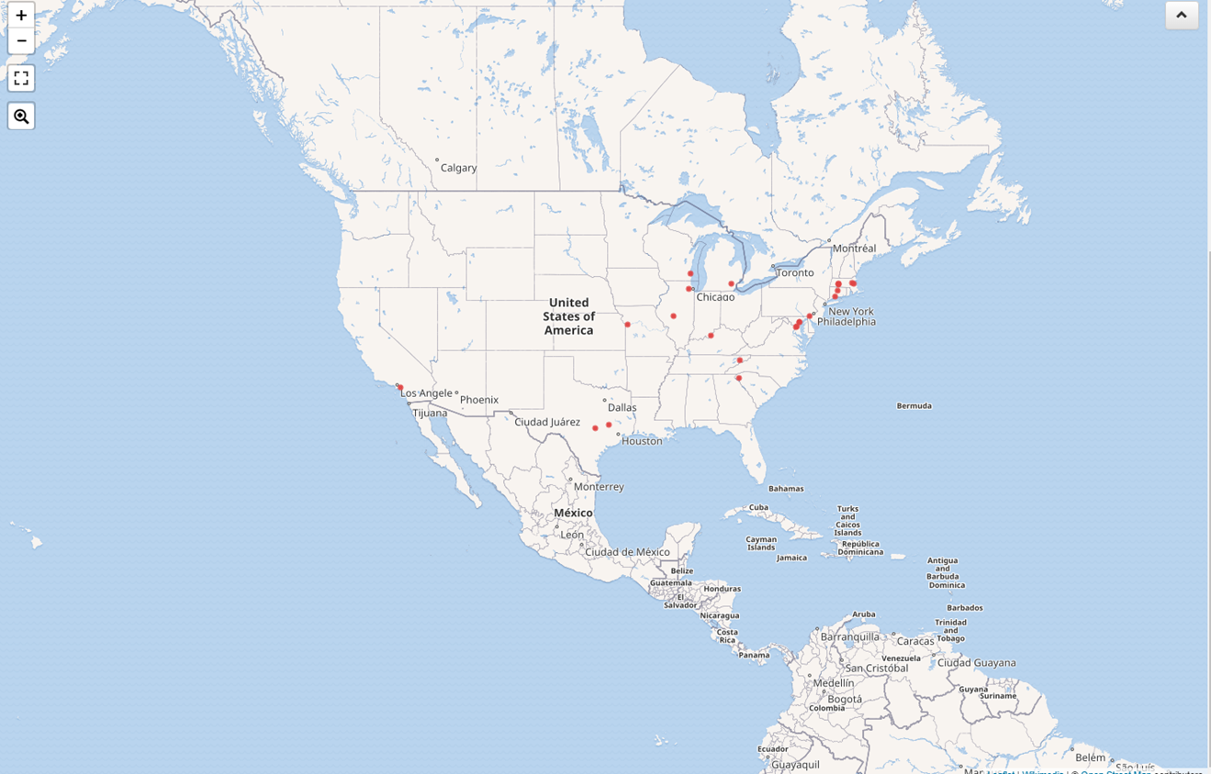
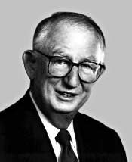
https://query.wikidata.org/

Slide 16
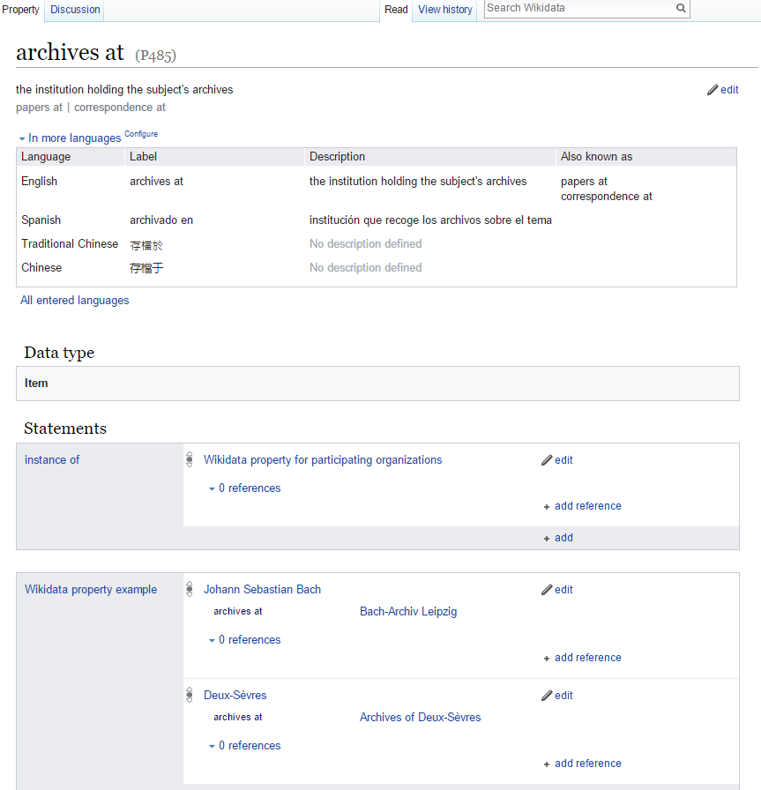
Nobody said there would be homework

Slide 17
Here comes everybody!
CC by SA 4.0, Iván Martinez

Slide 18

…not soulless!

Slide 19
Only 9% of
Wikipedia contributors are women ☹
Wikimedia Foundation. (2011). Editor survey 2011.

Slide 20
Wikimedia Foundation. (2012). Editor survey 2012.

Slide 21
356
Self-identified Librarian Editors
Wikipedia. (2017). Category:Wikipedian librarians.

Slide 22
SOLIS Wikipedia Edit-a-Thon
Overall Project Metrics
 | TARGET OUTCOME | ACHIEVED OUTCOME
# of Events | 3 | 3
# of Participants | 15 | 22
# of New Editors | 5 | 6
# of New Articles | 9 | 8
# of Repeat Participants | 10 | 7

Slide 23
SOLIS Wikipedia Edit-a-Thon
Individual Event Metrics
 | FEBRUARY EVENT | MARCH EVENT | APRIL EVENT
Event Theme | Black History Month | Art+Feminism (Women’s History Month) | World Book Day
Location Type | Public Library | Community College Library | Public Library
# of Participants | 10 | 5 | 7
# of New Editors | 4 | 0 | 2
# of New Articles | 4 | 2 | 2

Slide 24
Some of the
Articles Created
Elvira Dyangani Ose
Evita Robinson
Lindsey Day
Mary T. Washington
Eleanor Brown

Slide 25
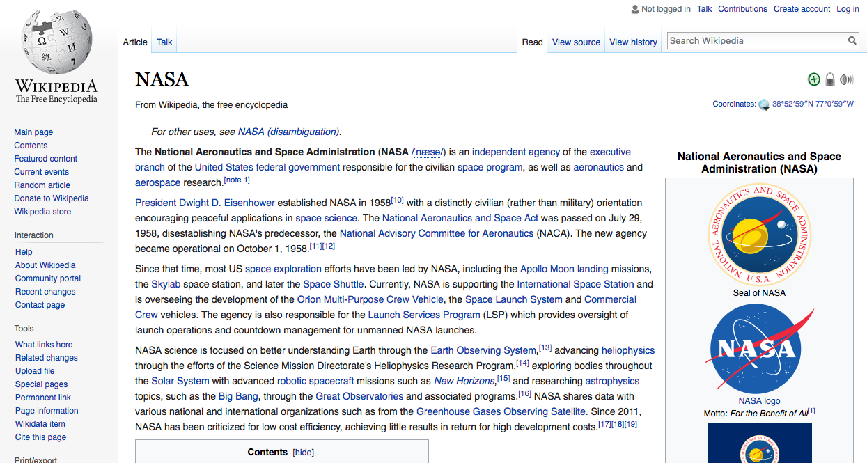

Slide 26
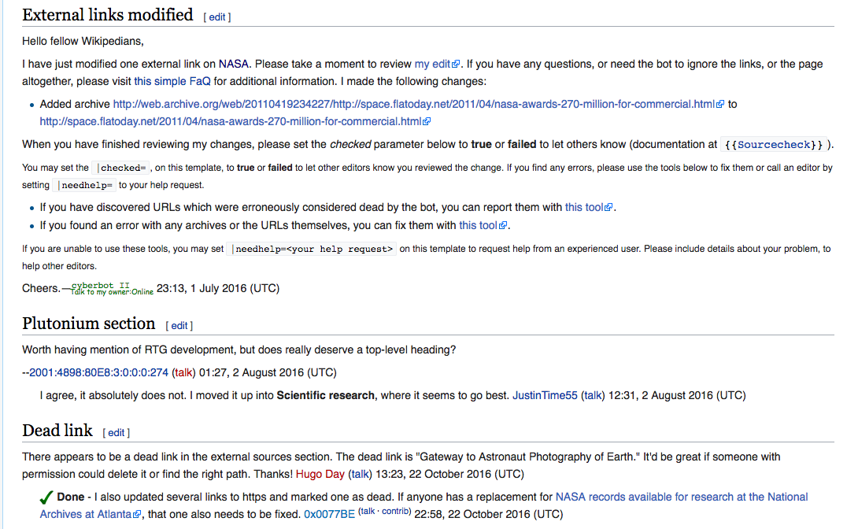

Slide 28
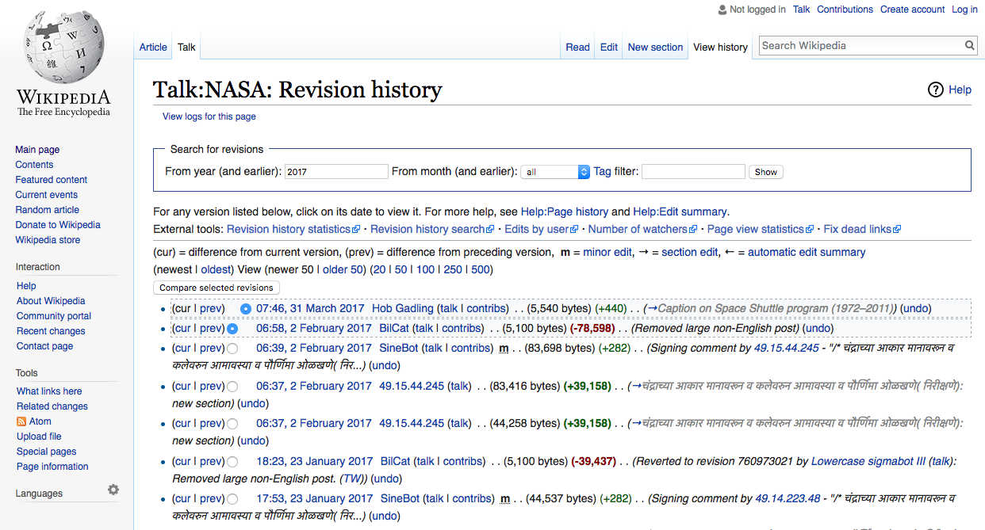

Slide 29
What do you need to host an edit-a-thon?
Computers
Internet Access

Slide 30
Pre-event preparation
Create a user account
Do your research

Slide 31
Edit-a-Thon
Tips
Wikipedia meetup page
Google Hangouts
Theme or ideas
Pre-session training
Experienced Wiki editor
Treats!

Slide 32
Marketing
Tips
Social media
Library listservs
Local newspapers
Radio
Word of mouth

Slide 33
Research editing policies
Add articles to watchlist
Use the sandbox
Start small
Editing
Suggestions

Slide 34
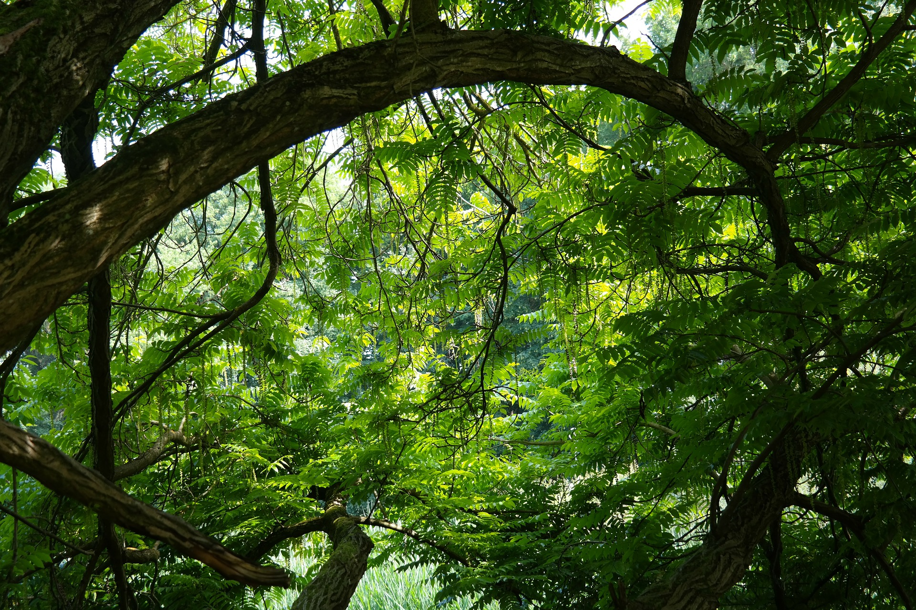
It’s a WIKI
jungle out there!

Slide 35

Be bold, by Wapcaplet, 2011, https://commons.wikimedia.org/wiki/File:Be_bold.svg (CC BY-SA 3.0)

Slide 36
References
Wikipedia. (2017). Category:Articles lacking sources. Retrieved May 10, 2017 from
https://en.wikipedia.org/wiki/Category:Articles_lacking_sources
Wikipedia. (2017). Category:Wikipedian librarians. Retrieved May 10, 2017 from
https://en.wikipedia.org/wiki/Category:Wikipedian_librarians
Wikimedia Foundation. (2012). Editor survey 2012: Wikipedia editing experience. Retrieved from
https://upload.wikimedia.org/wikipedia/commons/8/81/Editor_Survey_2012_-
_Wikipedia_editing_experience.pdf

Slide 37
Contact Information
Carrie A. Cullen
MLIS Student
University of South Florida, Tampa
carriecullen@mail.usf.edu
Robert Fernandez
Wikimedia District of Columbia
robert.fernandez@wikimediadc.org
http://wikimediadc.org

