Slide 1
Collaborative and engaging instruction in special collections & Archives
Rory Grennan, Florida State University Katherine Hoarn, Florida State University
Gerrianne Schaad,
Florida Southern College

Slide 2
Collaboration

Slide 3
how are we instigating collaborations?
Leveraging existing contacts
Utilizing outreach opportunities
Negotiating other requests
Cold calling
Word of mouth

Slide 4
Who are our collaborators?
Subject Librarians (Liasons) & Special Collections Colleagues
Help make contact with departmental instructors
Co-teaching
Combine bodies of expertise
Provide holistic view of available resources

Slide 5
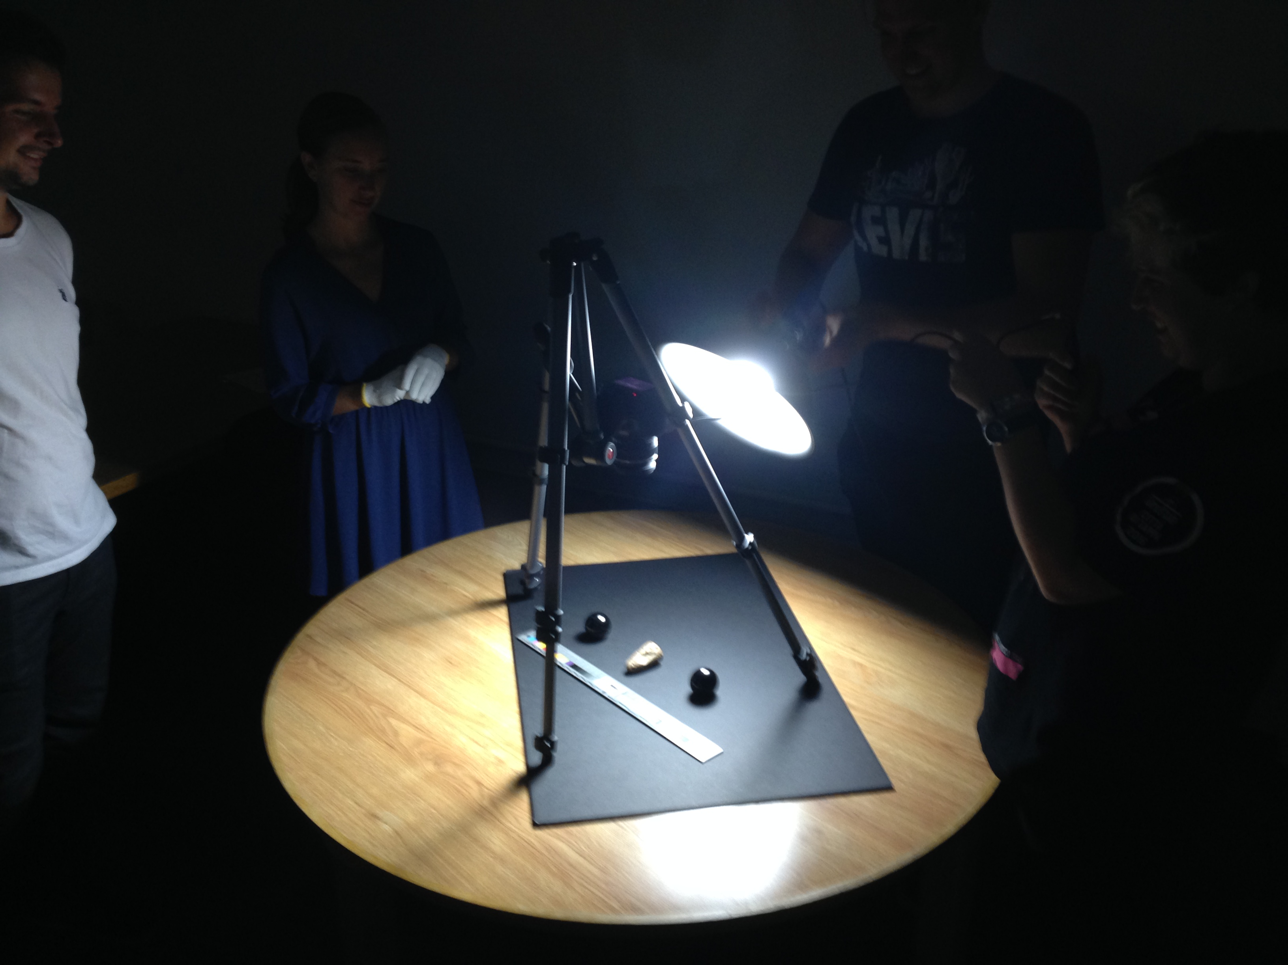
Who are our collaborators?
Class Instructors
Session planning
objectives and outcomes
content/activities
selecting materials
Co-teaching
Combine subject knowledge & collection knowledge
Ensuing activities
Student research
Assigned materials

Slide 6
What are we bringing to collaborations?
Collections Knowledge
Archival Literacy
Negotiation Skills
Flexibility
Patience
Gratitude

Slide 7
What are we taking away from collaborations?
New Friends
Finer Knowledge of Our Materials
More and Better Informed Researchers

Slide 8
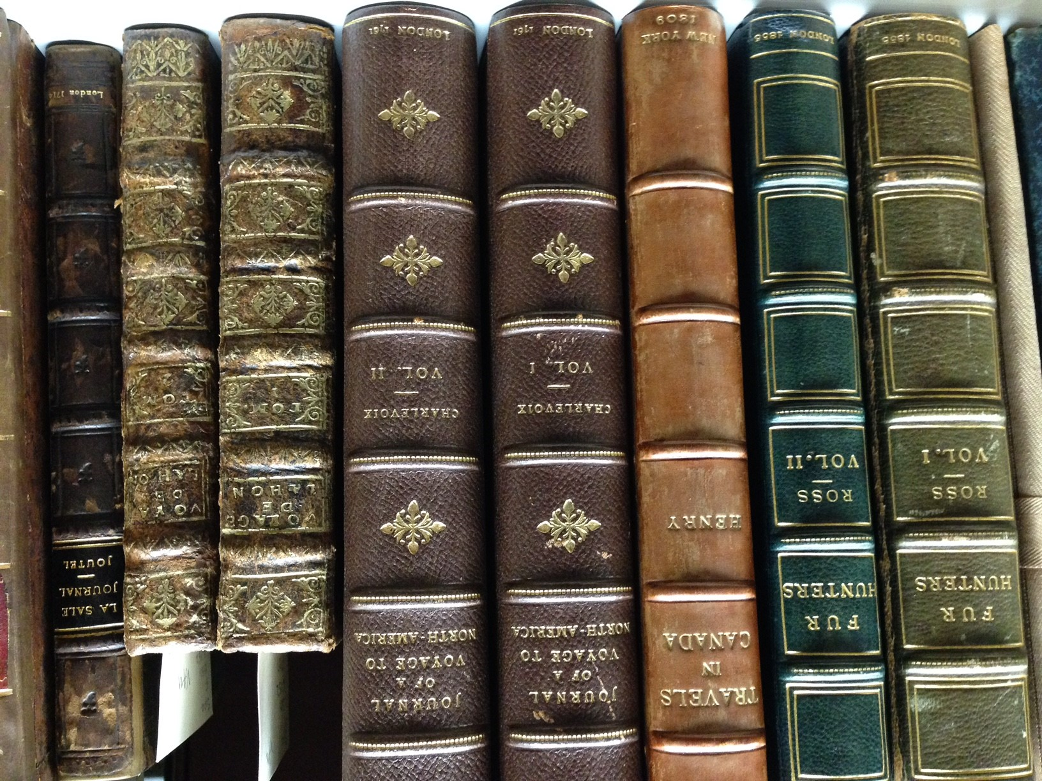
Student Engagement
Moving beyond show-and-tell

Slide 9
Two (imperfect) Approaches
Show-and-Tell
Laissez-Faire
I tell you everything
Look but don’t touch (unless there’s enough time at the end)
Here’s some cool stuff to look at
I’ll be around if you have questions

Slide 10
Lessons learned
Balance presenting the necessary information with allowing time for students to handle the materials and discover things on their own
Don’t pull too many things at once
Break large classes into smaller groups
Work with the class instructor to provide an in-class activity that will help achieve your learning objectives
Don’t “give away” answers – encourage the students to use what they already know
Bring it altogether at the end with a group discussion

Slide 11
In-class learning activities
“Tell me about this object”
Scavenger Hunts & Identification Worksheets
- Put the students in groups and give them each an item from a manuscript collection with minimal descriptive information
- Have the students research the history of the item using finding aids, the digital library, and other online resources
- Gather everyone at the end of class and have students share the story of their object
- Provide the students with pointed questions to guide them beyond "Wow, this is cool!"
- Questions might include:
How was this made?
Is it print or manuscript?
Who was it made for?

Slide 12
active learning with archives staff

