Slide 1
“An Enlightening Flickr in the Sunshine City: Sharing the Photographic Archives
of the St. Petersburg Museum of History”
Marta L. Jones, Archivist, St. Petersburg Museum of History
https://www.flickr.com/photos/spmoh-archives/albums

Slide 2
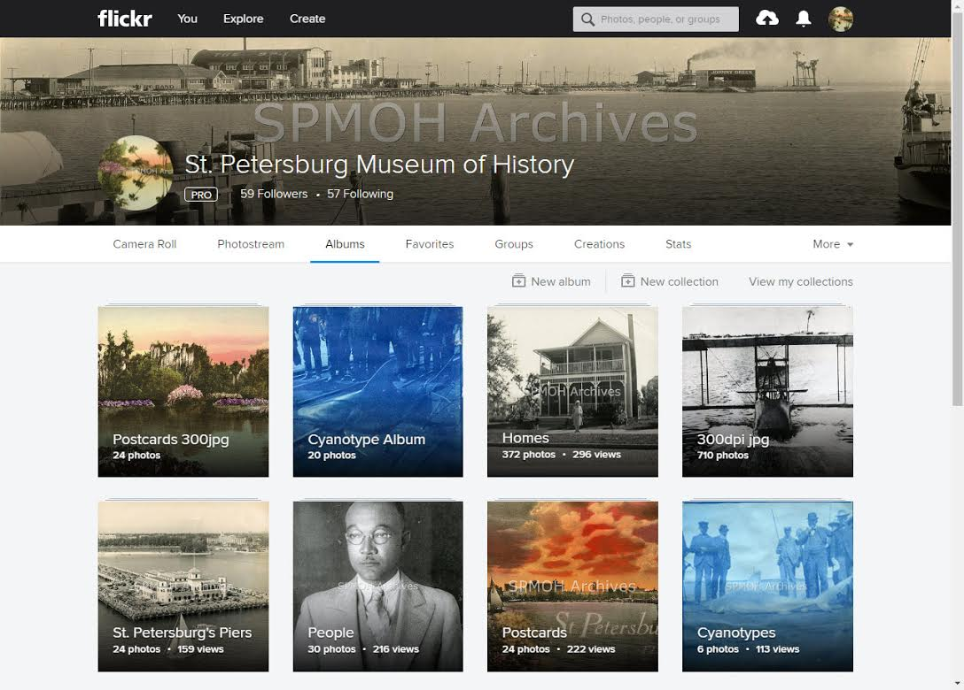

Slide 3
Who else is using Flickr?
- Smithsonian
State Library & Archives of Florida
The British Library
Internet Archive
And many more….

Slide 4
Why use Flickr
Your photos will appear in Google searches
Let them know your collection exists! - Univ. of Louisiana is losing its Natural History Collection. Univ. of Kansas Collection Manager, Andy Bentley stated, (via Smithsonian.com 03/2017) "It was shocking for me to realize the collection was so large. Regional collections are usually not that big," he says. Even a colleague doing a survey of all the fish collections in the world had not heard about the ULM trove, Bentley says. "There’s no information out there about the collection and nothing on web."

Slide 5
Relevance
Giving people a key to open an experience that matters to them
“The lower the effort the higher the relevance”
Grandson of Byrd Latham, (who was a member of the Early Birds of Aviation), saw the photo we have of his grandfather on our Flickr page

