Slide 1
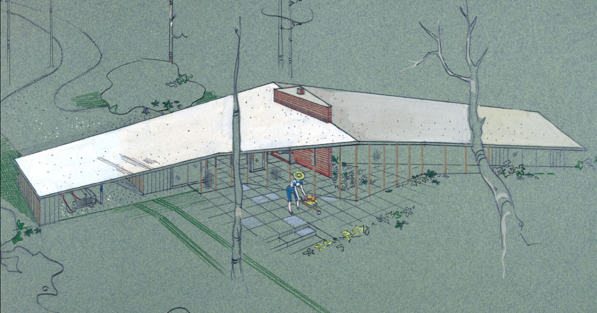
Building Engaged Communities and Collaborations for Architecture and Historic Preservation Collections
Society of Florida Archivists, St. Petersburg, May 2017
Notes:
Parker Ross Residence Wingspan

Slide 2
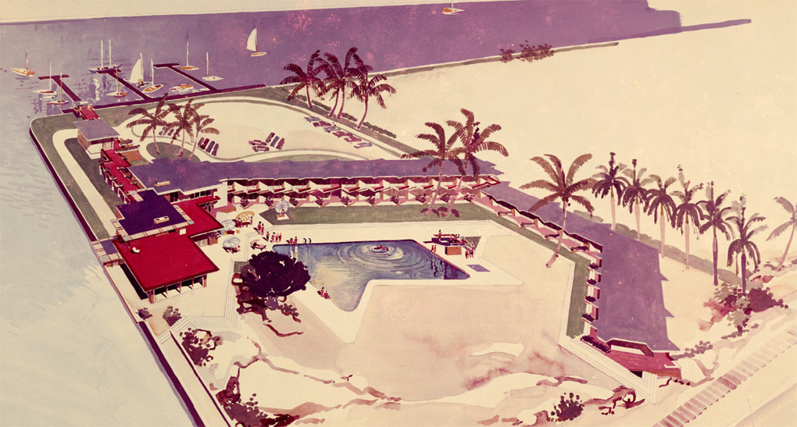
Architecture Archives @ UF
Florida & Caribbean
20th Century Focus
Notes:
Freeport Yacht Club

Slide 3
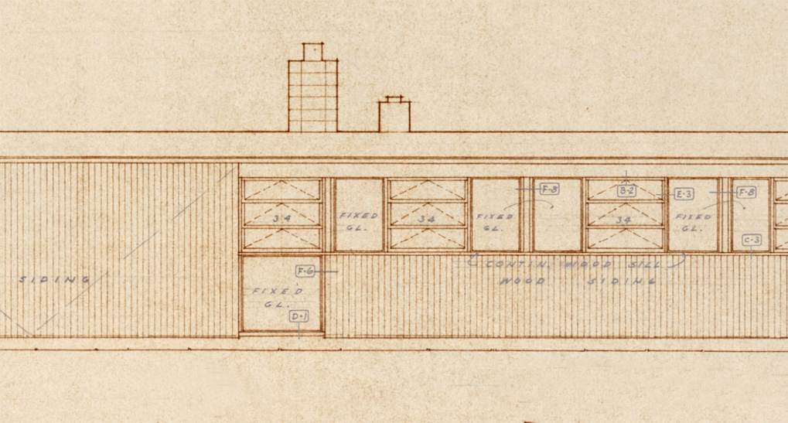
Academics
Architecture
Landscape Architecture
Historic Preservation
Notes:
Broward Laguna

Slide 4
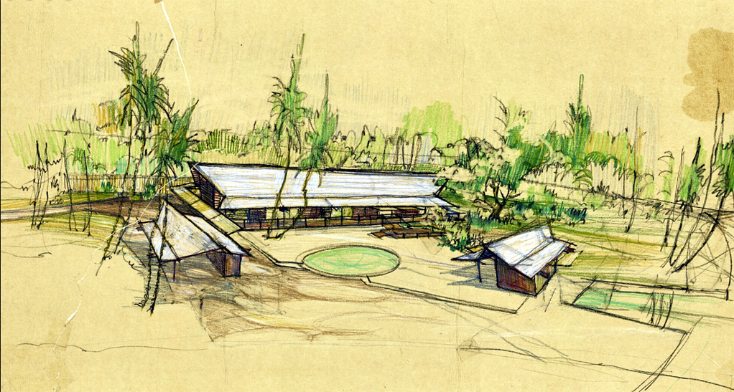
Faculty & Students
Collecting & Donors
Promotion & Public Engagement
Grad Students
Notes:
Nims Ratner
Jobs for grads and also attracting grads

Slide 5
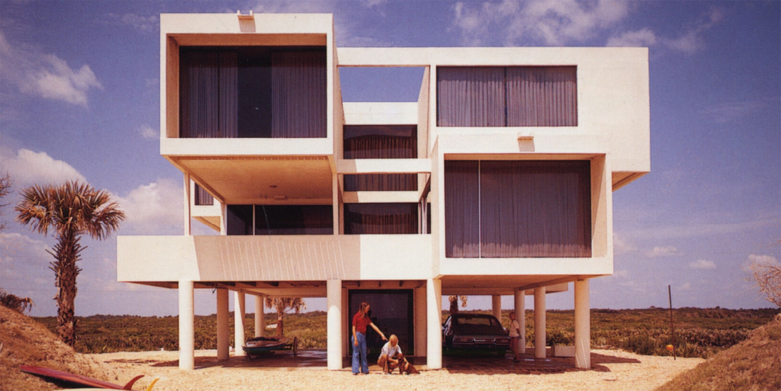
Practitioners & Owners
Historic Preservation
Restoration
Notes:
Morgan Goodloe

Slide 6
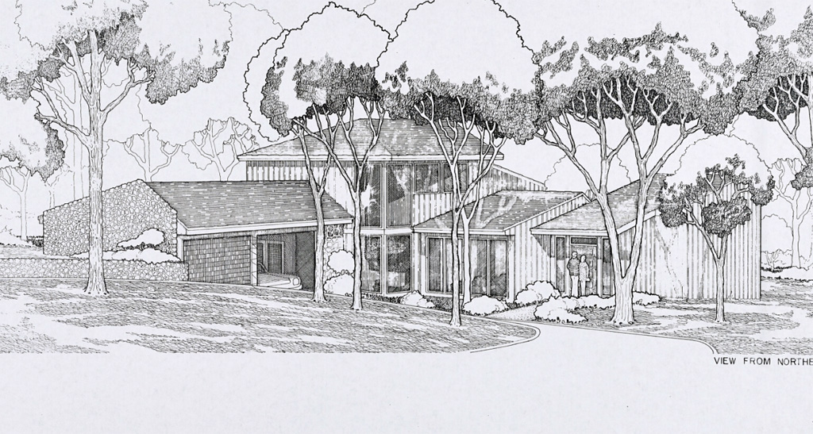
Organizations
DOCOMOMO Florida
Gainesville Modern
Center for Architecture Sarasota
Notes:
David Reaves – Butler Residence

Slide 7
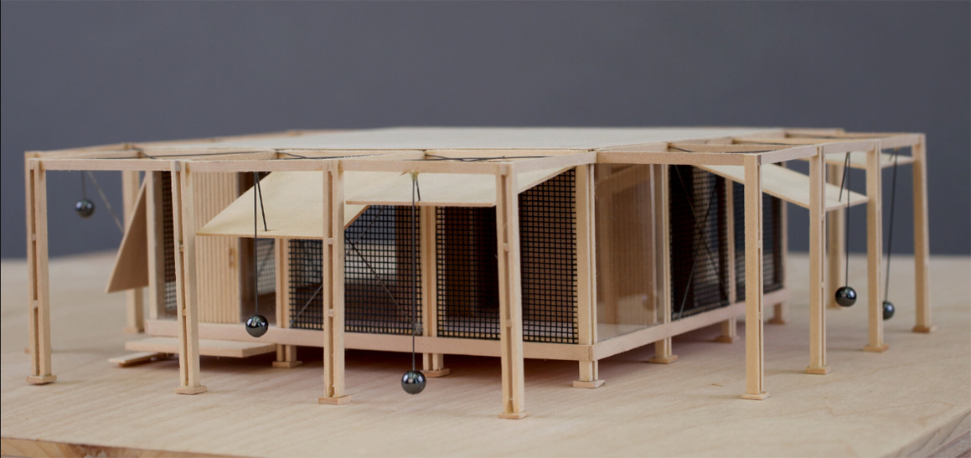
Exhibits
Students as Curators
Online & Physical
Loans
Notes:
Tim – Sarasota Modern
Museum Studies – Herschel Shepard

Slide 8
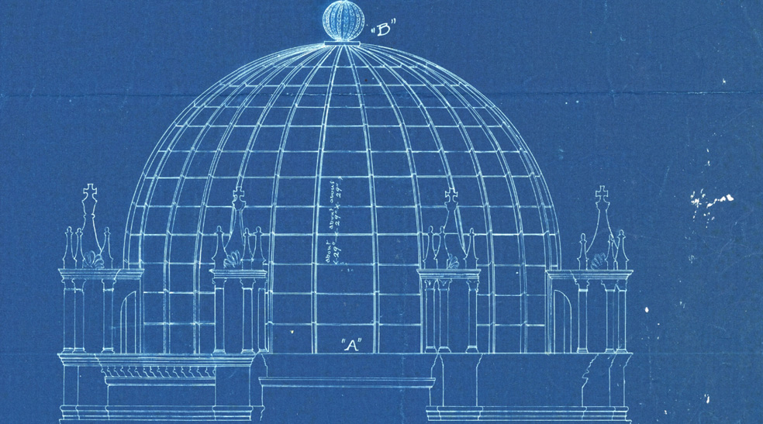
LAM Collaboration
Grant Projects
Public Programming & Lectures
Notes:
Flagler project / FLMNH and SPOHP lecture on St. Aug

Slide 9
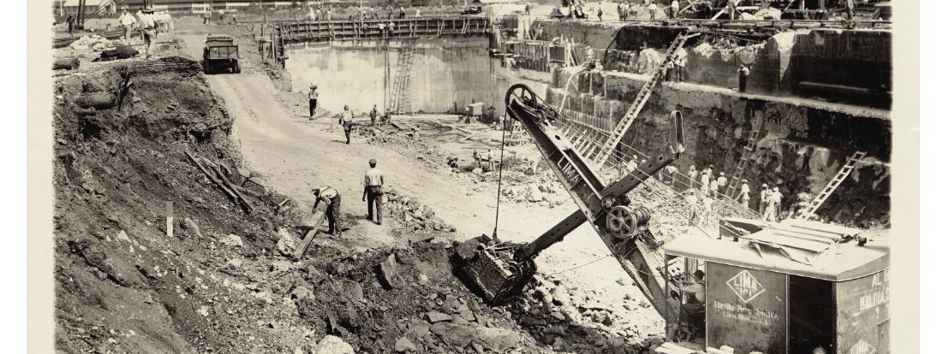
Challenges
Demand / Urgency
High Maintenance
Communicating

Slide 10
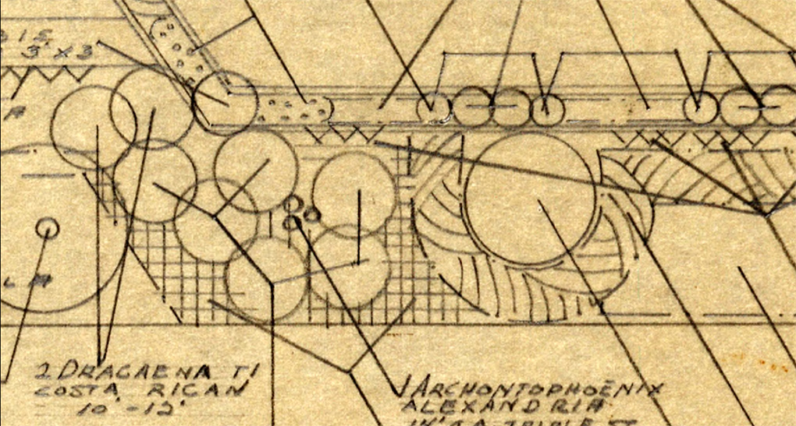
Discussion
Can you share a significant success or failure in community engagement or collaboration-building?
Notes:
Stresau Fountainbleau

Slide 11

Thank you!
John Nemmers, Associate Chair,
Special & Area Studies Collections
jnemmers@ufl.edu
Jessica Aberle, Ph.D., Architecture Librarian,
Architecture & Fine Arts Library
jaberle@ufl.edu
Matthew Armstrong, Collections Coordinator,
Government House Research Collections,
matthewwayland@ufl.edu

