Slide 1
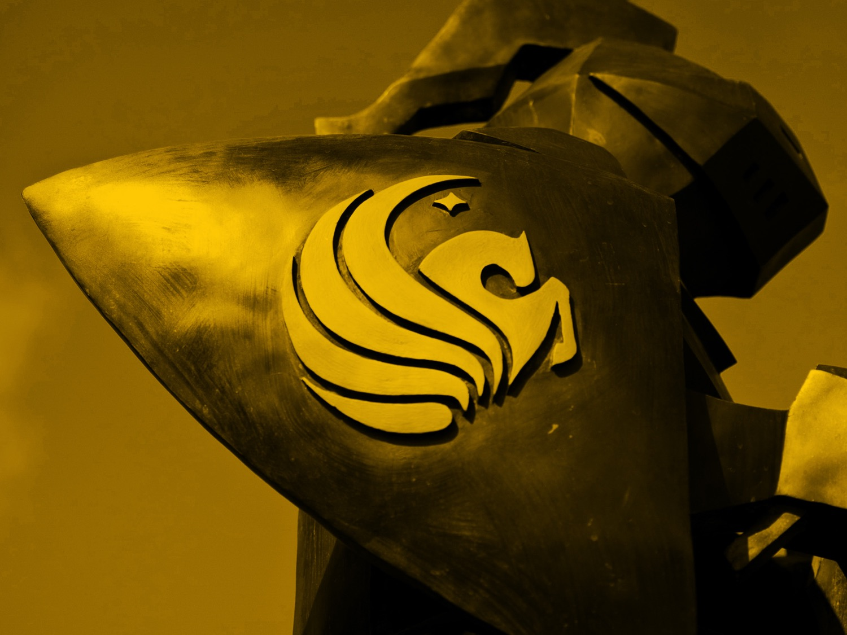
Adventures in a Mandated Website Redesign Mary Rubin
Notes:
Mary Rubin, Senior Archivist for University Archives, University of Central Florida

Slide 2
University of Central Florida
Founded in 1963 and located in Orlando, Florida
Largest university in the US
By undergraduate enrollment (2014-2015)
52,539 undergraduates¹
By total enrollment (2015-2016)
63,016 students²
Notes:
#1: https://ikm.ucf.edu/facts-and-reports/enrollment-statistics/2014-15-enrollment/
#2: https://ikm.ucf.edu/facts-and-reports/enrollment-statistics/2015-16-enrollment/

Slide 3
Special Collections & University Archives Staff
Notes:
Also a Digital Initiatives Department that helps with our digitization projects and digital collections.
Facebook: https://www.facebook.com/SpecialCollectionsUniversityArchives
Tumblr: https://ucfscua.tumblr.com/
Twitter: https://twitter.com/UCFSCUA

Slide 4
Special Collections & University Archives Staff
At the time of the Website Redesign, we had no department head nor conservator.
We reported to the Library Director.
Notes:
Facebook: https://www.facebook.com/SpecialCollectionsUniversityArchives
Tumblr: https://ucfscua.tumblr.com/
Twitter: https://twitter.com/UCFSCUA

Slide 5
Phase 1: WRAPT
Web Redesign and Policy Taskforce (WRAPT)
Convened September – December 2014
Phase 1 Report in December 2014
Audience: Who is the website for?
People seeking info about facility (hours, location, etc.)
People seeking specialized services
People investigating a topic
People who don’t know what they’re looking for
Demographics: UCF’s size, student levels, age
Principles: user-centered, well organized, responsive, compliant, inclusive, etc.
Analytics: previous page views, keywords, browsers, devices, search queries, etc.
Literature Review
Review of Other Websites
Decision: Migration to WordPress
Notes:
WordPress was chosen for its content management system that includes a WYSIWYG editor, user-based permissions, & plug ins.
MIT was an “Other Website”
WRAPT was charged with:
Presenting a redesign of the Libraries’ website, including design and architecture. The new website will be driven by:
Needs and perspectives of our end users
Metrics that indicate use of services and resources of the current website
ADA and graphics standards
Information architecture best practices
Seeking input from end users, involve internal stakeholders, and share information and updates as the work progresses.
Reviewing current procedures and workflows that guide updates, edits, and changes to higher level architecture, and suggest modifications that will allow the website to maintain its design and architectural integrity while still being responsive to an ever-changing information environment.

Slide 6
Phase 2: WRAPT & WWG
Web Redesign and Policy Taskforce (WRAPT)
Phase 2, to be completed by March 2015
User Testing & Feedback
User Experience Design & Early Design Models
Beginning the Web Working Group (WWG)
Web Working Group (WWG)
First meeting 1/28/2015, last Wed of the month
Leadership: Two co-chairs, the Web Applications Developer & the Applications System Analyst/Programmer
Department Representatives, including branch libraries and one member for all regional libraries
Ad Hoc Representatives: PR Director, Electronic Resources Librarian, & LibGuides Administrator
(Until the end of time ☹ )

Slide 7
Task 1: Inventory
Task 1: Inventorying and cleaning up current pages / Identify pages for sharing
SCUA had 793 items that made up its website
For deletion (40%):
Folders: 108
Others: 121
Styling: 85
To be “archived” (6%):
Exhibits: 50
Needed for new website (54%):
Finding Aids: 144
Exhibits: 253
Forms: 2
Tables: 6
Content: 24
Notes:
Previous website was completely inclusive, with the exception of digital collections (maintained by the Digital Initiatives department).
None of the 793 items were images. The items consisted of only folders, webpages, styling sheets, finding aids, forms, etc.
A lot of the “Others” that got deleted were duplicate files and webpages. For example, we use to have two pages for collections: one by alphabetical and one by subject. The alphabetical page was marked for deletion. We had old entry forms all the way back from 2008 for our Book Arts Competition. There were 45 webpages that helped to facilitate one exhibit that were marked for deletion.

Slide 8
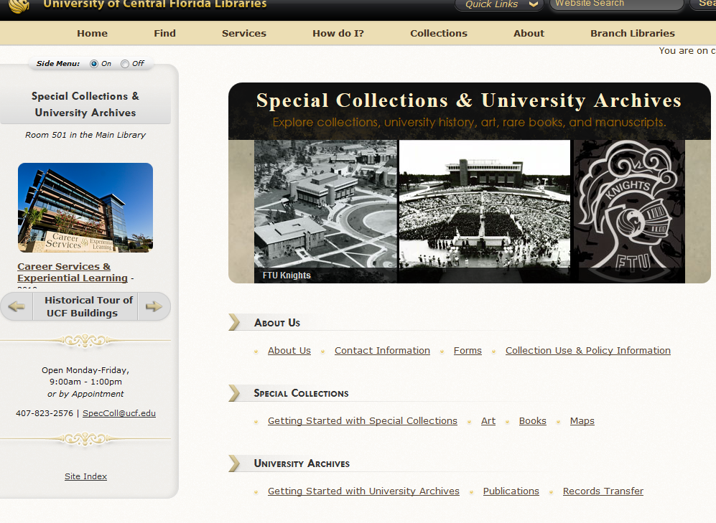
Previous Website
Notes:
Historical Tour of UCF Buildings is the exhibit that had the 45 webpages marked for deletion. Those 45 pages helped to facilitate that exhibit by enabling users to scroll through the buildings quickly on our sidebar.

Slide 9
Previous Website, chart
Notes:
Folders, Others, Styling marked for deletion (40% of website)
Findings Aids & Exhibits (half of the website) weren’t able to be migrated into Wordpress so their migration was unknown.
I was essentially working with 10% of the website.

Slide 10
Task 1: Inventory (cont.)
Task 1: Inventorying and cleaning up current pages / Identify pages for sharing
SCUA had 793 items that made up its website
To be “archived” (6%):
Exhibits: 50
Needed for new website (54%):
Finding Aids: 144
Exhibits: 253
Forms: 2
Tables: 6
Content: 24
Notes:
“Archived” exhibits contained specialized features like Flash or Java that I know we would not find a solution for migration.
Site says: In 2015 the library website was upgraded and at that time certain exhibits were chosen to be archived instead of moved to the new upgraded website. Those exhibits have been archived on a CD and can be found on the Reference Shelf in our Reading Room.
SCUA does not have a true digital archiving mechanism yet.
Florida Archives and Manuscripts Repository which is a list of all the Florida archives and manuscript repositories by city and county. The guide was first developed by Carla M. Summers, CA, CRM, as a sabbatical project in 1999. Funding to support the creation of the guide came from the University of Florida, University of Central Florida, Florida Humanities Council, Florida State Historical Records Advisory Board and the Society of Florida Archivists. Turned into a web accessible resource in 2003, the Guide is continually updated upon request by the University of Central Florida Libraries.

Slide 11
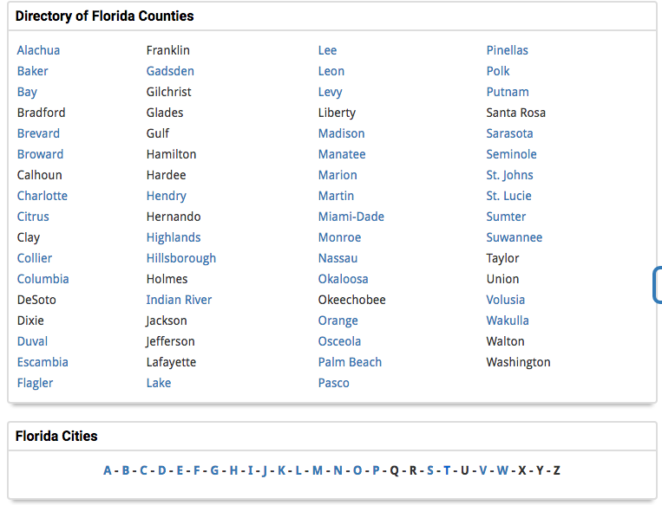
Task 1: Tables, now a LibGuide
http://guides.ucf.edu/FloridaArchivesManuscriptsRepository
Notes:
Florida Archives and Manuscripts Repository which is a list of all the Florida archives and manuscript repositories by city and county. The guide was first developed by Carla M. Summers, CA, CRM, as a sabbatical project in 1999. Funding to support the creation of the guide came from the University of Florida, University of Central Florida, Florida Humanities Council, Florida State Historical Records Advisory Board and the Society of Florida Archivists. Turned into a web accessible resource in 2003, the Guide is continually updated upon request by the University of Central Florida Libraries.
The county of Levy belongs to both cities Bronson and Cedar Key.
Include a form!
11

Slide 12
Task 1: Shared Pages
Shared pages
Collections
Policies
Copyright
Book and Gift Donations
Build Our Collection*
Nested under “Services for Faculty”
Schedule an Appointment*
We got our own form!
Hours
Notes:
*I wasn’t originally asked to be on these shared pages. I had to seek the groups out for SCUA to be included.

Slide 13
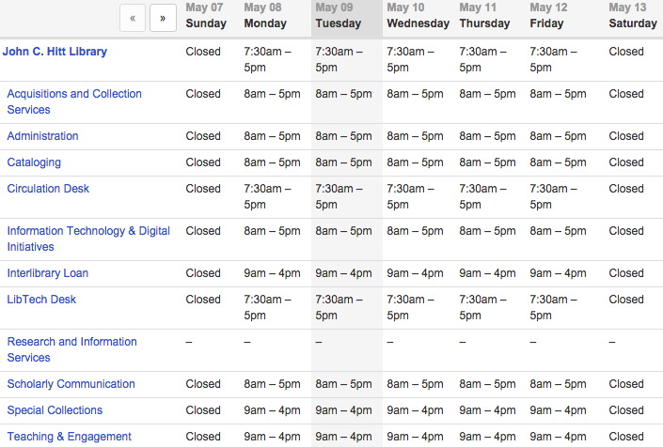
Task 1: Shared Pages, hours
Notes:
13

Slide 14
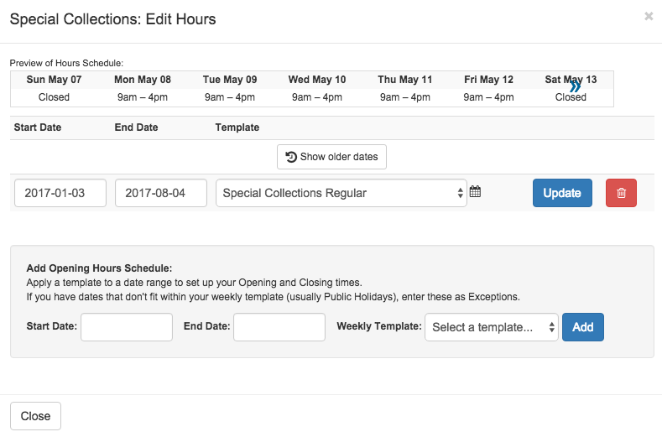
Task 1: Shared Pages, hours
Notes:
*I wasn’t originally asked to be on these shared pages. I had to seek the groups out for SCUA to be included.
14

Slide 15
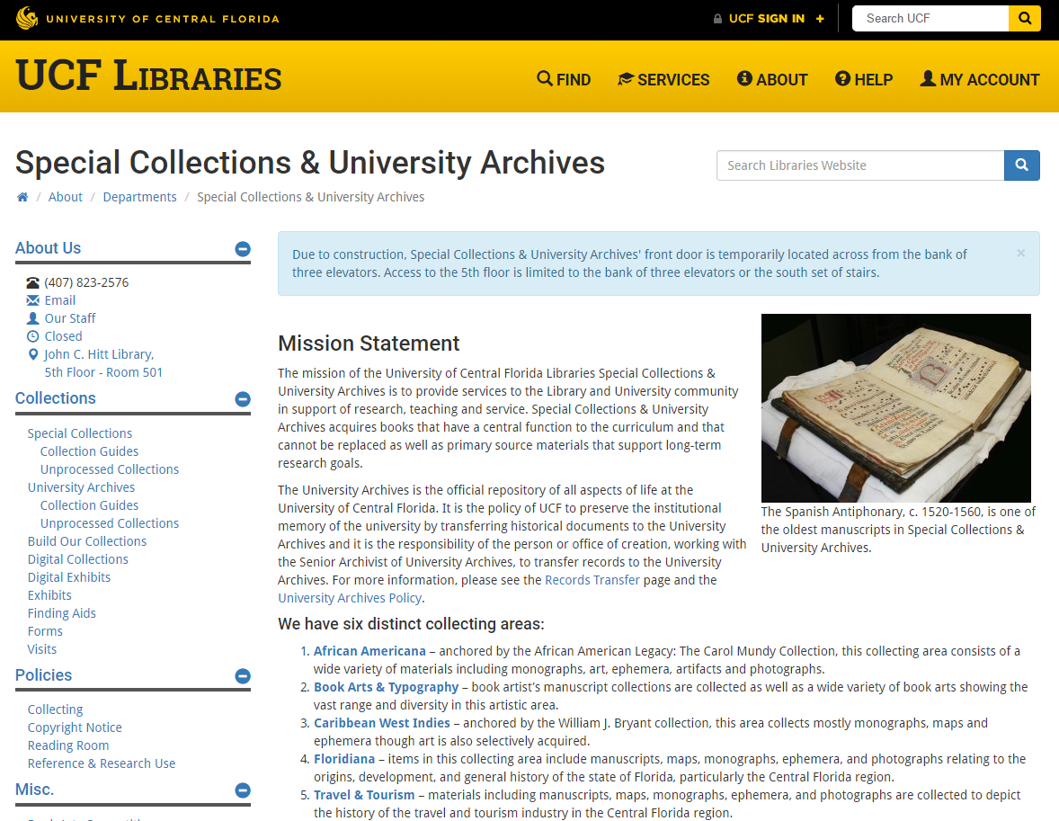
New Website
Notes:
The “Archived” exhibits
15

Slide 16
Task 2: Content
Task 2: Content Analysis, Recommendations & Focus
Analysis & Recommendations:
Eliminate jargon or explain in context
Special Collections
University Archives
Monographs
Serials
Manuscripts
Finding Aids
Add more graphics, maps, or photos
Find a solution to host finding aids and other unique content
Notes:
The “Archived” exhibits

Slide 17
Task 2: Solutions
Task 2: Content Analysis, Recommendations & Focus
Analysis & Recommendations:
Find a solution to host finding aids and other unique content
Finding Aid Solution: Archon, hosted by FLVC*
Other Content Solution: STARS, UCF’s instance of Bepress’ Digital Commons
Notes:
FLVC is now FALSC
Called MIT who also uses Wordpress; however, their site is a combination of wordpress and homegrown websites. They used Archivist Tool Kit to create PDFs and html findings aids. But they were moving into ArchivesSpace.
Choices: Archon, PDF in STARS, Finding Aid Module in Islandora (Drexel and UCLA)
As of January 2014, Archon is no longer supported by the University of Illinois.

Slide 18
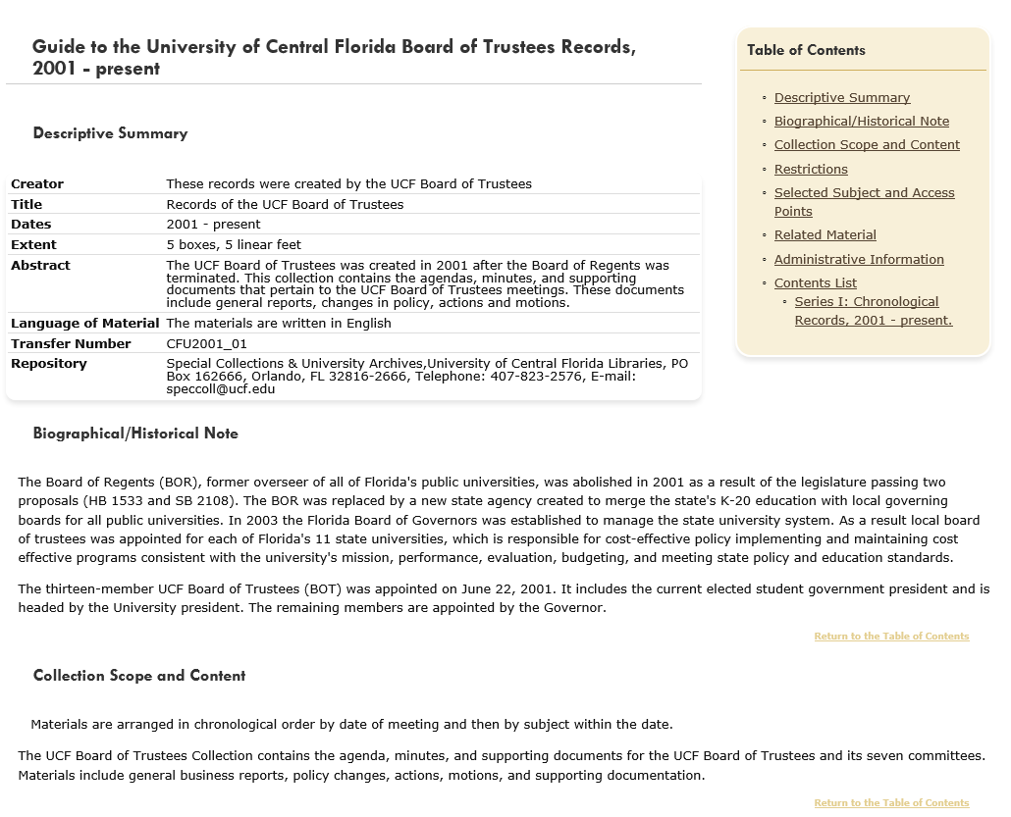
Previous Finding Aids
Notes:
The “Archived” exhibits

Slide 19
Task 2: Finding Aid Solution
Finding Aid Solution: Archon, hosted by FLVC*
Test migration
Editing before upload
Altering fields: <author>, <unittitle>
Including missing fields: <accessrestrict>, <arrangement>
Links to old finding aids in Related Materials
> 10 characters in the folder field? Condense
Mass deletions of commas & periods before specific tags
Editing after upload
Sort titles
Additional extent information
Series title
Exporting
PURLs
Notes:
FLVC is now FALSC

Slide 20
Task 2: PURLs
PURLs
http://ucfarchon.fcla.edu/?p=collections/controlcard&id=179
http://purl.flvc.org/UCF/ead/UCFNursingDept
Notes:
FLVC is now FALSC
20

Slide 21
Task 2: Content (cont.)
Task 2: Content Analysis, Recommendations & Focus
Focus:
Collections & Materials
Finding Aids
Unprocessed Collections page
Digital Collections
Exhibits
Services
Class Visits
Research Requests
Policies & Forms
About Us
Contact/Location Information & Hours
Social Media
Notes:
The “Archived” exhibits

Slide 22
New Website
Notes:
The “Archived” exhibits
22

Slide 23
Phase 3: WRAPT & WWG
Web Redesign and Policy Taskforce (WRAPT) & Web Working Group (WWG)
Phase 2 projected to end in March but realistically ended in April
Phase 3, May to July
User Testing & Feedback (cont.)
Design & Final Content
Marketing
Rollout

Slide 24
Phase 3: User Testing
Question: You heard the library has a collection of special materials from the West Indies. Where can you find information on this collection?
13 users
4 figured it out immediately (3 steps from Library homepage)
5 figured it out eventually (4-6 steps)
1 immediately went to “Ask a Librarian”
1 went to the right pages but didn’t recognize that
2 couldn’t locate the information
Notes:
24

Slide 25
Phase 3: User Testing (cont.)
Question: You heard the library has a collection of special materials from the West Indies. Where can you find information on this collection?
Take aways:
5 figured it out eventually (4-6 steps)
Expected collection names to be links (implemented)
Feature collections on homepage
Notes:
25

Slide 26
New Website
Notes:
The “Archived” exhibits
26

Slide 27
Task 2: Solutions (cont.)
Other Content Solution: STARS, UCF’s instance of Bepress’ Digital Commons
Coordinated by Digital Initiatives Librarian
Knew about it in early January
Paperwork signed in mid-February
By mid-May, all PDFs previously on the website were evaluated for specific collections
By mid-July, the instance went live to be populated
Notes:
FLVC is now FALSC

Slide 28
Phase 3: WRAPT & WWG
Web Redesign and Policy Taskforce (WRAPT) & Web Working Group (WWG)
Phase 3 projected to end in July but “ended” in August
Website went live on 8/13/2015
Classes begin 8/24/2015
Exhibits were not migrated yet
Notes:
28

Slide 29
SCUA’s Current Website
Platforms
WordPress
25 pages
Archon, finding aids
STARS, exhibits and digital collections
LibApps
LibGuides
LibCal

Slide 30
Previous Website

Slide 31
New Website

Slide 32
Going Forward
Expansion of LibGuides
Adapting Pitt’s Student Organization Records Toolkit (SORT)
http://pitt.libguides.com/SORT
Or adapting UA’s Your Organization Lives On (YOLO)
https://sites.duke.edu/yoloatua/
Featured Collections on Homepage (scrolling banner)
Collections Guide reorganized
Integration with Catalog Records
Tagged with Subjects for Better Sorting
Islandora
Notes:
32

Slide 33
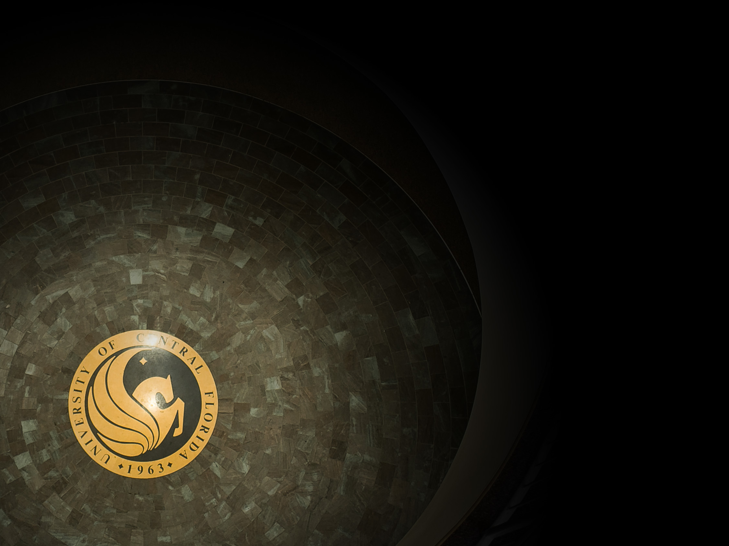
Mary Rubin, Senior Archivist Special Collections & University Archives University of Central Florida (407) 823-5427 Mary.Rubin@ucf.edu

