Slide 1
CREATOR, USER, KEEPER:
The relationship between donors and repositories in architectural collections
12 May 2015
PRESENTED BY:
CYNTHIA L. PETERSON
Elling O. Eide Charitable Foundation
cpeterson@ellingoeide.org

Slide 2
Donors of Architectural Collections
“My buildings speak for themselves; I don’t see the value of preserving the records in their creation.”
“I am God’s gift to the architectural world-everything I have touched or drawn needs to be saved for historical purposes.”

Slide 3
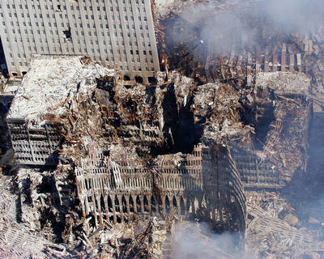
Photo © Eric J. Tilford / U.S. Navy / Getty Images
World Trade Center designed by Minoru Yamasaki - Destroyed 2001

Slide 4
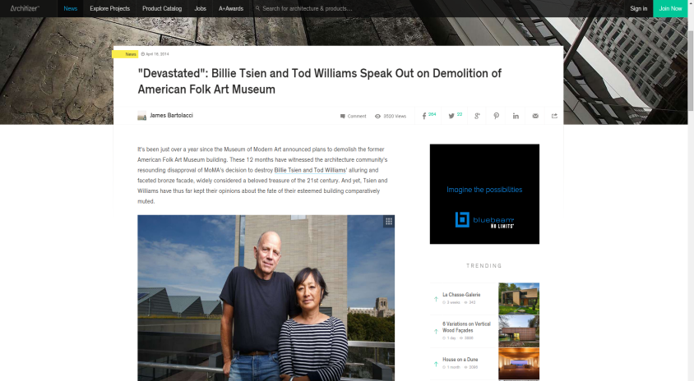
"Devastated": Billie Tsien and Tod Williams Speak Out on Demolition of American Folk Art Museum

Slide 5
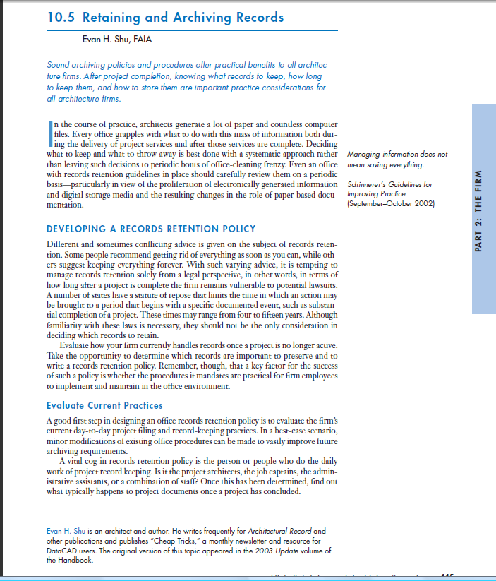
“Retaining and Archiving Records,” in The Architect’s Handbook of Professional Practice (14th ed.) includes a brief discussion on record keeping to create a legacy within your firm as well as finding an archival repository to preserve your legacy.

Slide 6
It is important for architects to realize the impact they are making in their own communities and changing the landscape forever.

Slide 7
“Granted my collection may include a considerable amount of material but it is wonderfully organized and ready to be donated.”

Slide 8
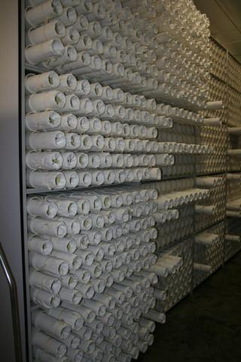

Slide 9
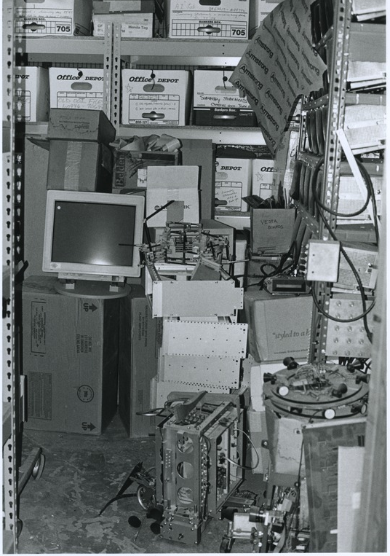

Slide 10
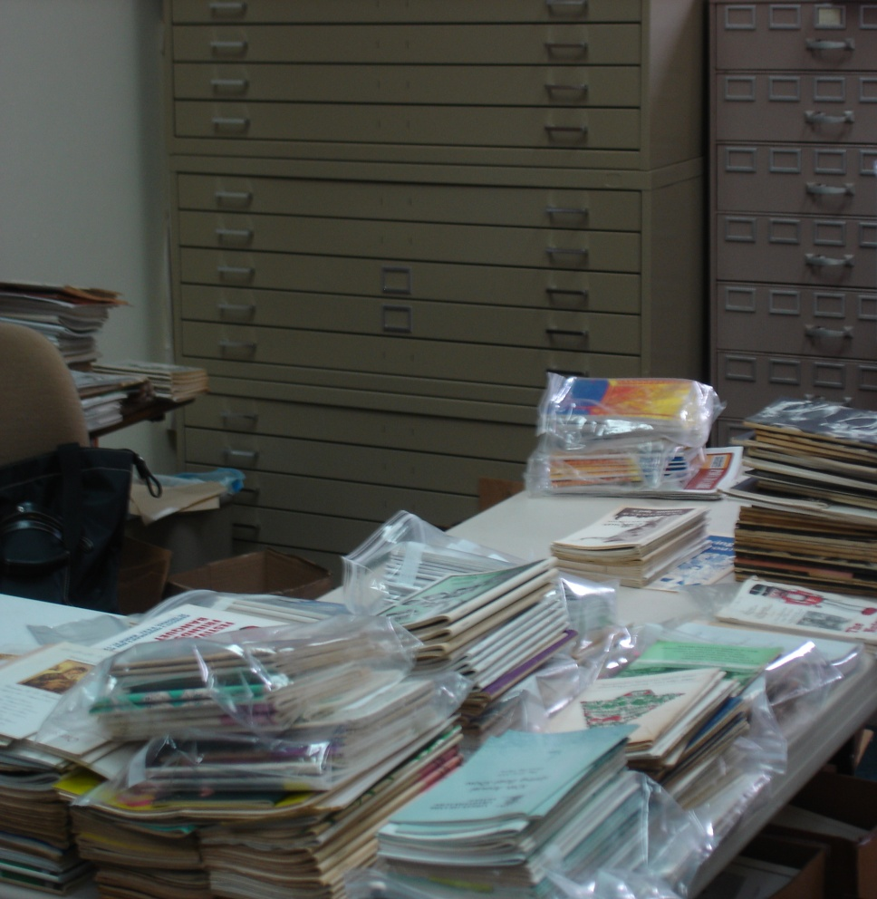
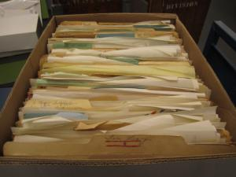
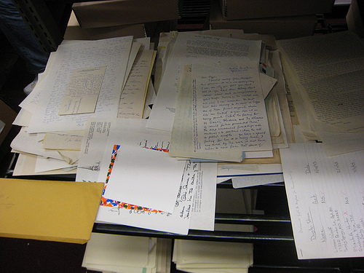
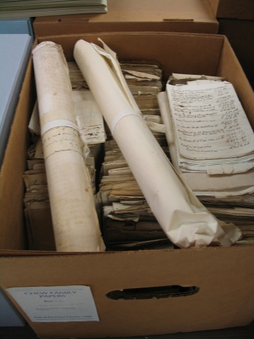

Slide 11
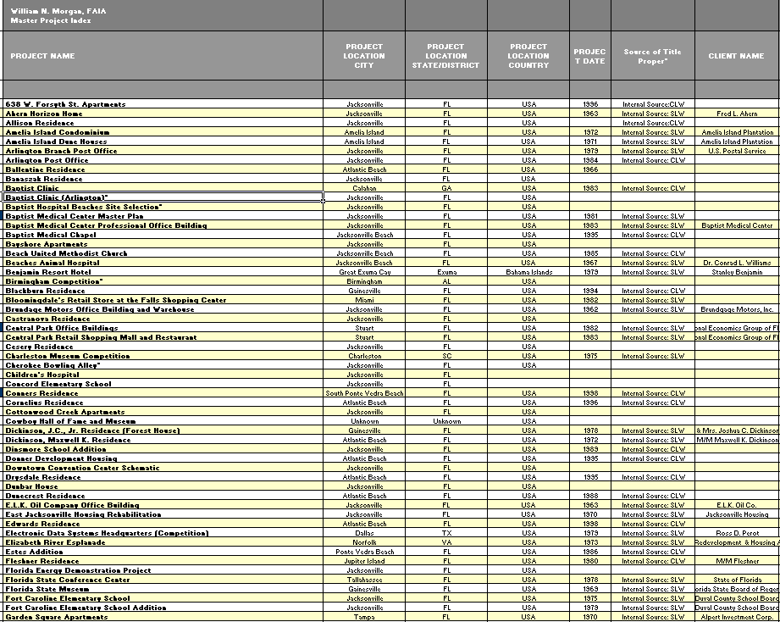
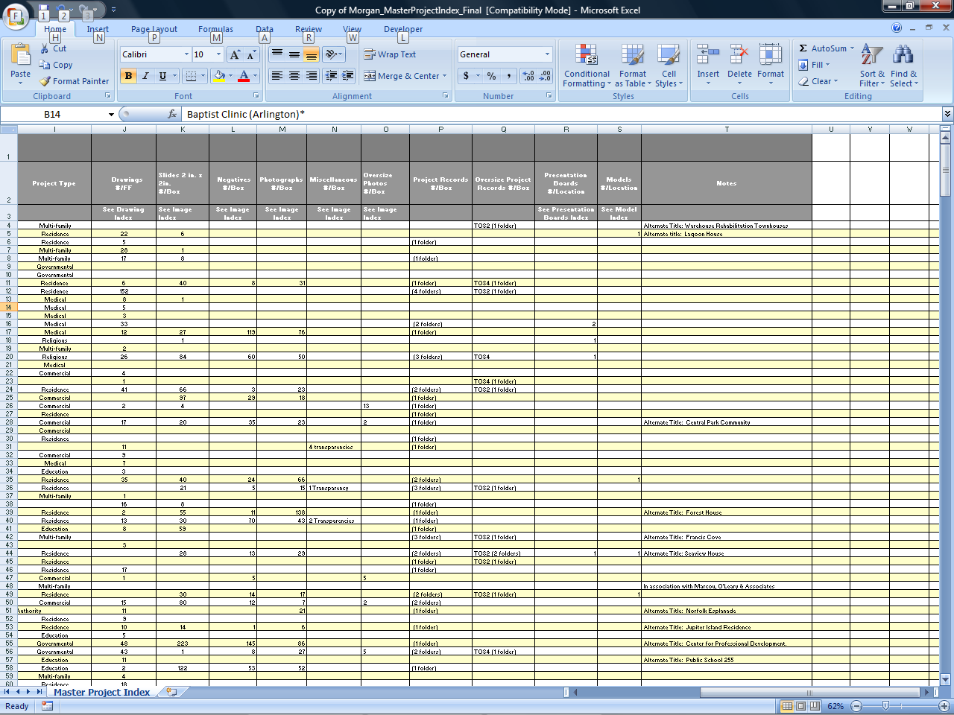
EXAMPLE OF MASTER PROJECT INDEX AND COLLECTION INVENTORY

Slide 12
Getting to know one another: Improving the Process of Acquisitions

Slide 13
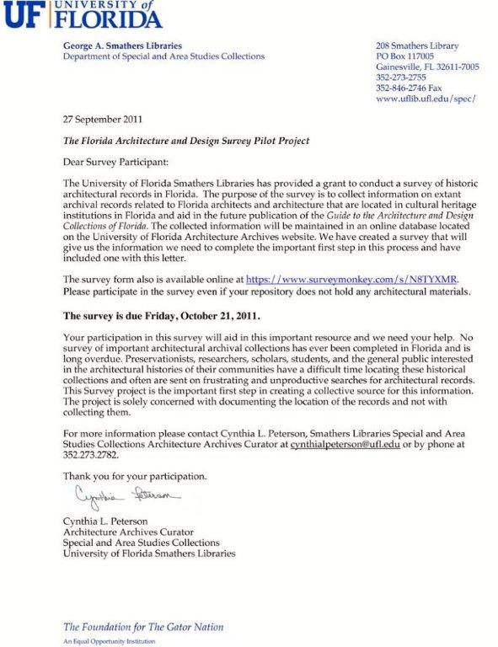

Slide 14
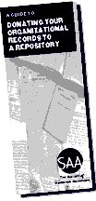

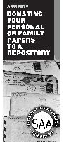
Society of American Archivists Brochures

Slide 15
Bibliography
American Institute of Architects Foundation. Proceedings of the Conference: Toward Standards for Architectural Archives, February 12-13, 1981. Washington, DC: American Institute of Architects Foundation, 1984.
Ballast, David Kent. Creative Records Management: A Guidebook for Architects, Engineers and Interior Designers. Newton, MA: Practice Management Associates, 1987.
Bole, Frank and Julia Marks Young. Archival Appraisal. New York: Neal-Schuman, 1991.
Conservation Center for Art and Historic Artifacts, ed. Architectural Records Conference Report. May 3-5, 2000, Philadelphia, Penn. http://www.ccaha.org/arch_records.php (July 1, 2012).
Daniels, Maygene and David Peyceré , editors. “A Guide to the Archival Care of Architectural Records: 19th-20th Centuries. Paris: International Council on Archives, 2000.
Fallon, Kristine Associates. Collecting, Archiving, and Exhibiting Digital Design Data. Chicago, IL: Department of Architecture, Art Institute of Chicago, 2004 http://www.artic.edu/aic/collections/dept_architecture/ddd.html (June 30, 2012).
Hildesheimer, Françoise. The Processing of Architect’s Records: A Case Study: France. Paris: General Information Programme and UNISISR, 1987.
Kissel, Eleonore and Erin Vigneau. Architectural Photoreproductions: A Manual for Identification and Care. New Castle, DE: Oak Knoll Press, 1999.
Lowell, Waverly and Tawny Ryan Nelb. Architectural Records: Managing Design and Construction Records. Chicago, IL: The Society of American Archivists, 2006.
University of Florida Architecture Archives, University of Florida: http://www.uflib.ufl.edu/spec/architecture/ (June 23, 2012).

